Slide 1
Biology 323
Human Anatomy for Biology Majors
Lecture 14
Dr. Stuart S. Sumida
Development and Structure, of the Excretory System

Slide 2
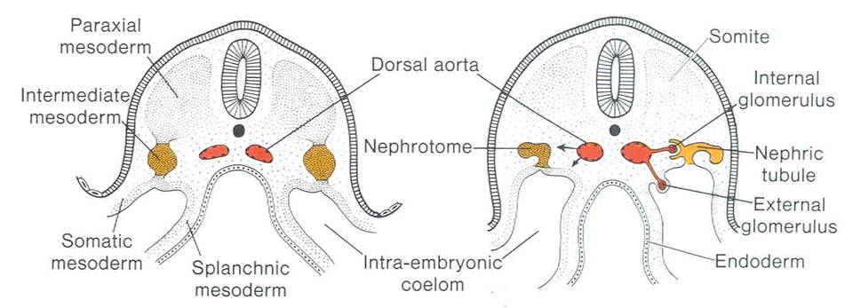

Slide 3
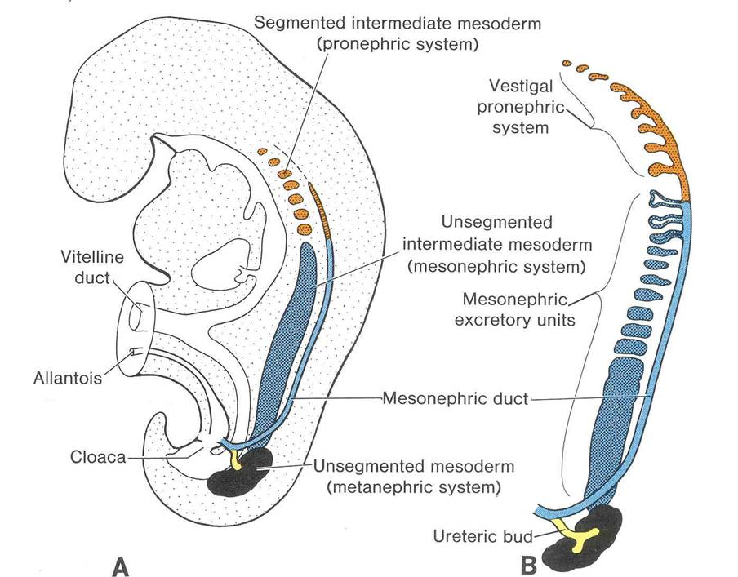

Slide 4
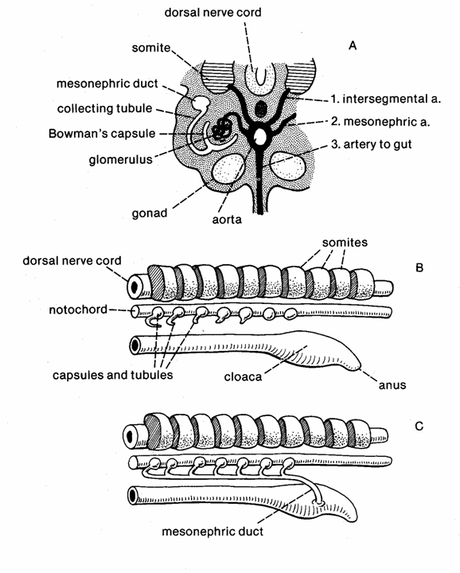

Slide 5
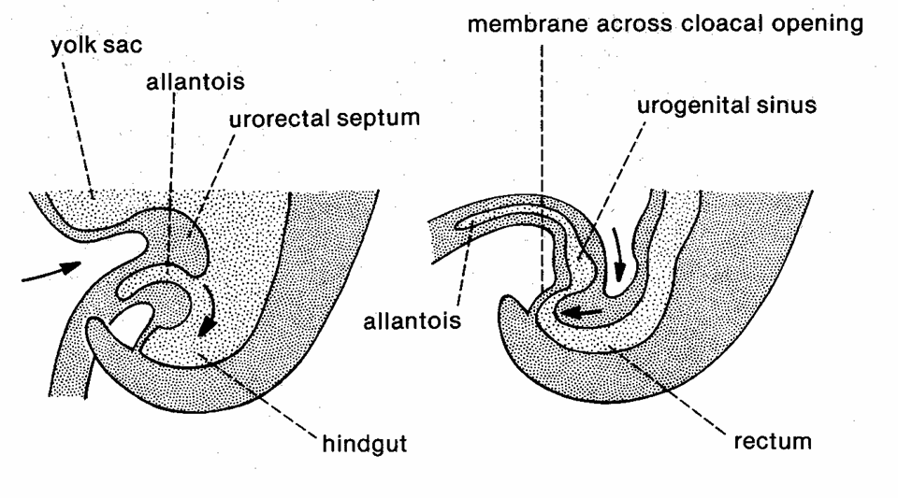

Slide 6
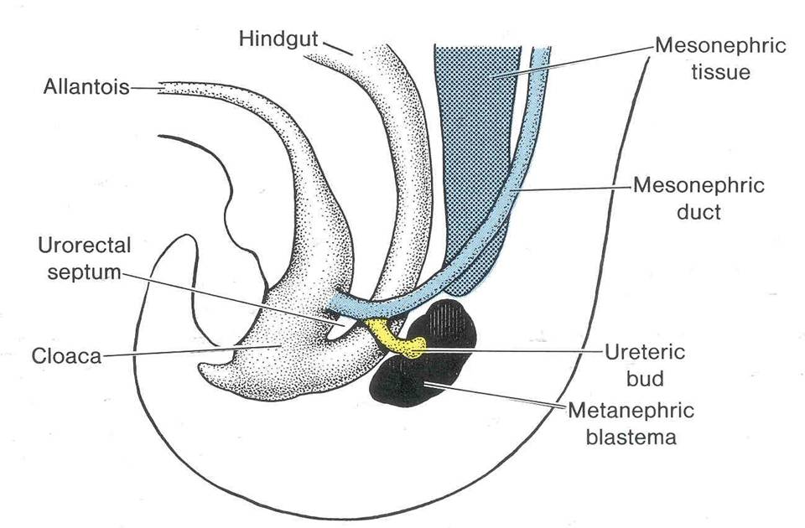
Developing

Slide 7
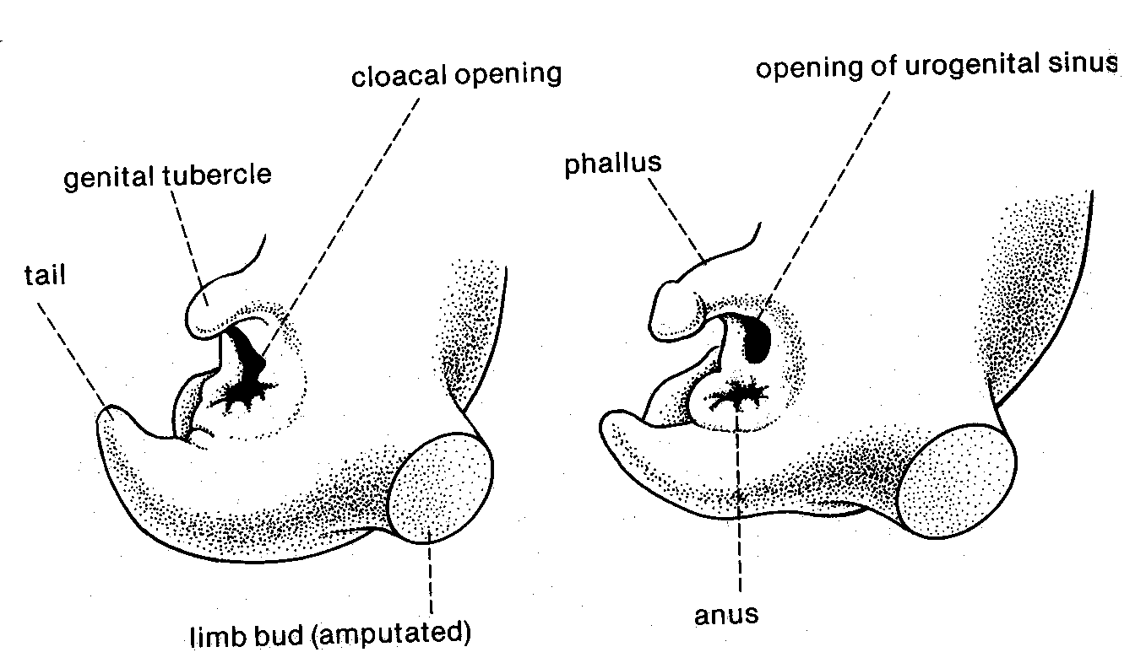

Slide 8
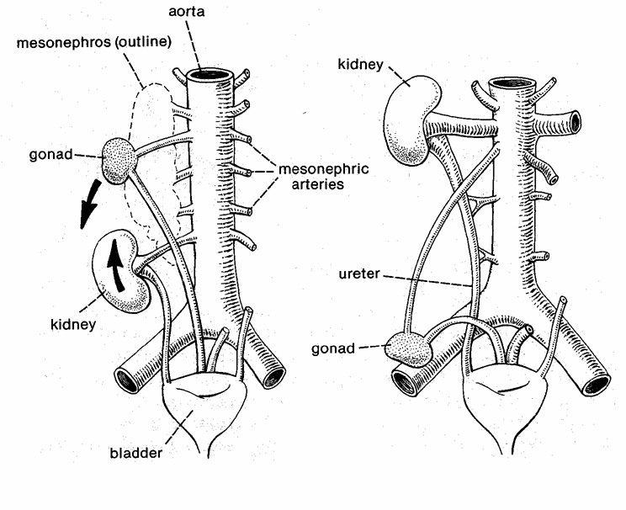
Descent of Gonads / Ascent of Kidneys

Slide 9
Developmental basis of adult kidney/POSITION & VASCULAR SUPPLY
Renal artery
Gonadal artery - Testes or ovaries

Slide 10
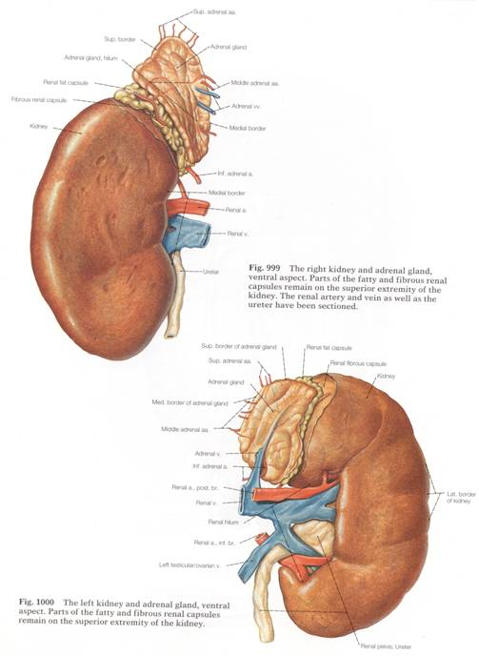
Recall BASIC KIDNEY STRUCTURE
Note: Large vessels usually ventral to ureter exit.

Slide 11
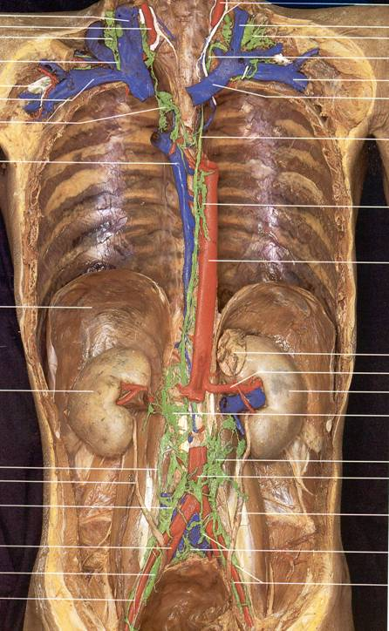

Slide 12
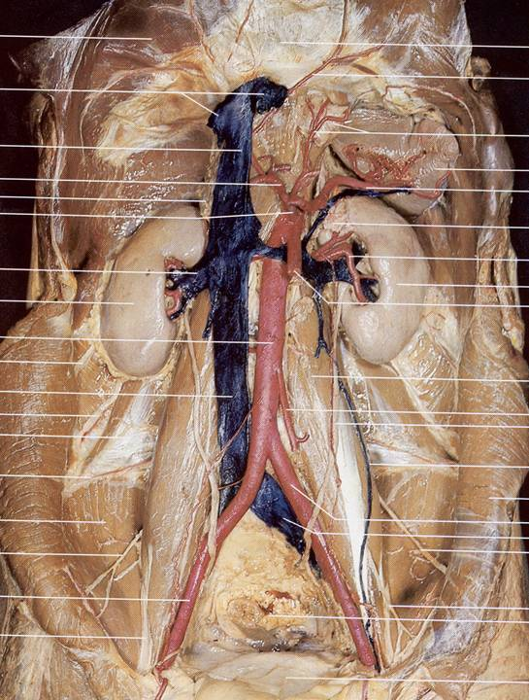
Paired retroperitoneal organ of excretion and endocrine gland
Inferior to liver and spleen, lateral to psoas major mm.
Connected by ureters to urinary bladder

Slide 13
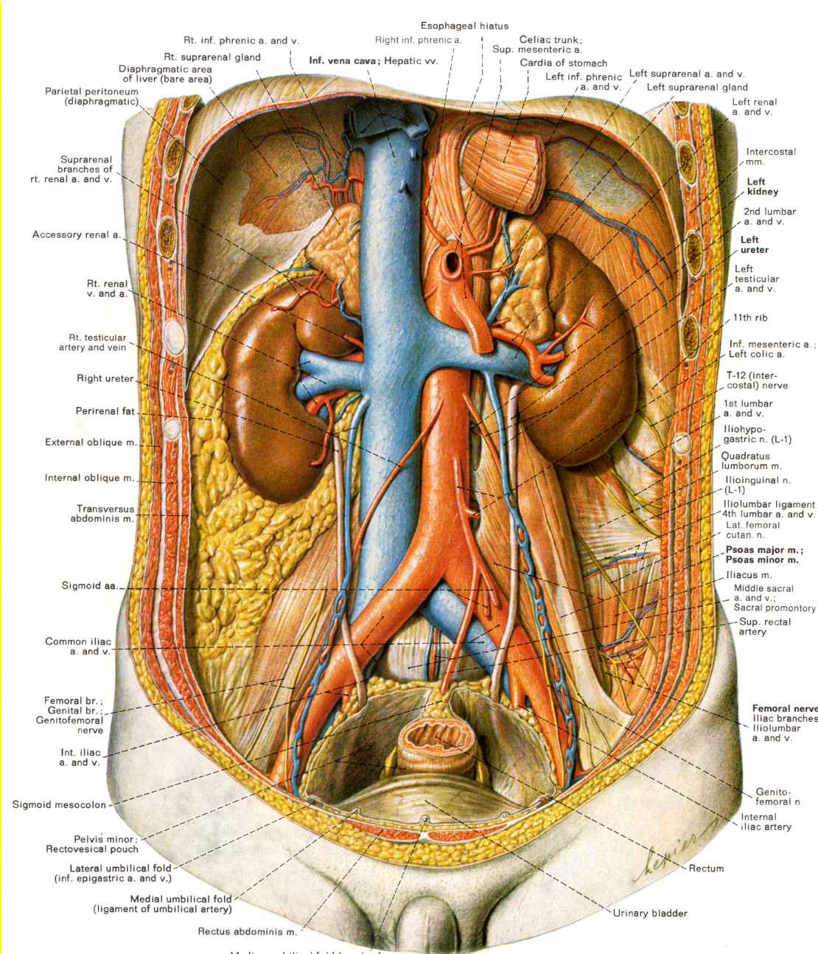
Paired renal arteries from abdominal aorta
Paired renal veins to IVC
Note long left renal vein to IVC
Note that it receives suprarenal and gonadal veins.

Slide 14
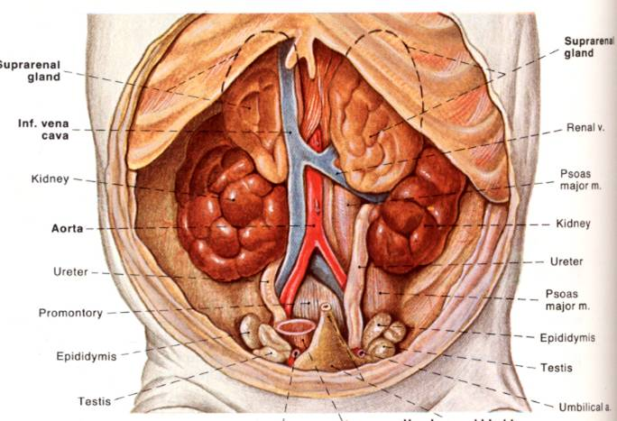
Developmental basis of adult kidney/ CONSEQUENCES OF DEVELOPMENT
Lobulation of kidney in term fetus

Slide 15
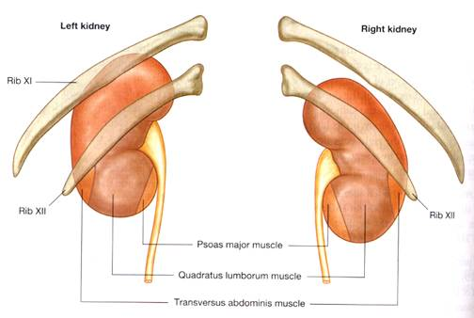
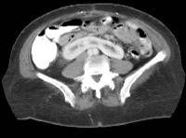
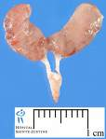
Developmental basis of adult kidney/ ANOMALIES EXPLAINED BY DEVELOPMENTAL MIGRATION
Normally left superior pole of kidney higher than right [11th rib versus 11th inter-costal space
Defects of ascension:
Pelvic kidney & “horseshoe kidney”
Accessory renal arteries

Slide 16
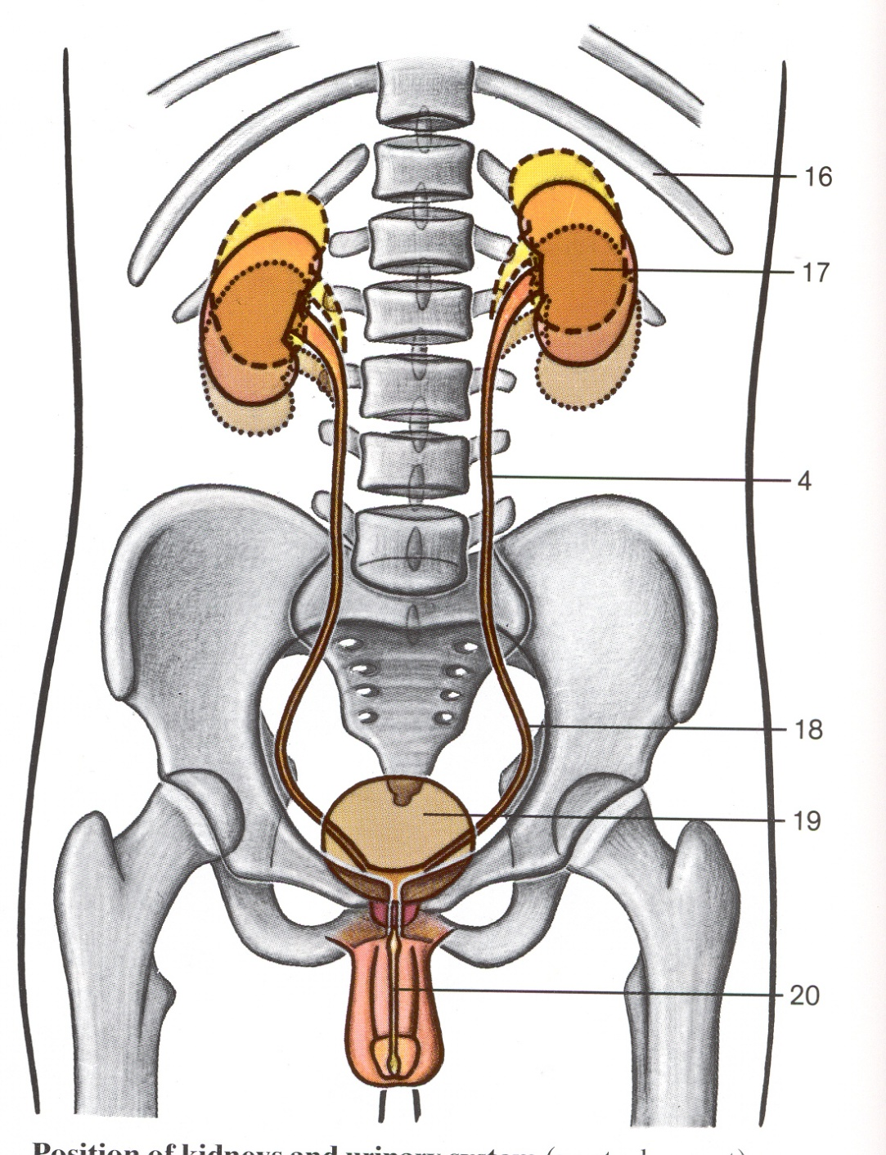
KIDNEYS ARE RETROPERITONEAL!!
(They do move a reasonable amount when you breathe. This is why they can REALLY hurt when they have problems. Retroperitoneal pain can be extreme.)

Slide 17
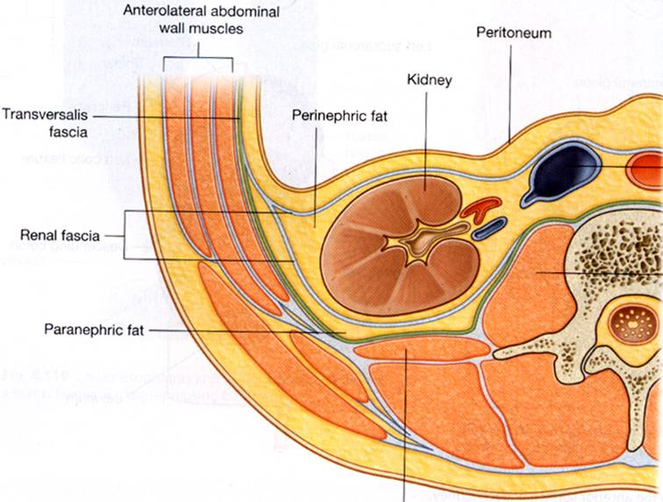
3-D relationships
Psoas major

Slide 18
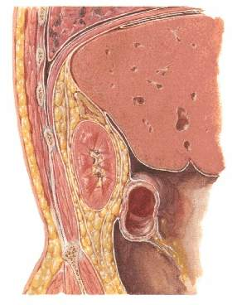
Kidney /FASCIAL COMPARTMENTS
Diaphragm
Suprarenal gland
Kidney
Parietal peritoneum

Slide 19
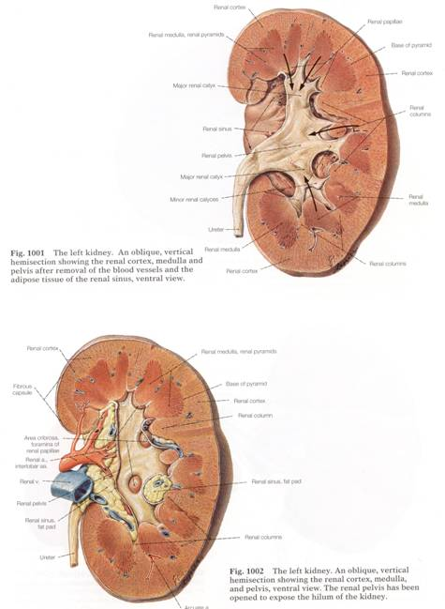
KIDNEY IN SECTION:
Outer CORTEX
Inner MEDULLA

Slide 20
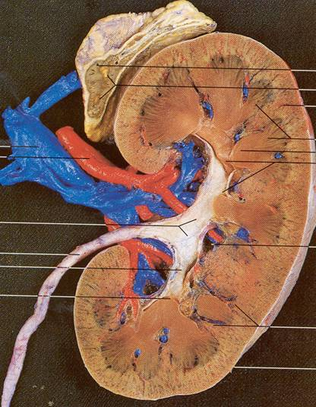
/ Kidney /INTERNAL MORPHOLOGY
Cortex
Medulla

Slide 21
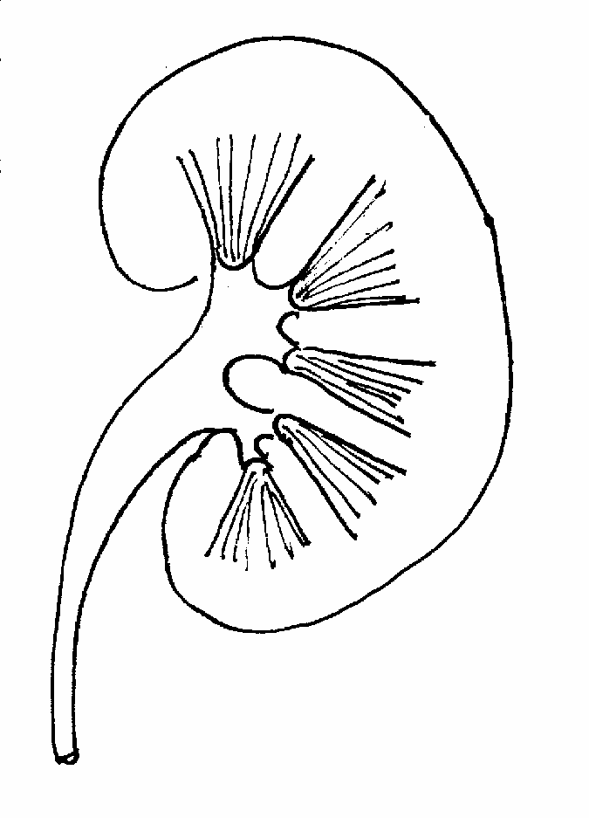
Kidney/ INTERNAL MORPHOLOGY
Pyramid
Papilla
Renal column

Slide 22
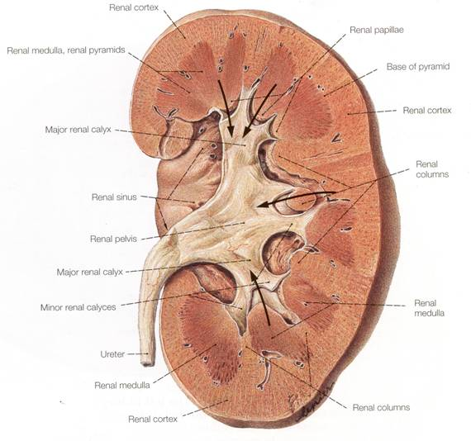
URETER runs from kidneys to urinary bladder.

Slide 23
Neurovascular Supply of the Kidney:
Artery: Renal Artery
Vein: Renal Vein
Sympathetic: T5-9 via Greater Splanchnic Nerve, synapsing in the Celiac ganglion
Parasympathetic: Pelvic splanchnic nerves, S2-4

Slide 24
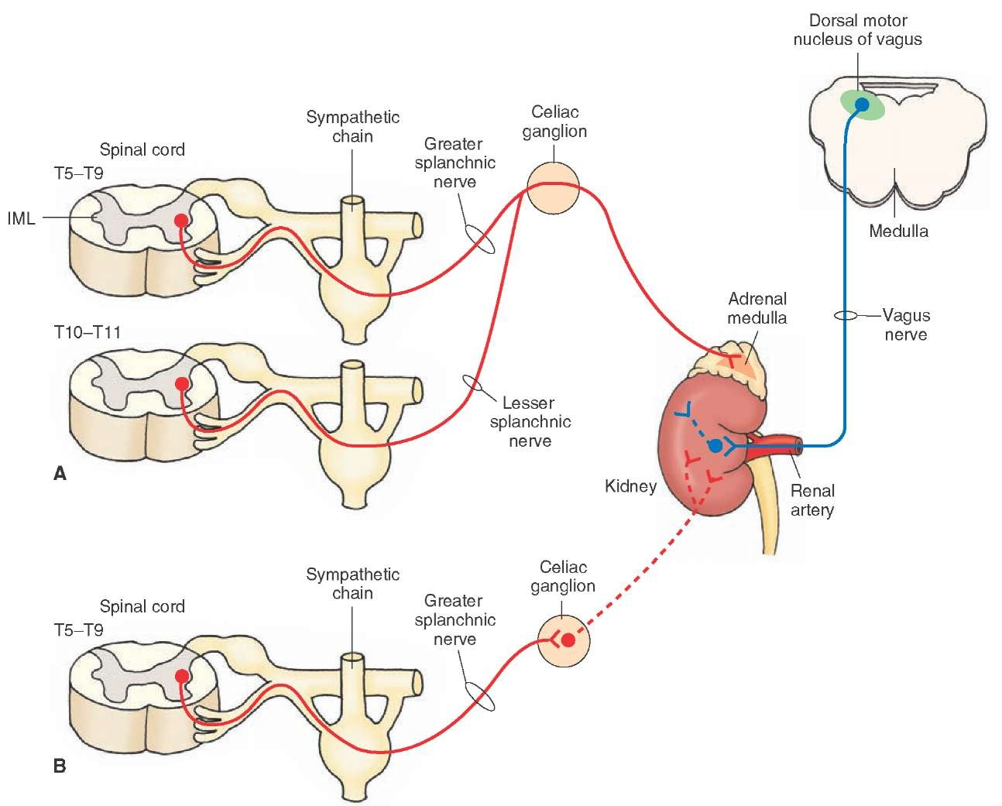

Slide 25
STRUCTURE OF THE BLADDER
Sort of a bulging tetrahedron in shape.
4 ATTACHMENTS - one at each corner.
One corner lies at top edge of pubic symphysis (here, vestigal URACHUS holds it down)
Right and left URETERS dump in cranio-dorsally.
URETHRA exits caudally (inferiorly).

Slide 26
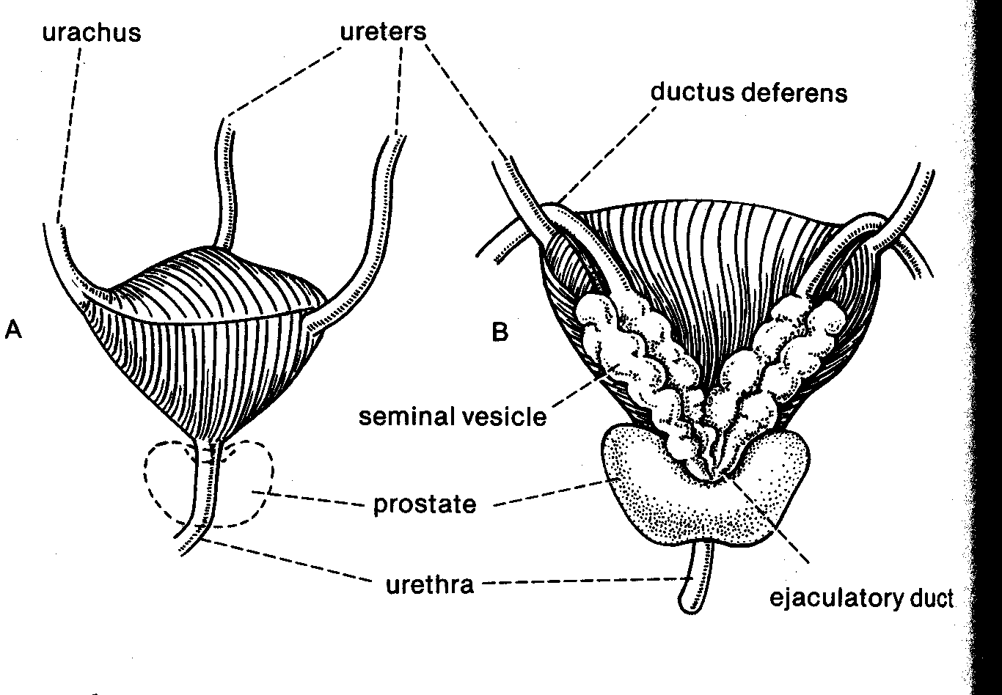
1. Urachus 2. Right Ureter
4. Urethra 3. Left Ureter

Slide 27
The triangle defined by the connection of the two ureters and the exit of the urethra is NOT ELASTIC. It is known as the TRIGONE OF THE BLADDER.

Slide 28
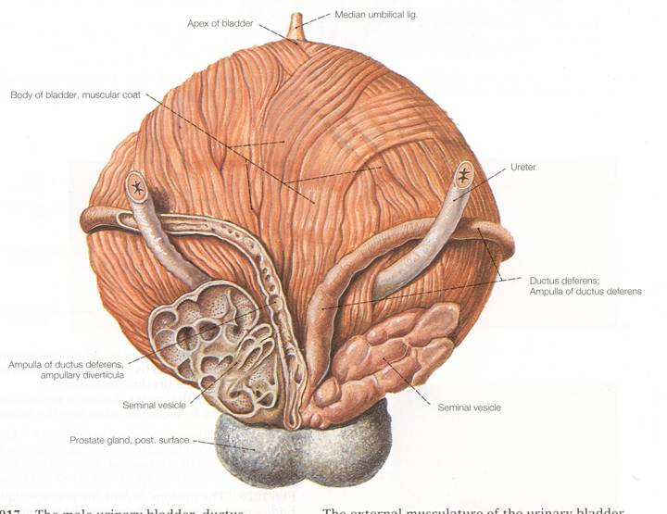
The bladder is lined by a special type of epithelium: TRANSITIONAL EPITHELIUM (it’s stretchy).

Slide 29
Neurovascular Supply of the Bladder:
Artery: Superior and Inferior Vesicular Artery
Vein: Superior and Inferior Vesicular Vein
Sympathetic: T12, L1,2 via Lumbar Splanchnic Nerve, synapsing in the Inferior Mesenteric ganglion
Parasympathetic: Pelvic splanchnic nerves, S2-4

Slide 30
URETER ATTACHMENT
Traverse the bladder obliquely.
So, when bladder is full, they get squeezed flat.
There is no valve, but this passive closing prevents urine from backing up into the kidneys.

Slide 32
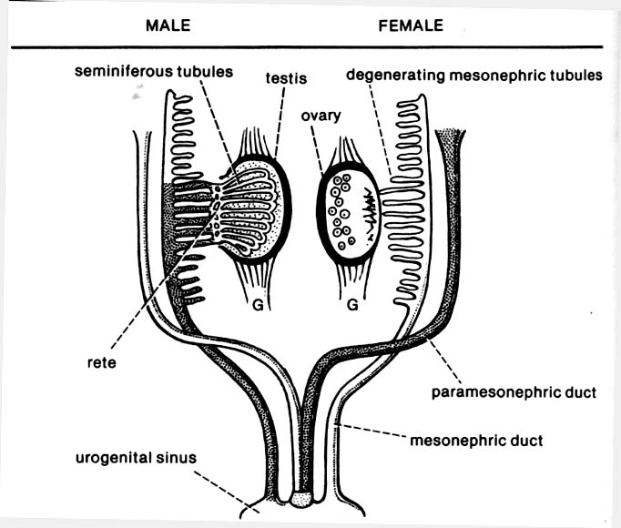
Development: Mesonephric duct of developing kidney co-opted by gonad in male but not in female.
“MARS”
(Men)
Former kidney duct become ductus deferns, epididymous, retains connection to bladder
X
X
X
X
X
X
X
X
“VENUS”
(Women)
New tubes fuse at midline to become uterine tubes, uterus, superior 2/3 vagina

