Slide 1
Biology 323
Human Anatomy for Biology Majors
Lecture 18
Dr. Stuart S. Sumida
From the Head to the Neck
(or was it from the body to the neck?)

Slide 2
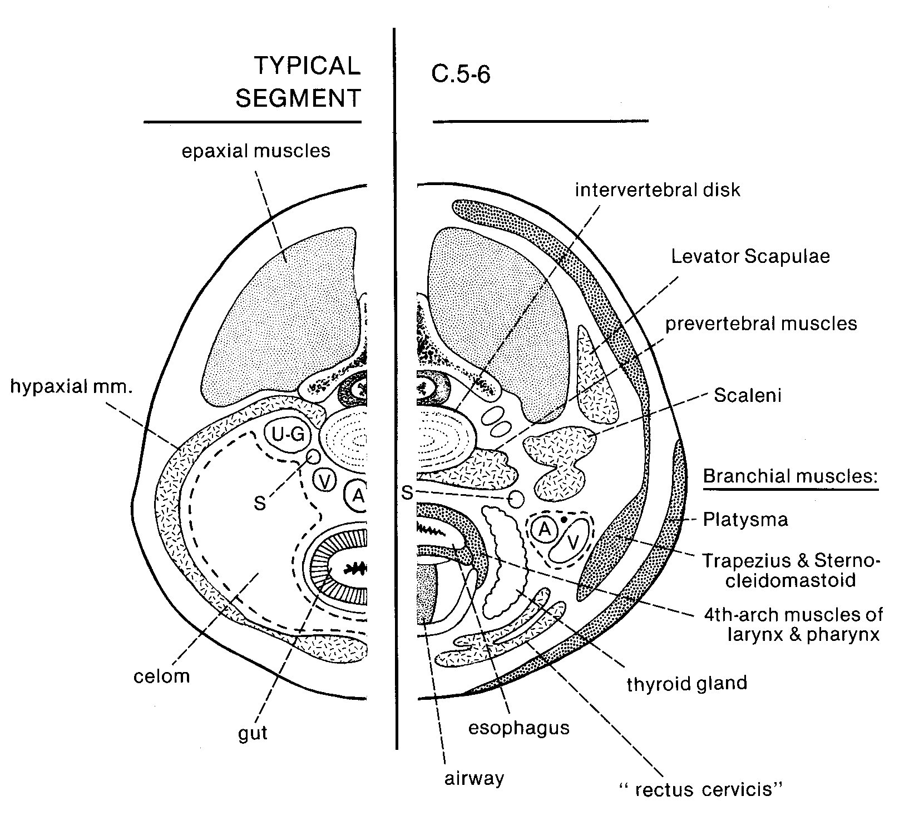

Slide 3
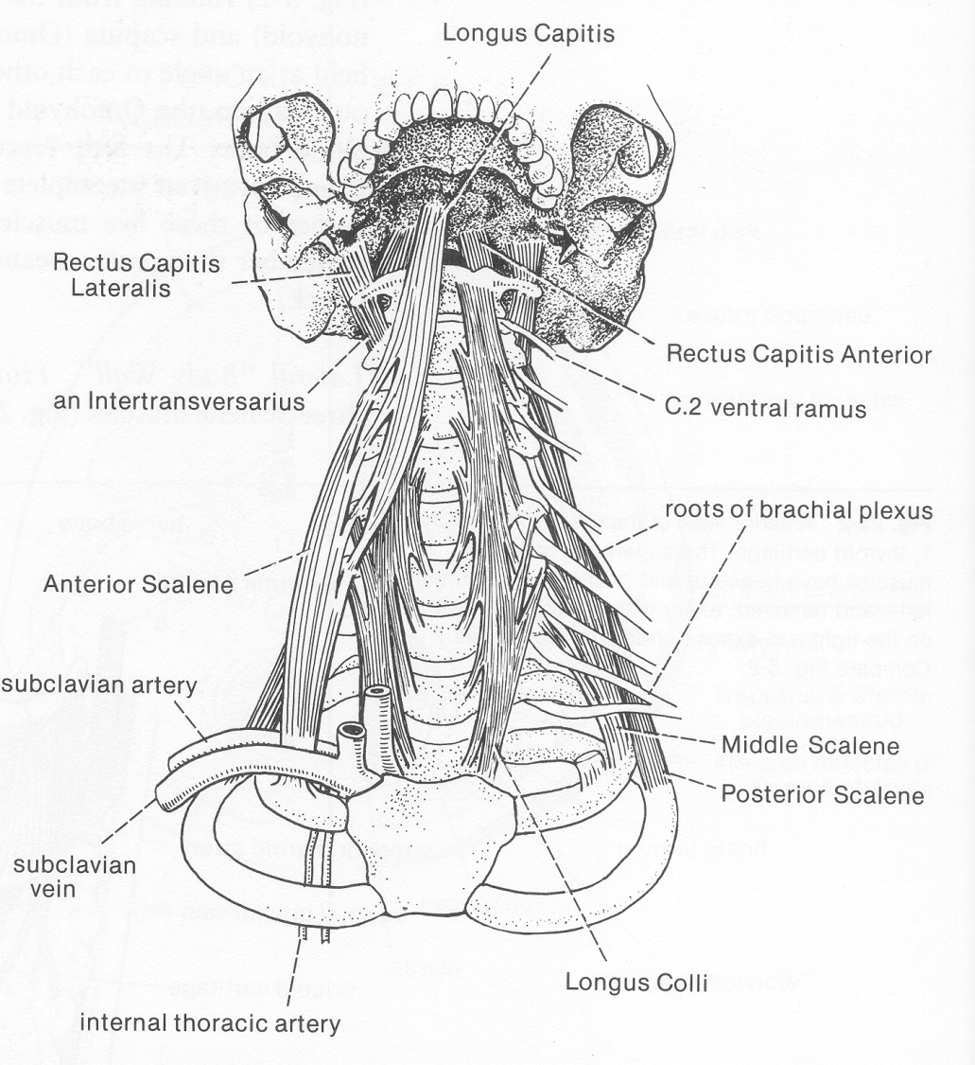

Slide 4
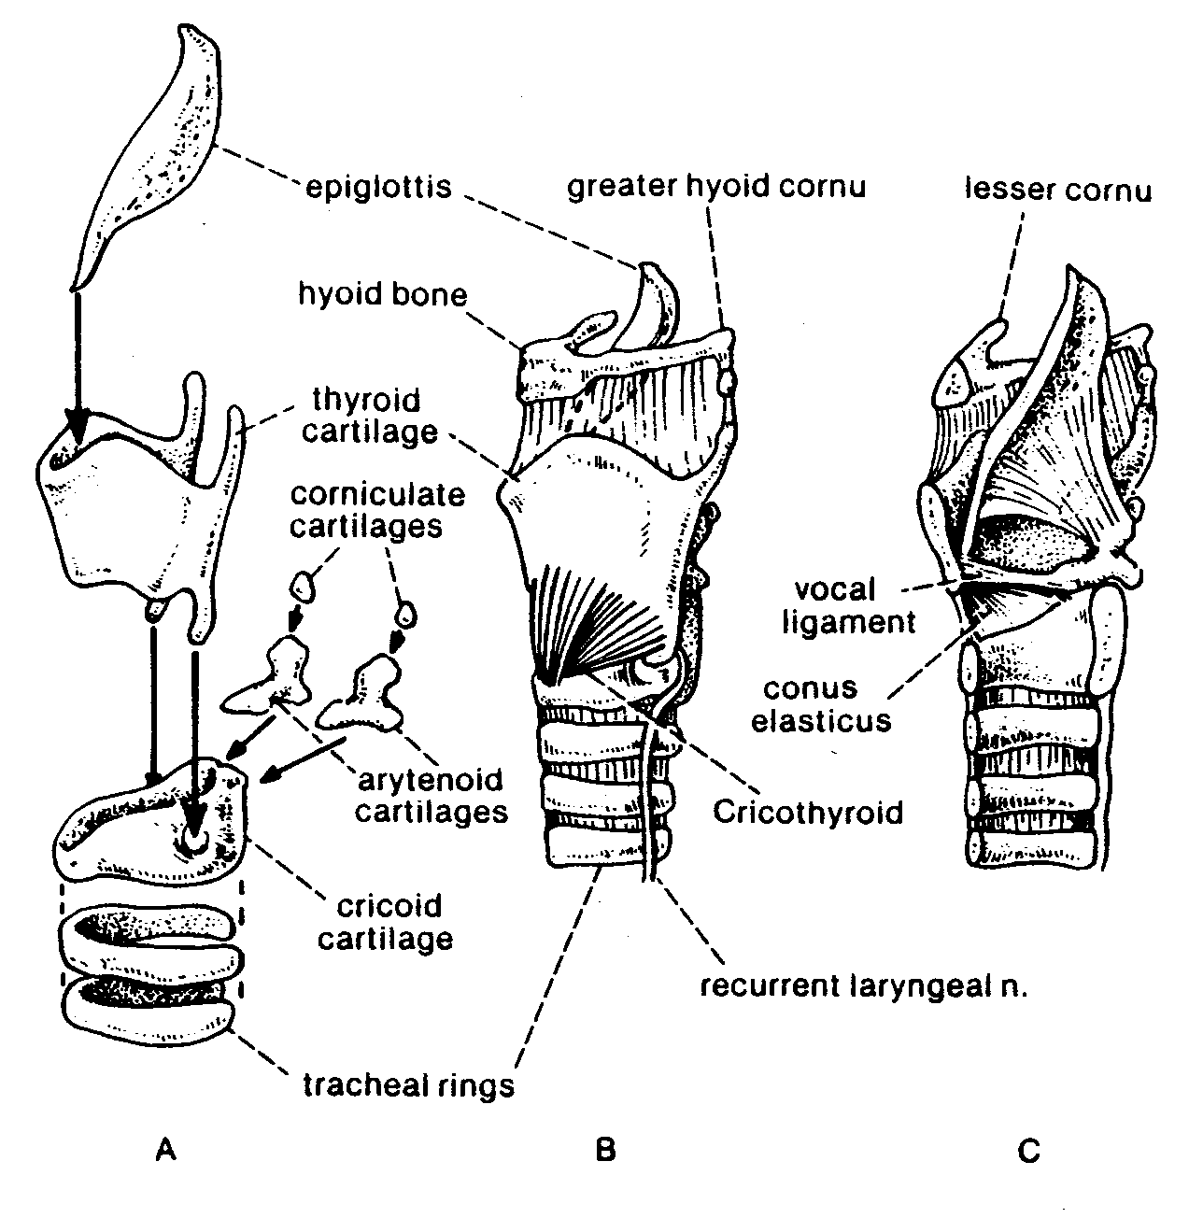

Slide 5
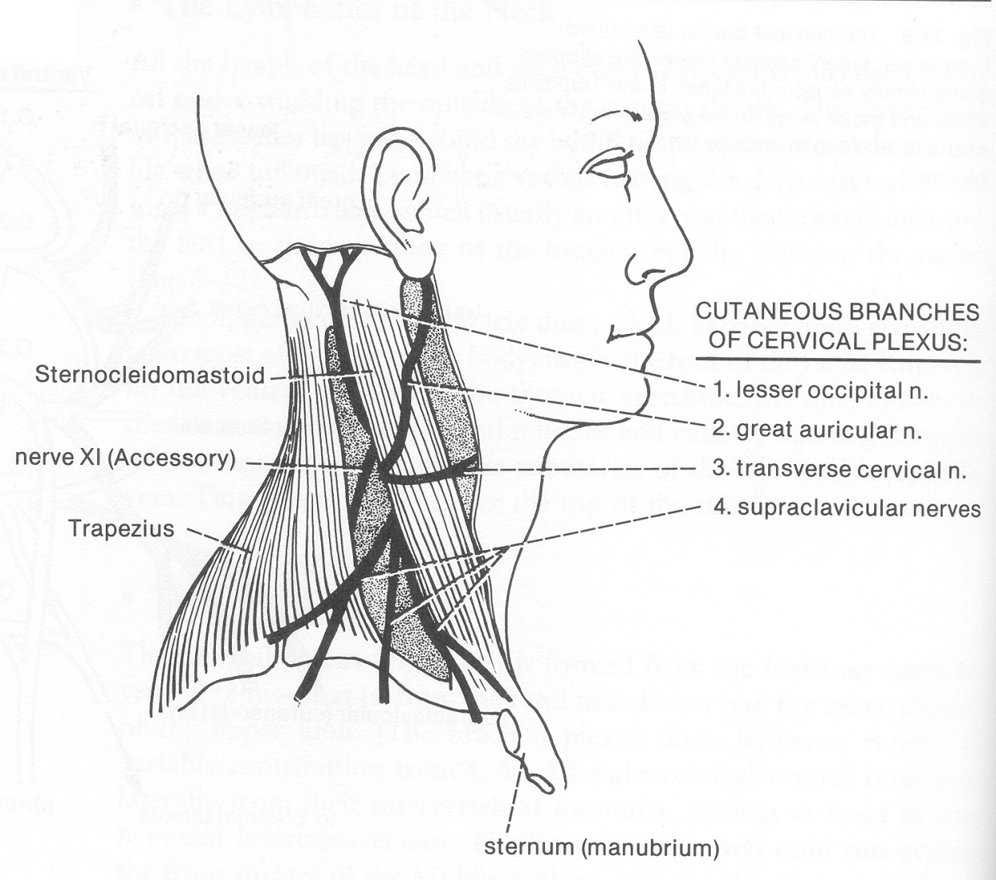

Slide 6
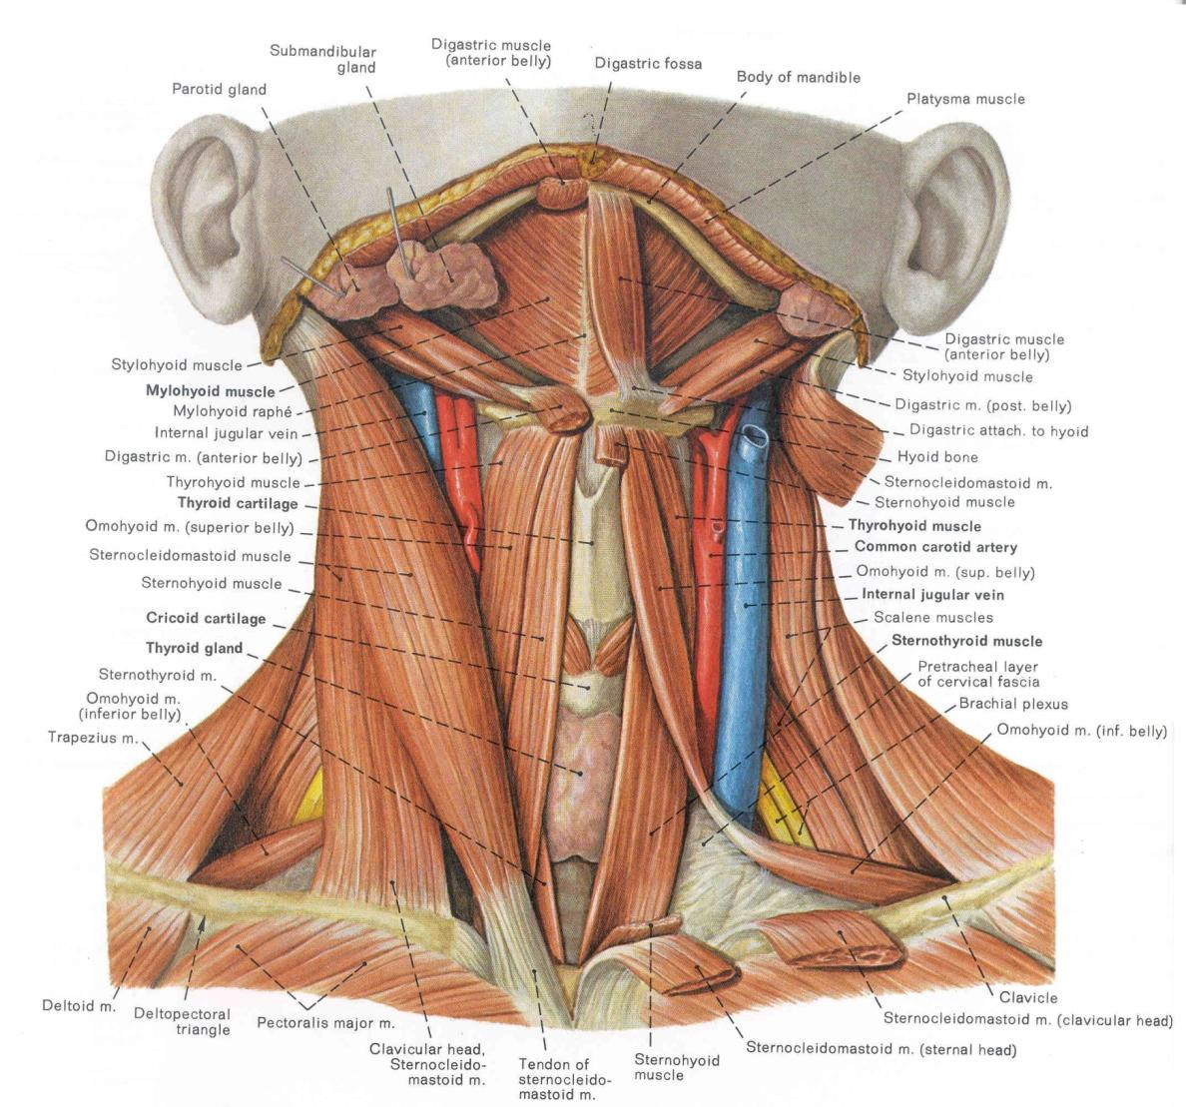

Slide 7
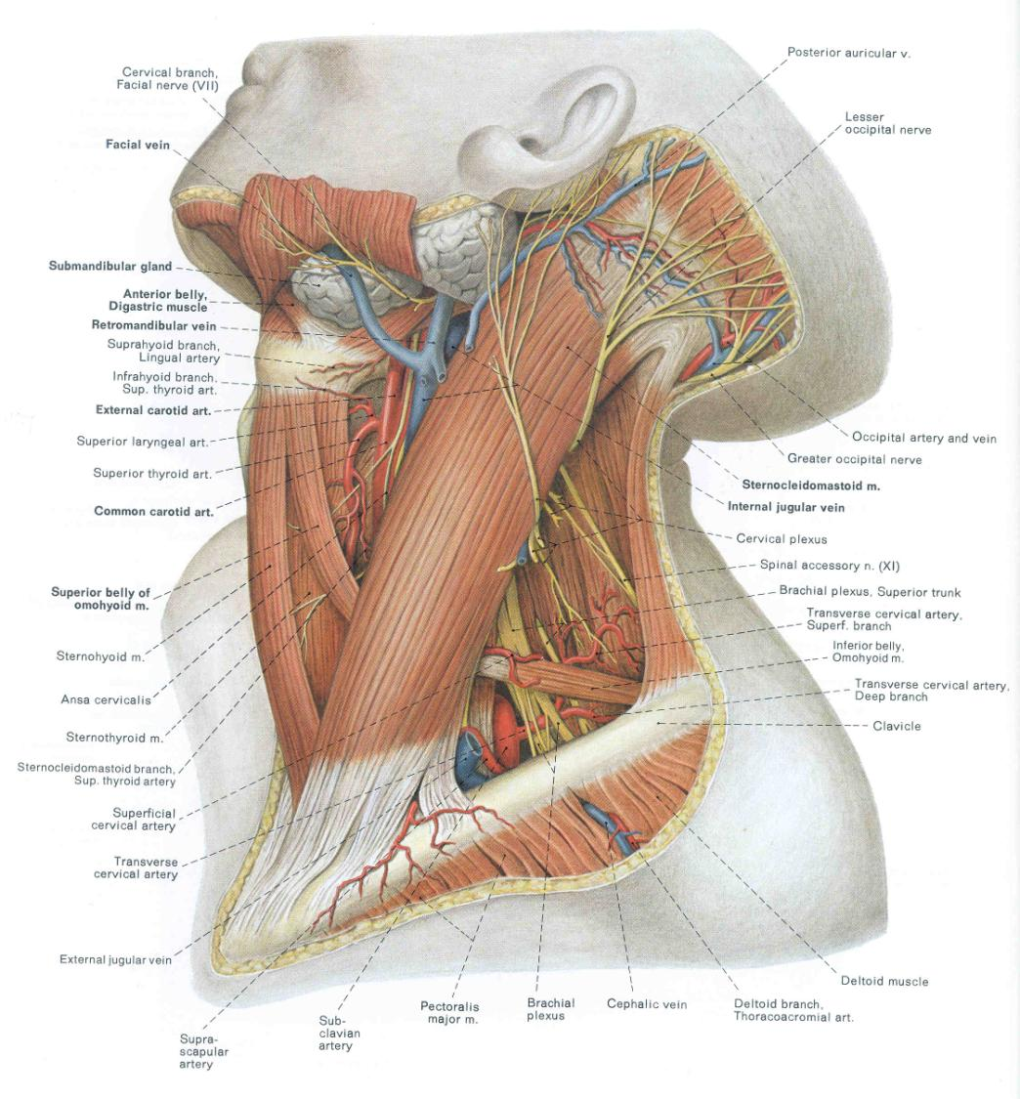

Slide 8
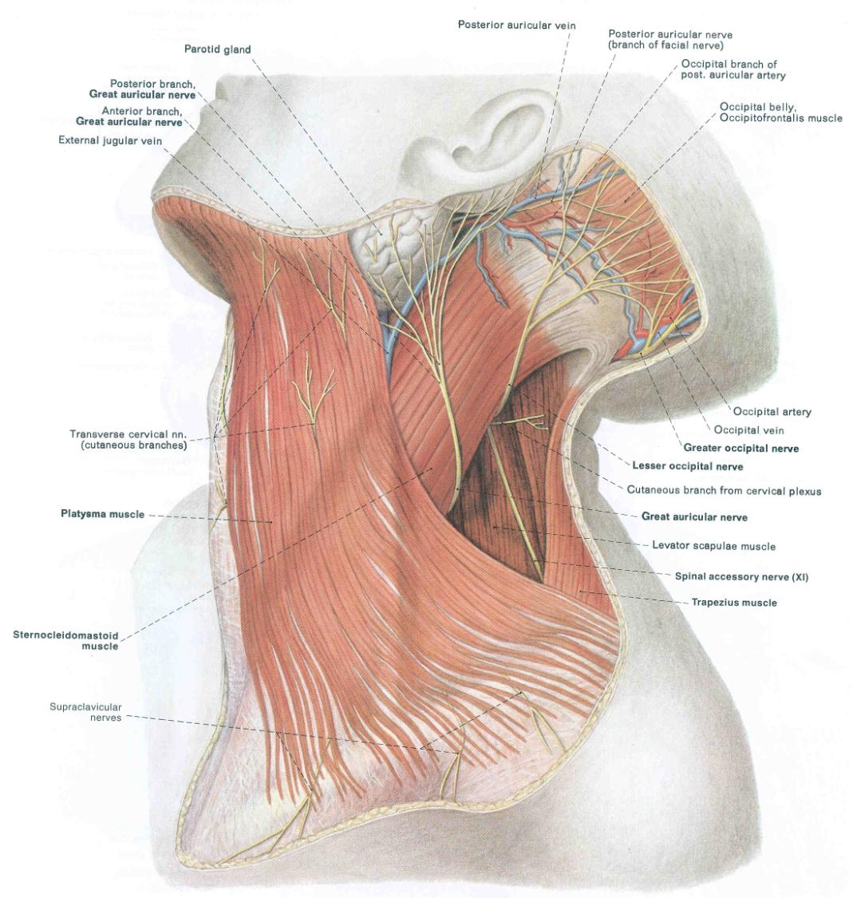

Slide 10
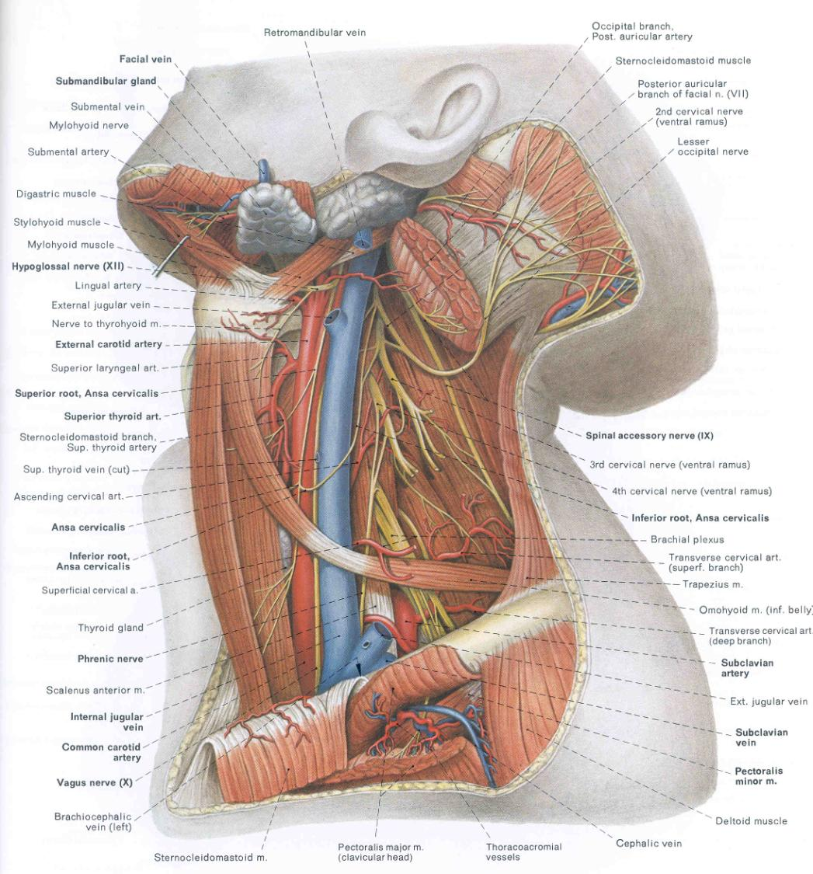

Slide 11
Carotid Sheath:
Carotid Artery
Jugular Vein
Vagus Nerve
Do you remember what foramina these pass through?!

Slide 12
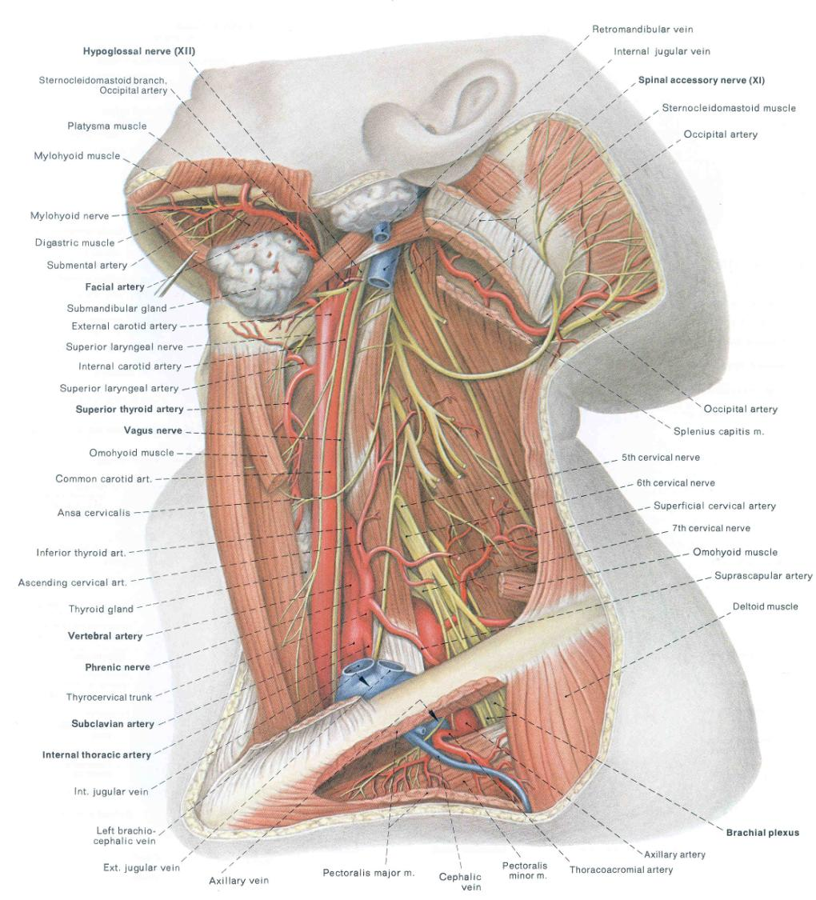

Slide 13
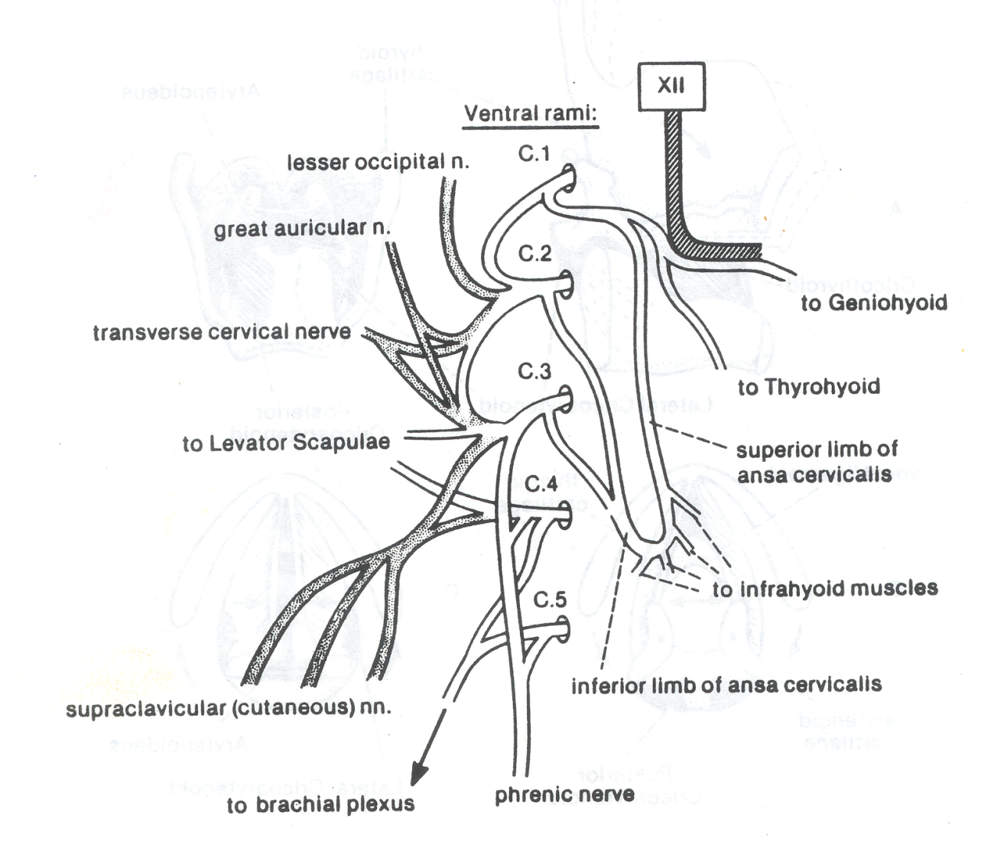

Slide 14
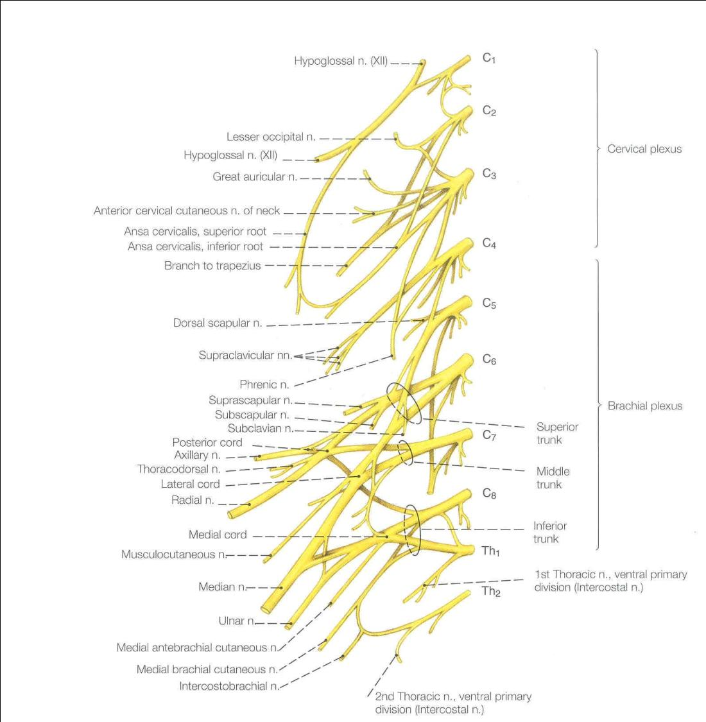

Slide 15
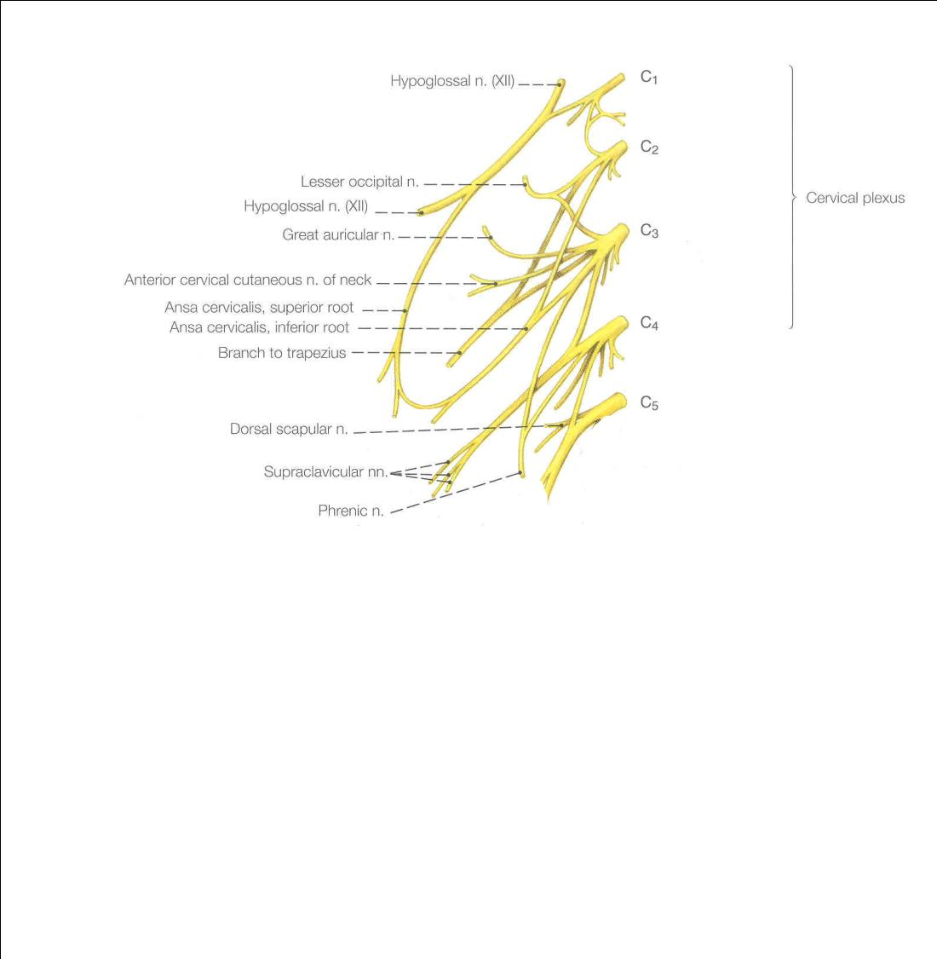

Slide 17
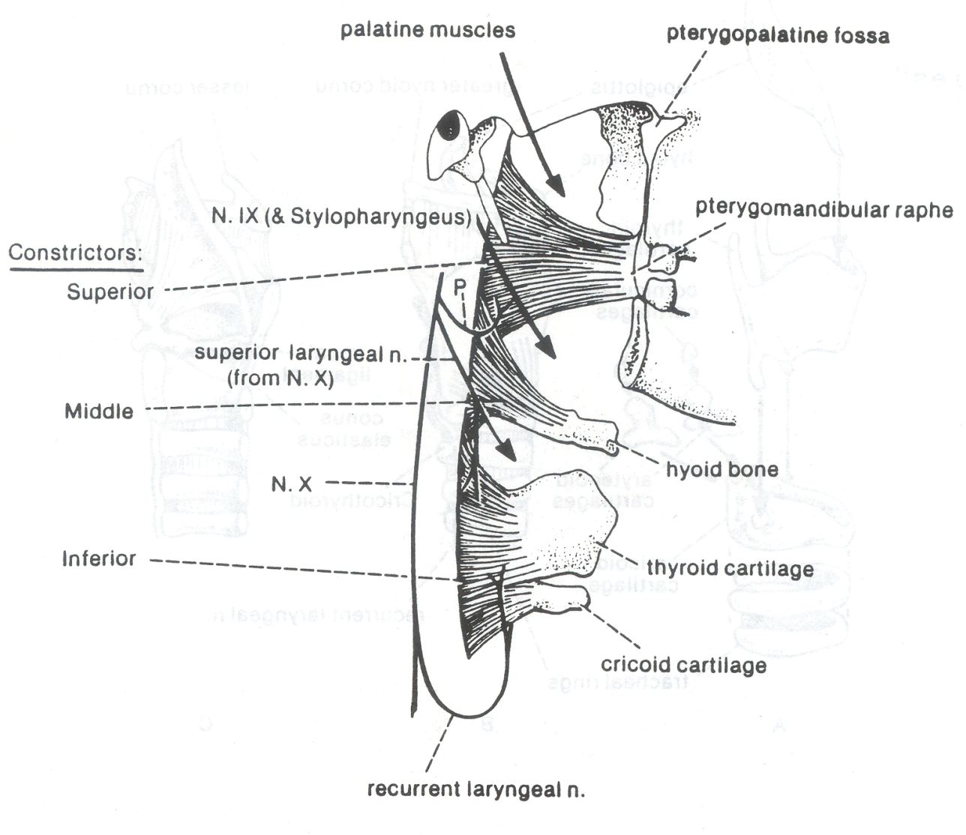

Slide 18
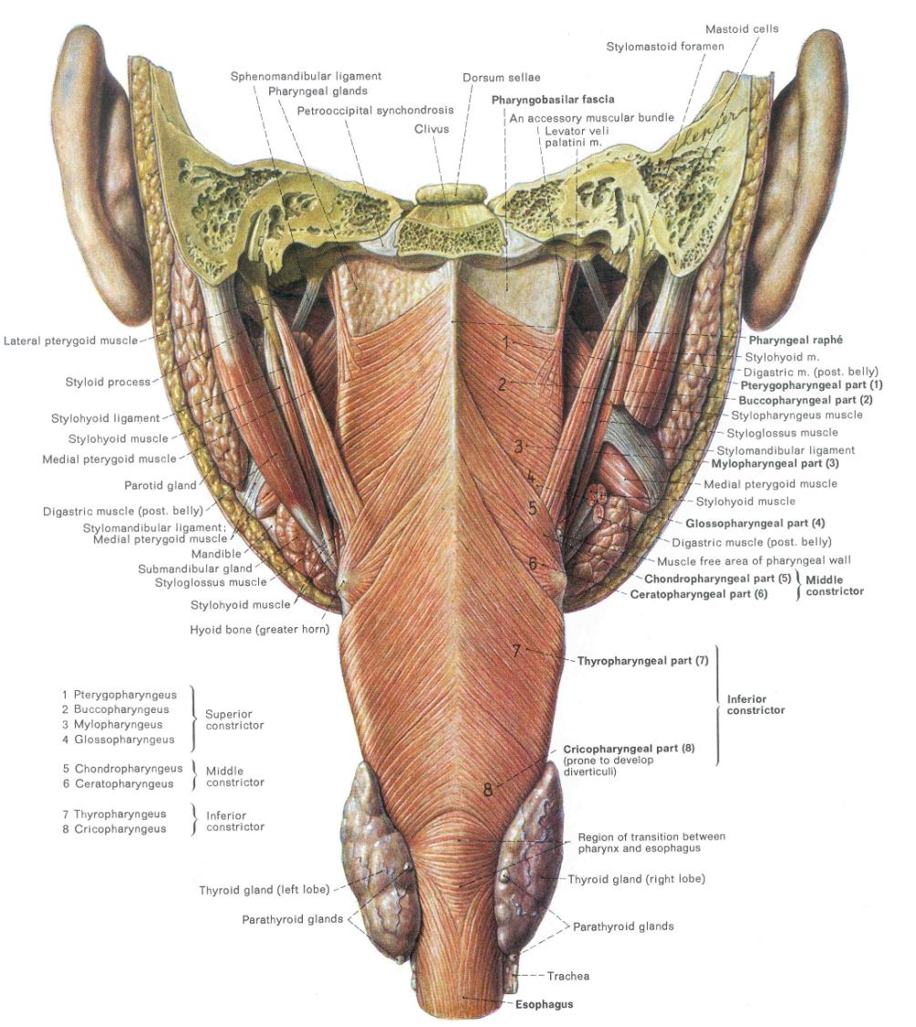

Slide 19
Superior Pharyngeal
Constrictor (attaches to
Pterygomandibular raphe’)
Middle Pharyngeal
Constrictor (attaches to
Hyoid bone)
Inferior Pharyngeal
Constrictor (attaches to
Thyroid and cricoid cartilages)

Slide 21
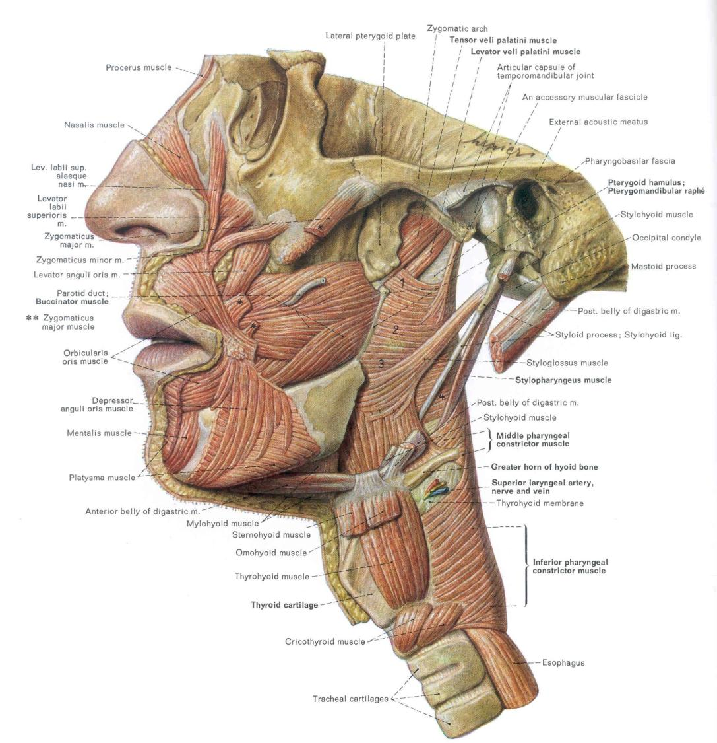

Slide 22
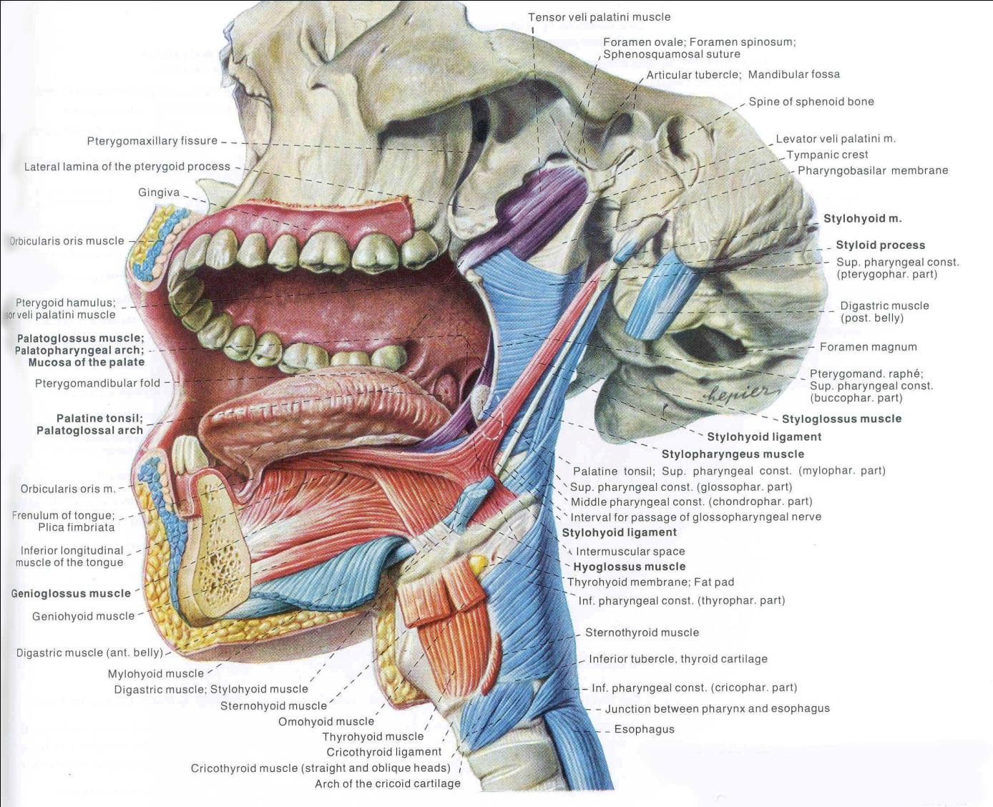

Slide 24
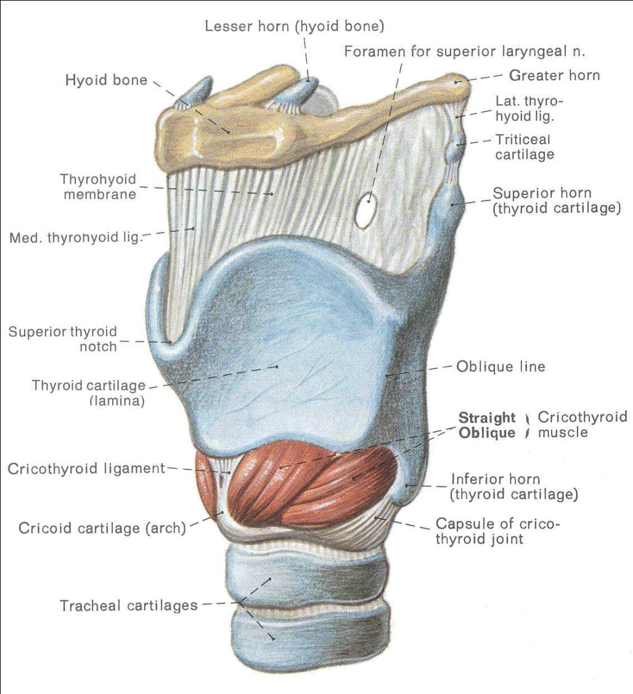

Slide 25
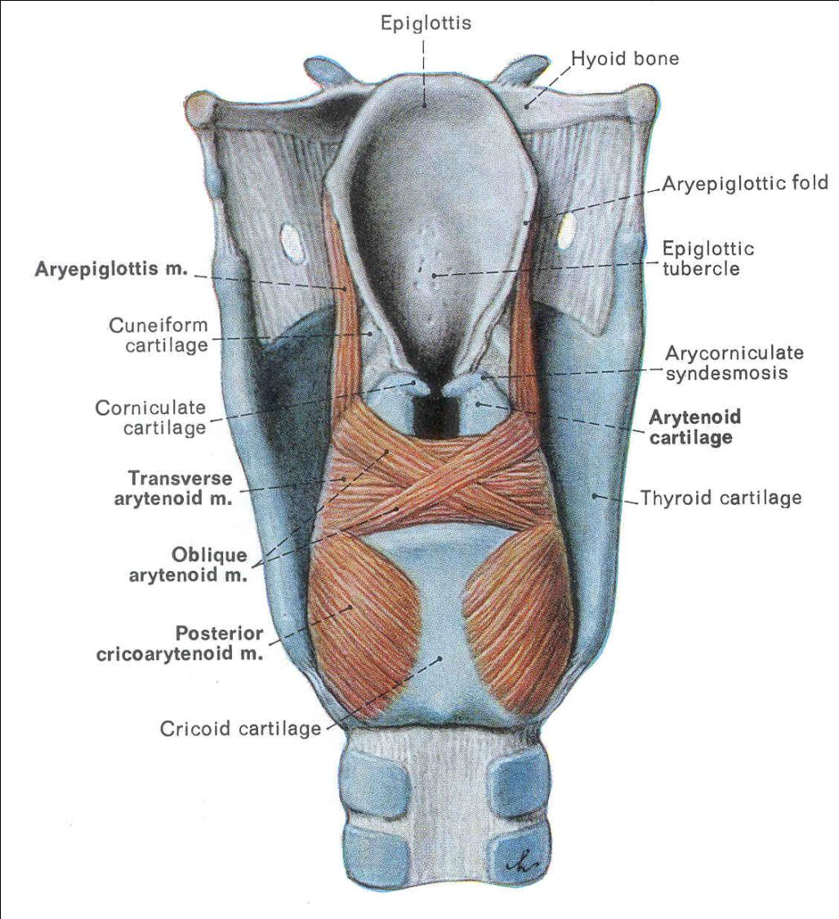

Slide 26
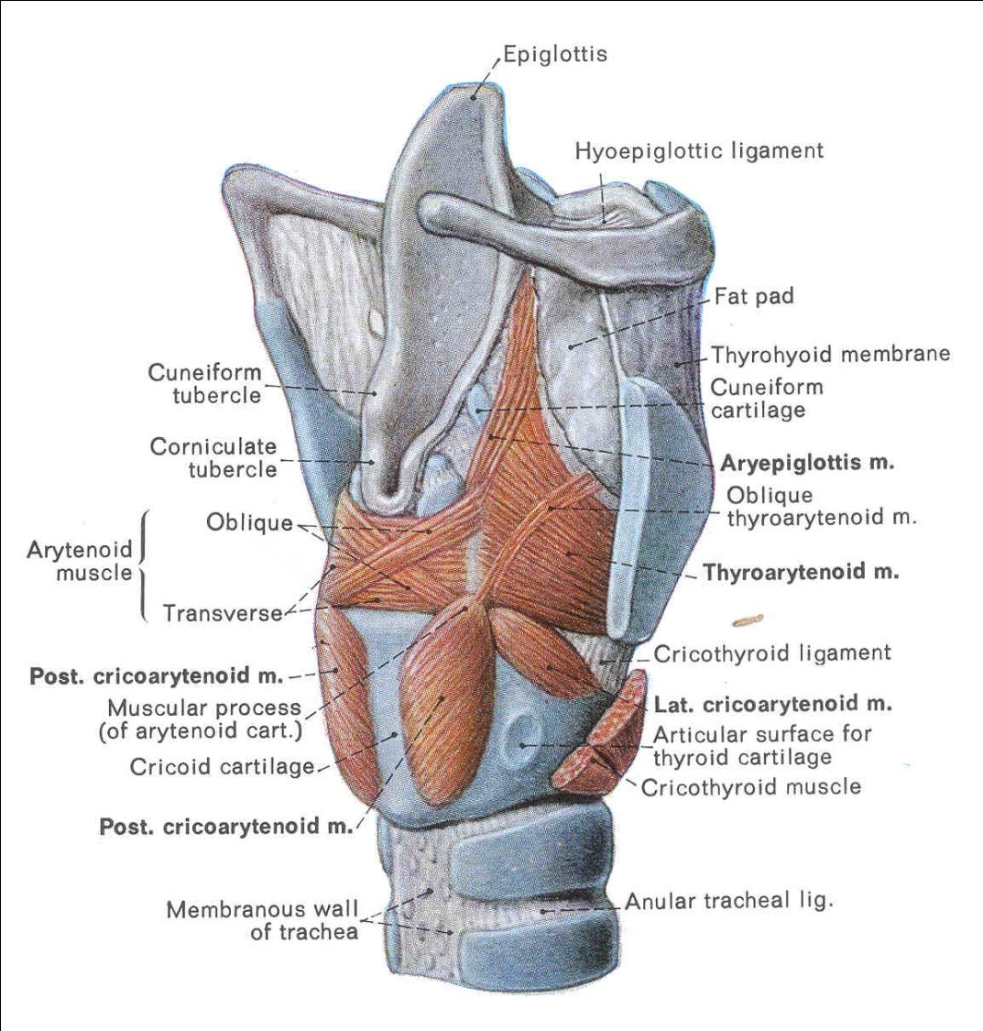

Slide 27
Phonation (Speaking)

Slide 28
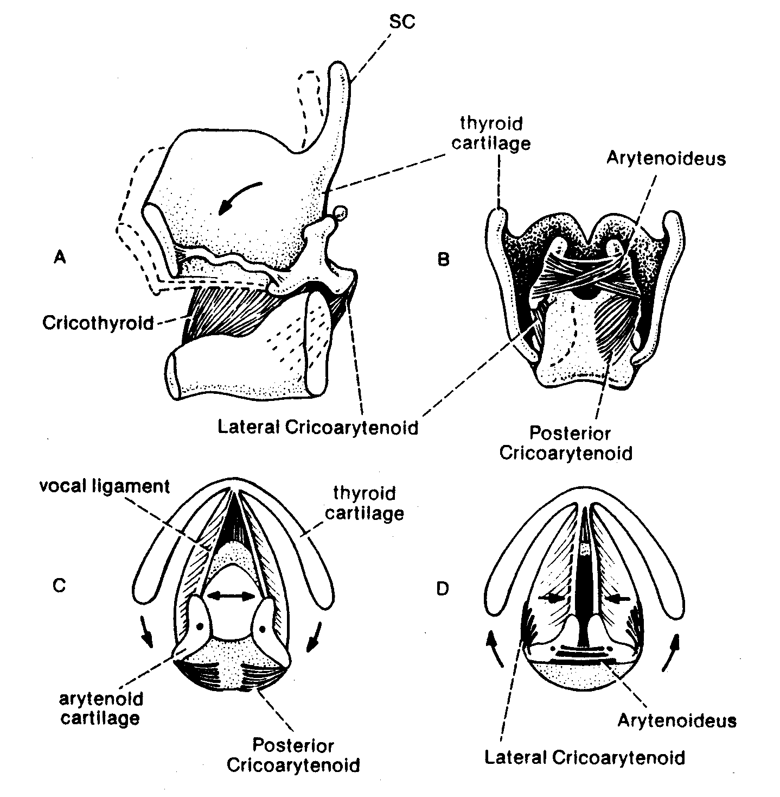

Slide 29
Phonation & Articulation
Glottis closes
Recurrent laryngeal nerve from CN X
Air is forced through the glottis
Vocal folds vibrate and produce a constant tone (phonation)
Pitch of the tone depends on:
Diameter, length, tension of vocal folds (CN X)

Slide 30
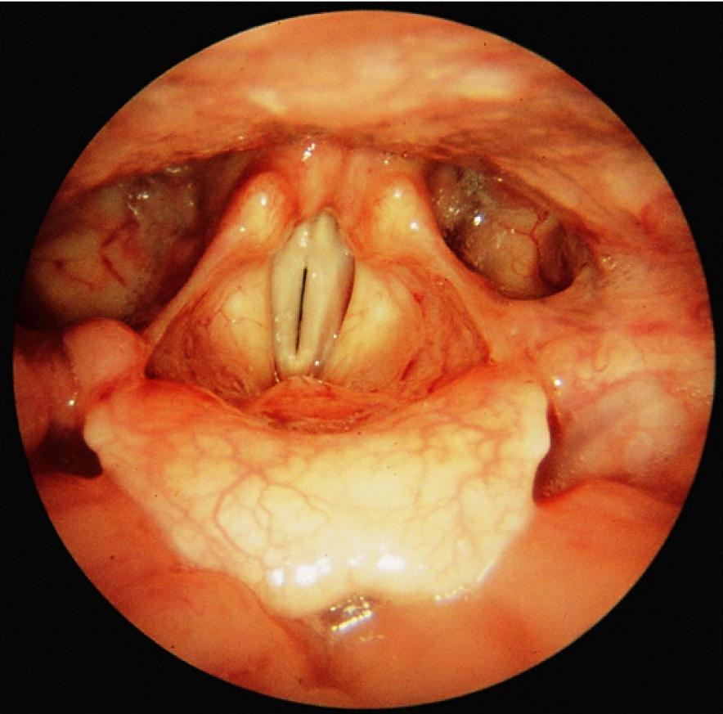
Glottis
closed
Vocal folds
Epiglottis

Slide 31
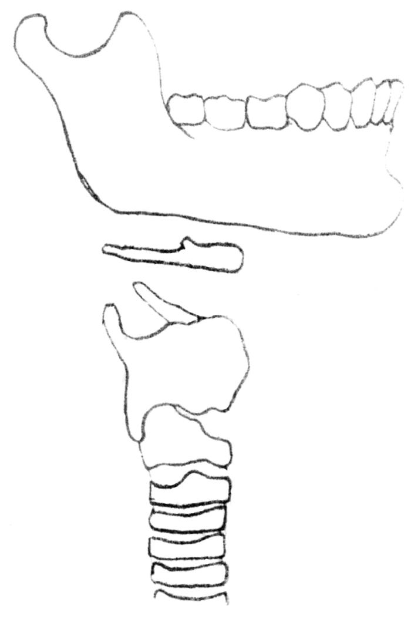
“Strap” Muscles Aid in Phonation
Geniohyoid
(elevates hyoid or
depresses jaw)
Thyrohyoid
(depresses hyoid or
raises larynx)
Sternohyoid
(depresses hyoid)
Sternothyroid
(depresses larynx)
Sternum

Slide 32
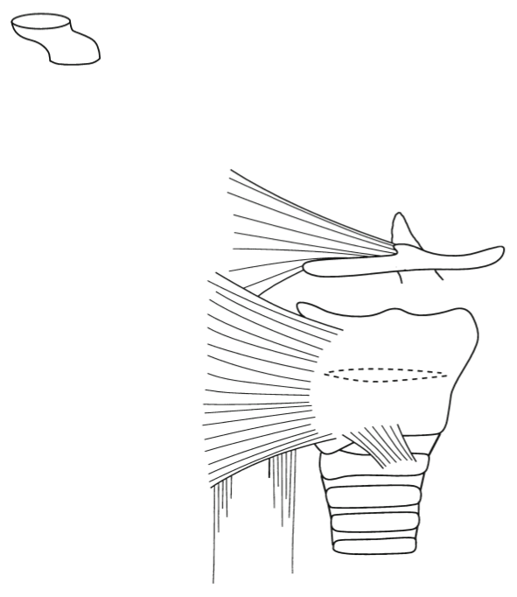
X
Pathways of the Vagus Nerve (CN X)
Jugular
foramen
Sensory
Parasympathetic
Branchial Motor
Hyoid bone
Pharyngeal
Constrictor
Muscles
Laryngeal
Muscles
Thyroid cartilage
(Laryngeal cartilage)
Cricoid
cartilage
Recurrent
laryngeal
nerve
Esophagus

Slide 33
Phonation & Articulation
The tone is articulated into voice.
Tone depends on:
Size and shape of the oropharynx and nasopharynx
Position of jaw (CN V3), tongue (CN XII), and lips (CN VII)

Slide 34
Test yourself and identify the following structures…

Slide 35
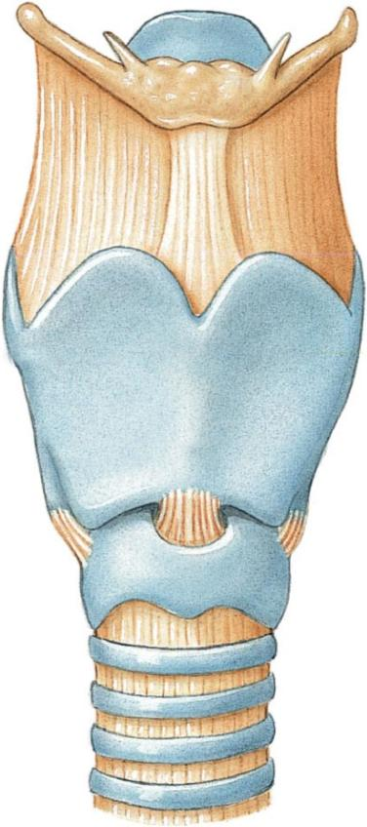
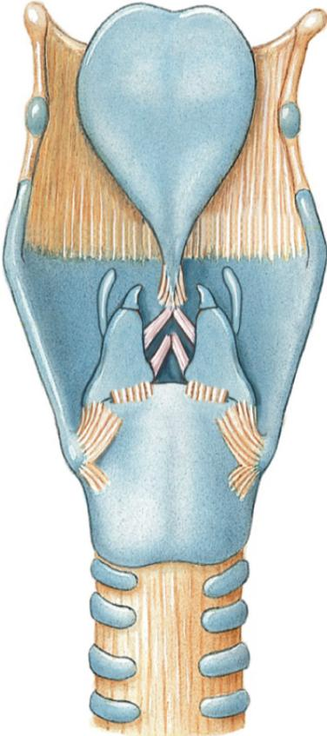
Anterior
Posterior

Slide 36
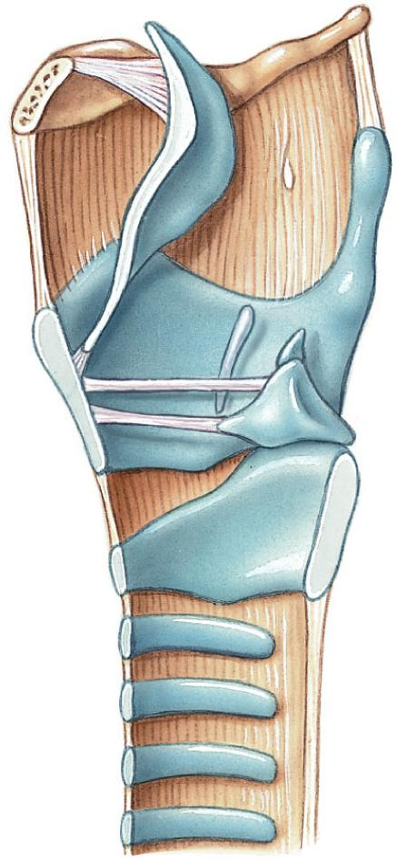
Anterior
Posterior

Slide 37
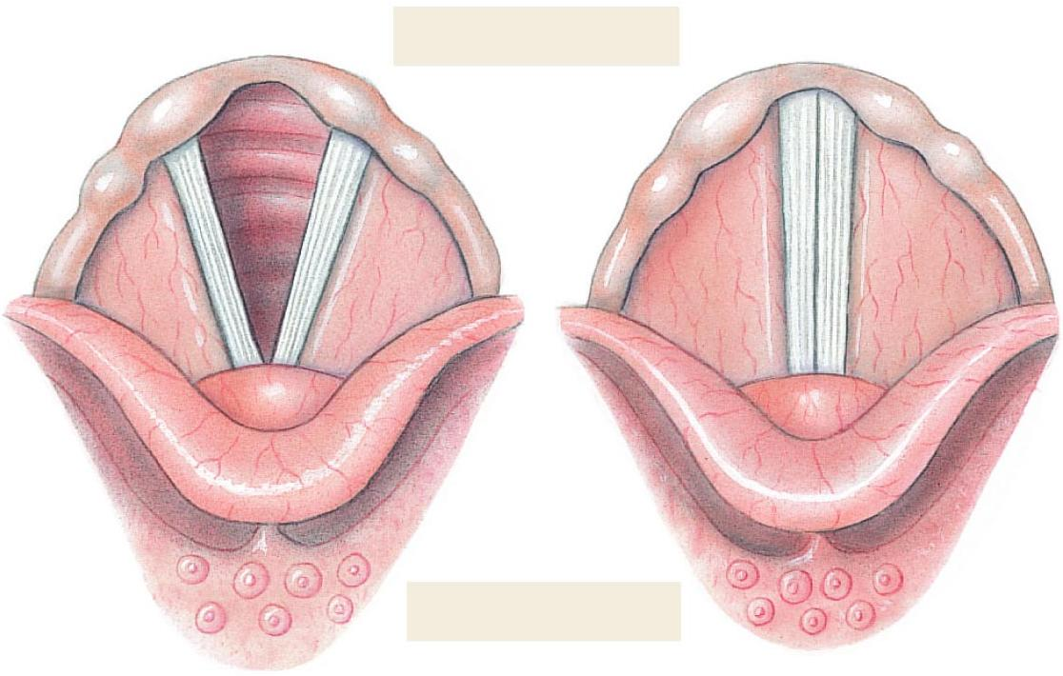
Posterior
Anterior

