Slide 1
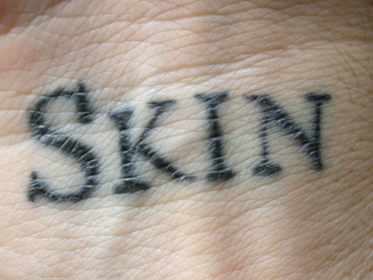
Biology 323
Human Anatomy for Biology Majors
Lecture 3
Dr. Stuart S. Sumida
Integument
Support Structures; Axial Skeleton

Slide 2
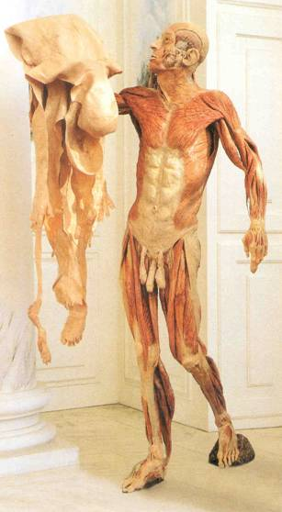
Integumentary System
Functions
Protection
Sensory
Synthesis

Slide 3
The Skin…
Epidermis - ectodermal; stratified squamos epithelium
Dermis - mesodermal; collagen, elastic fibers, papillary layer, and reticular layer
Hypodermis

Slide 4
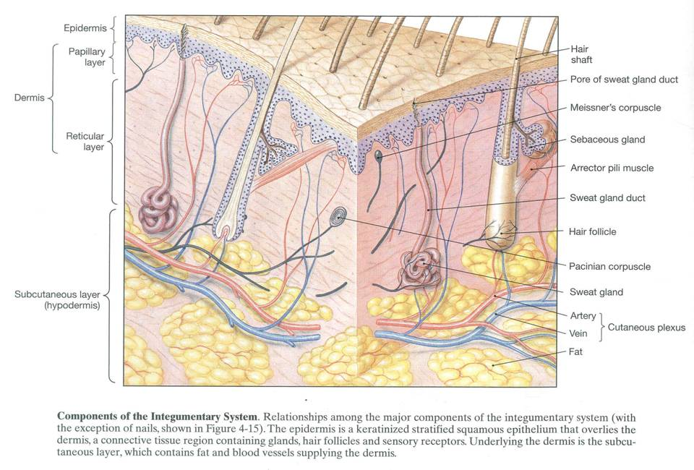

Slide 5
Detail on Epidermis:
Stratum corneum (dead)
Stratum lucidum
Stratum granulosum
Stratum spinosum
Superficial
Deep
(Dermis)

Slide 6
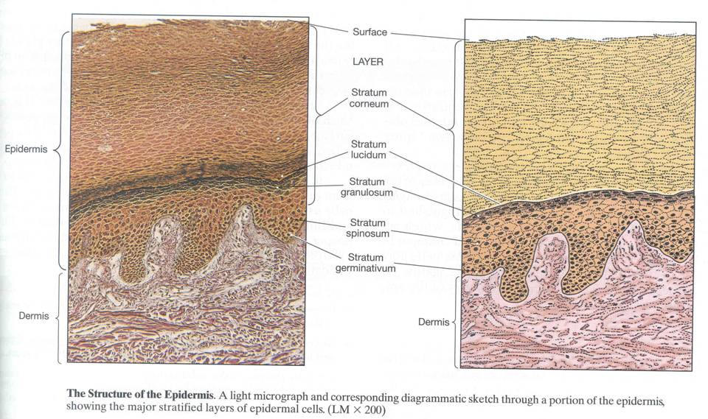

Slide 7
Detail on Epidermis:
Stratum corneum (dead)
Stratum lucidum
Stratum granulosum
Stratum spinosum
Superficial
Deep
(Dermis)

Slide 8
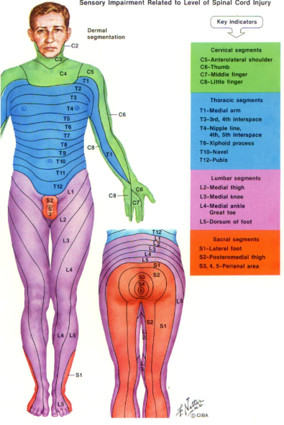
Segmented Dermatome

Slide 9
Subcutaneous Layer (= Superficial Fascia = Hypodermis)
Division between the Reticular Layer (Dermis) and Subcutaneous layer is indistinct
Consists of Areolar and Adipose tissues, large number of blood vessels

Slide 10
Hair:
Bulb
Artery
Vein
Arrector Pila Muscle
Gland
Papilla
Shaft

Slide 11
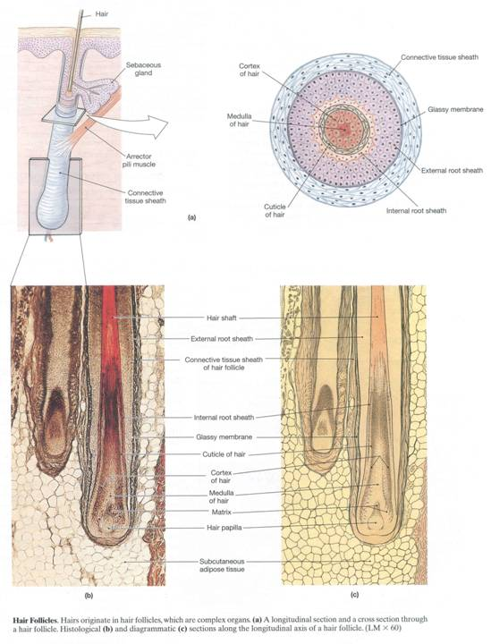

Slide 12
Different Hair Shaft Shapes give different characteristics:
Round Cross-section = straight hair
Oval Cross-section = Wavy Hair
Flat Cross-section = Kinky Hair

Slide 13
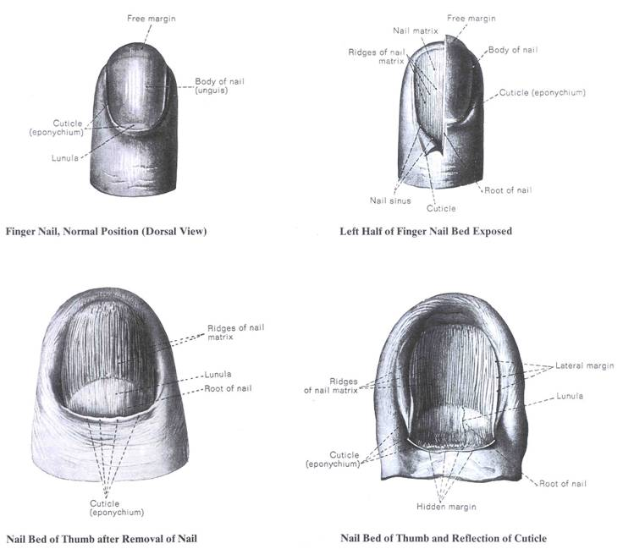

Slide 14
Glands
Eccrine
Apocrine
Mammary glands (Not reproductive organs!)

Slide 15
Eccrine Glands
The predominant sweat glands of the body.
Produce clearly, watery odorless liquid + salt.
Apocrine Glands
Develop in association with hair follicles.
Heavier, more oily secretion.
Specialized versions include Moll's glands seen on the eyelids; the cerumen-producing (ear wax) glands of the external auditory canal; and the milk-producing glands of the breasts.

Slide 16
The scent produced by apocrine glands should not be confused with the unpleasant body odor produced by microorganisms that grow on moist sections of the skin.
Microorganisms create body odor by digesting sebum, the oily substance secreted by sebaceous glands in the skin of mammals. The presence of water, in the form of sweat from eccrine (simple) sweat glands, aids in this process.
Eccrine glands are activated by heat, explaining why we sweat more profusely as ambient temperatures rise. Apocrine glands react to stress and sexual activity, and respond by producing sweat with a personally characteristic -- but not (necessarily) unpleasant -- odor.

Slide 17
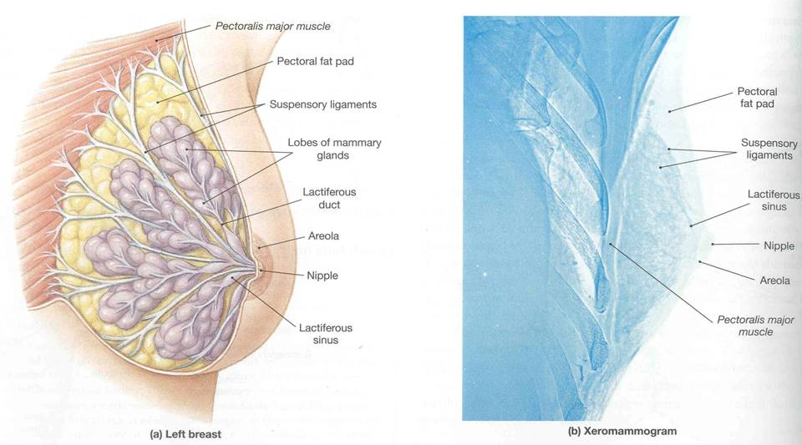
Mammary Gland – a skin gland, not a reproductive organ...

Slide 18
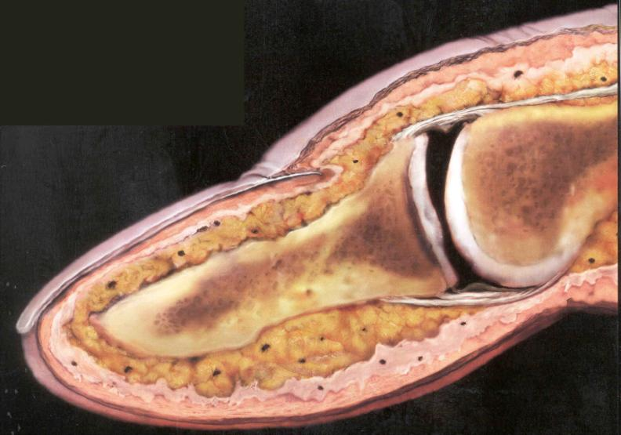

Slide 19
Dermis
Hypodermis
Epidermis

Slide 20
Support systems
Support systems built of hard tissues, such as bone and cartilage
Support systems produced by the manipulation of soft tissues

Slide 21
Soft tissue support - structures which maintain structural integrity without the use of a hard, internal skeleton.
Constant volume
Pressurize
Hydrostatic skeleton

Slide 22
Tongue
Muscle & Fluid-based structure
Attached to what bones?
Coelom
A space
Stable & still base of support

Slide 23
The Skeleton

Slide 24
Cartilage
Function
Cartilage materials - chondrocytes
Interstitial growth
Perichondrium
According to a scale from softest to hardest, where does cartilage belong, if other skeletal materials are bone, calcified cartilage, enamel, and dentin?

Slide 25
What is bone made of?
Hydroxyapatite
Bone organic content (Osteocytes)
Bone mineral content

Slide 26
Hydroxyapatite:

Slide 27
What is bone made of?
Hydroxyapatite:
Ca₁₀(PO₄)₆(OH)₂

Slide 28
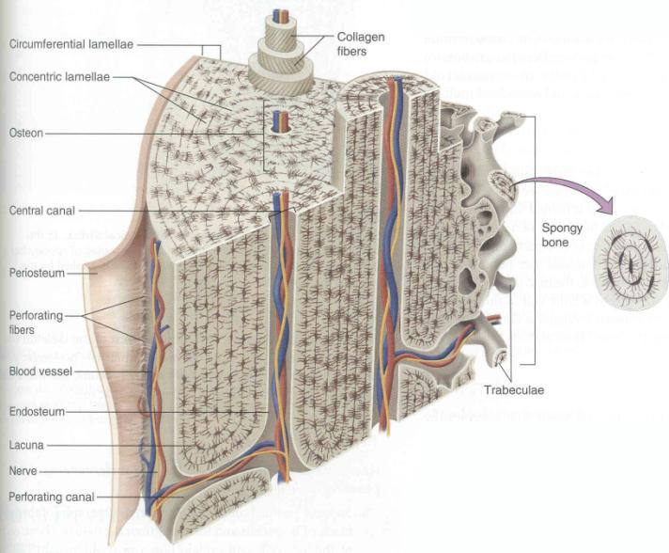
Bone structure

Slide 29
Haversian systems
Haversian canals
Lacunae
Canaliculi

Slide 30
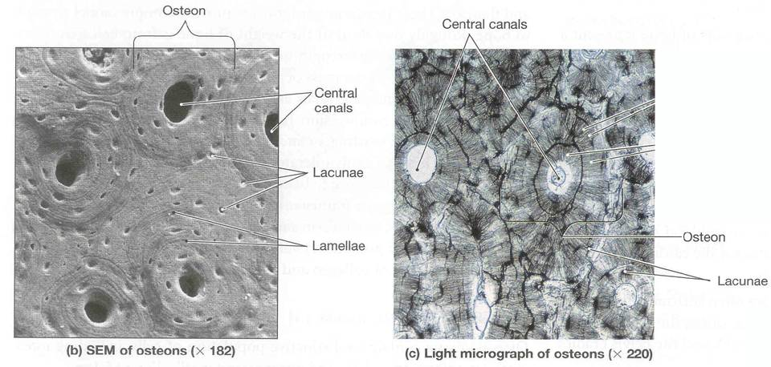

Slide 31
Compact Bone vs.
Spongy Bone (Trabecular Bone)

Slide 32
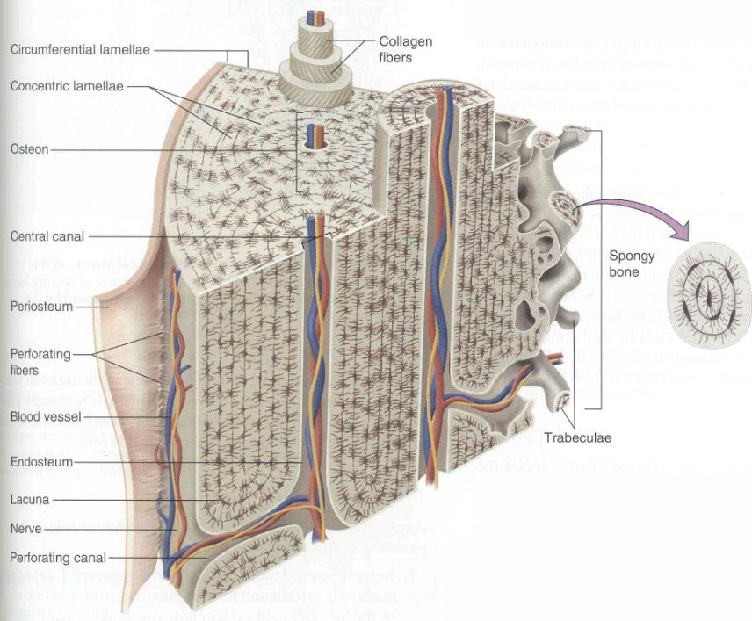

Slide 33
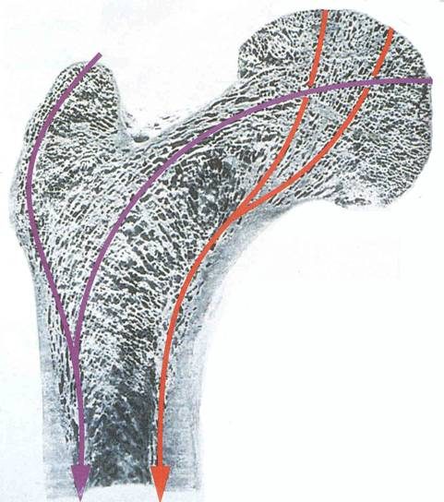
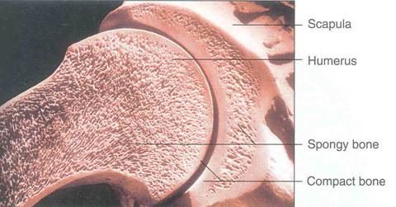
Shoulder Joint
Femur

Slide 34
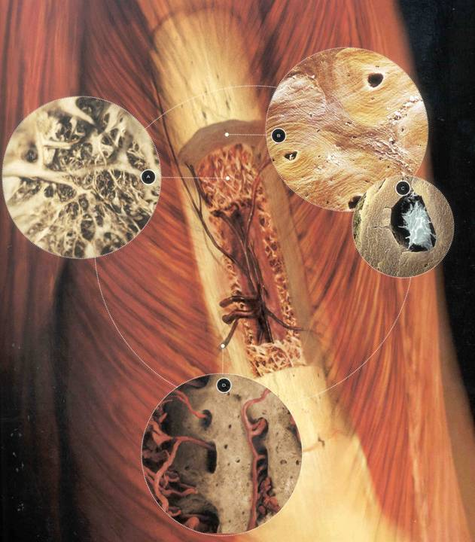

Slide 35
Regional Classification of the Skeleton
Endoskeleton vs. exoskeleton
Visceral skeleton vs. Somatic Skeleton

Slide 36
Visceral skeleton
Associated with Splanchnopleure (gut)
Origin

Slide 37
Somatic skeleton
Associated with Somatopleure
Origin
Axial skeleton
Appendicular skeleton

Slide 38
Developmental Classification of the Skeleton
Endochondral bones vs. dermal bones
Endochondral - epiphysis & epiphyseal plates
Dermal - "intramembranous bones"

Slide 39
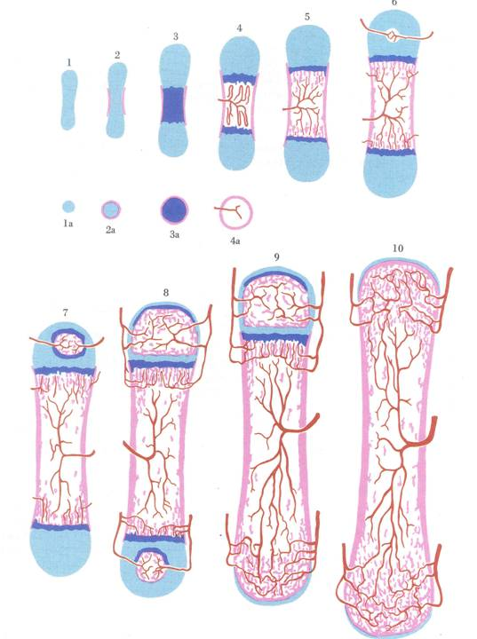

Slide 40
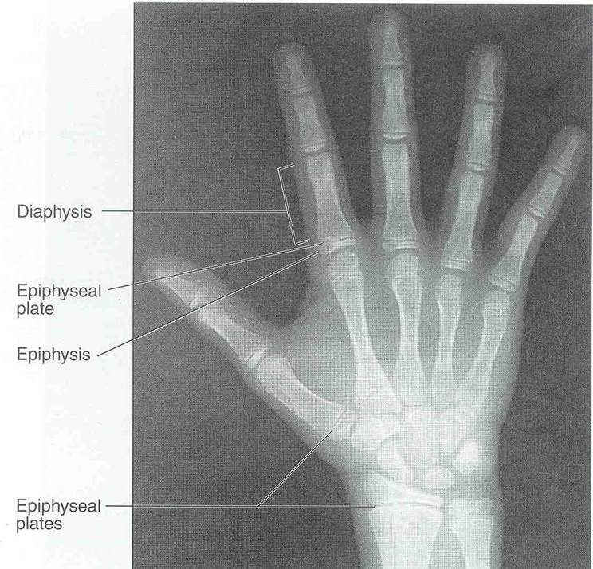

Slide 41
Bone Function
Structural
Red blood cell manufacture
Homeopoietic tissue
Red bone marrow vs. yellow bone marrow
Mineral regulation
Calcium levels
Importance of phosphorus

Slide 42
Articulations
Different types of bone attachments
Ligaments
The Joint Capsule

Slide 43
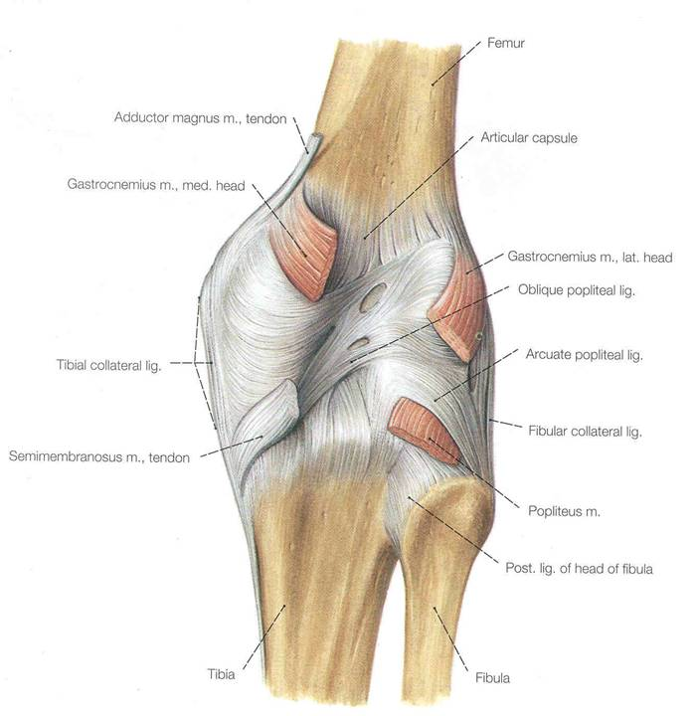
Joint Capsule of Knee

Slide 44
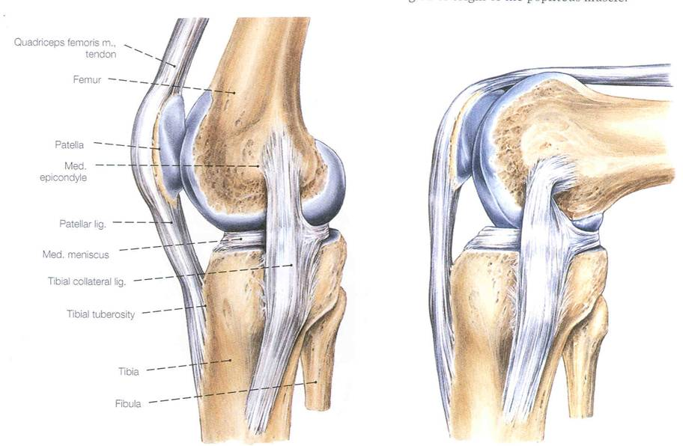
Examples of Major Ligaments of Knee

Slide 45
Movements and the Skeleton
Flexion
Extension
Rotation
Circumduction
Abduction
Adduction
Protraction
Retraction
Depression
Elevation
Supination
Pronation
Opposition
Reposition
Inversion
Eversion

Slide 46
Axial Skeleton

Slide 47
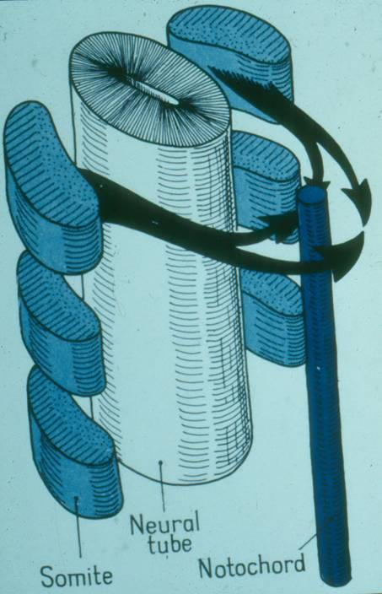

Slide 48
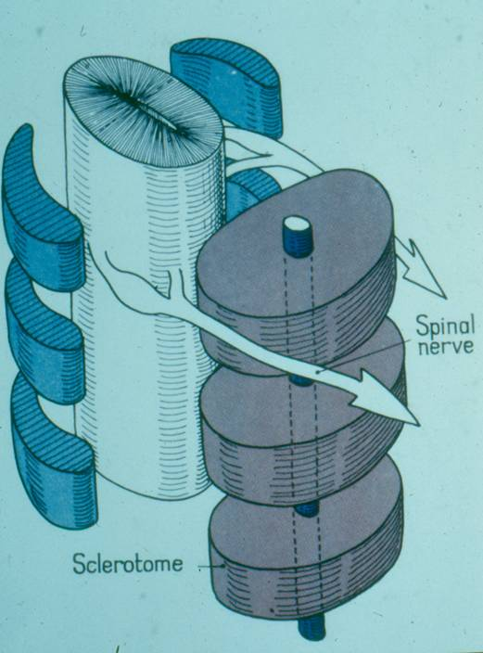

Slide 49
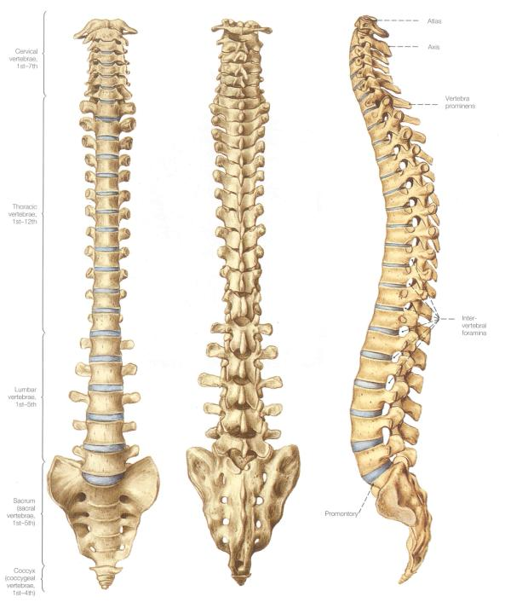

Slide 50
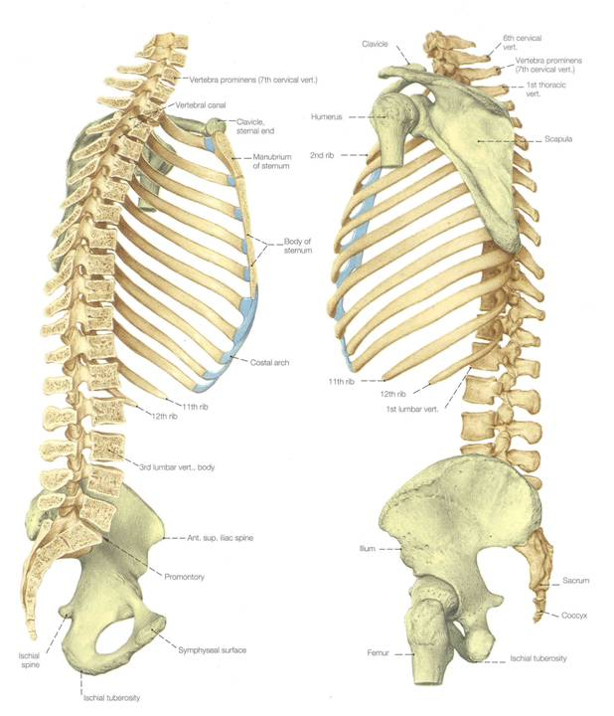

Slide 51
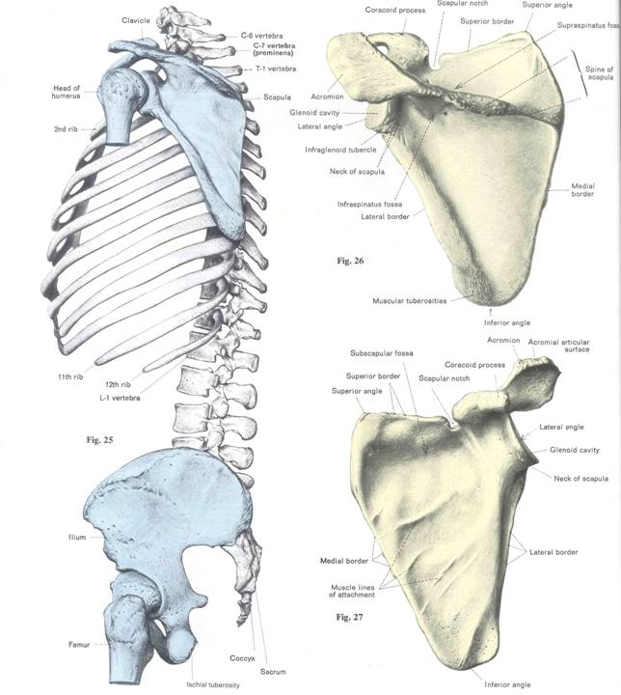

Slide 52
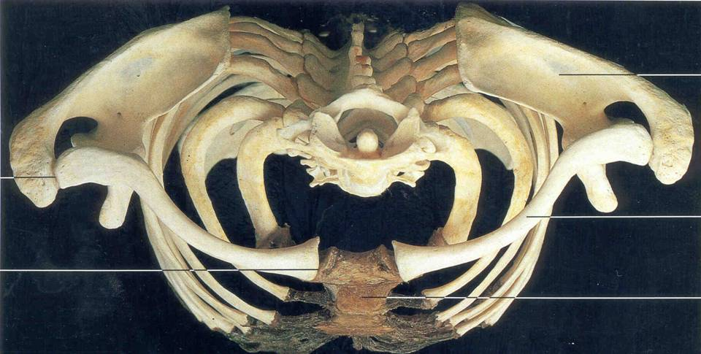

Slide 53
4 Distinct Curvatures of the Vertebral Column

Slide 54
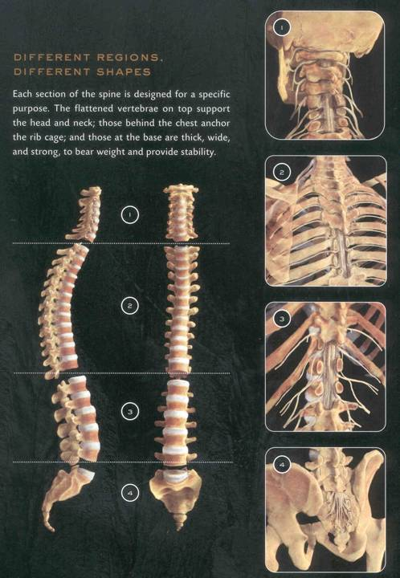

Slide 55
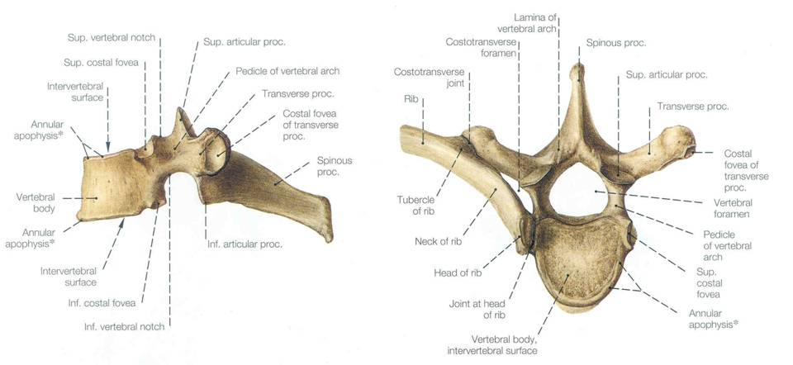

Slide 56
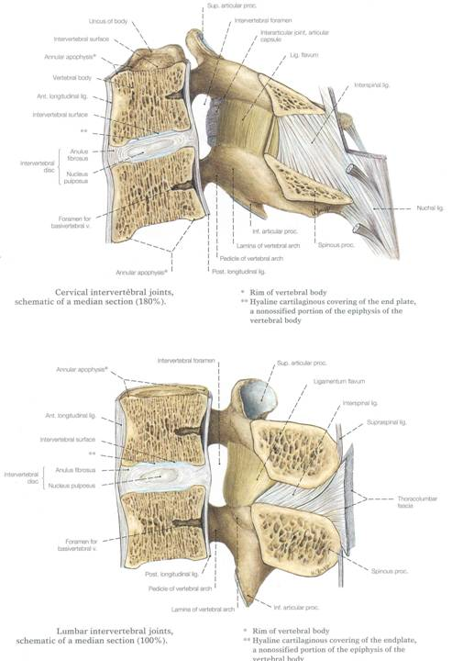

Slide 57
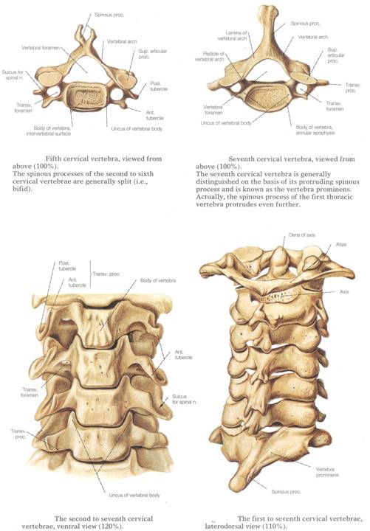
Cervical verterbrae:
Transverse foramen
Vertebral artery

Slide 58
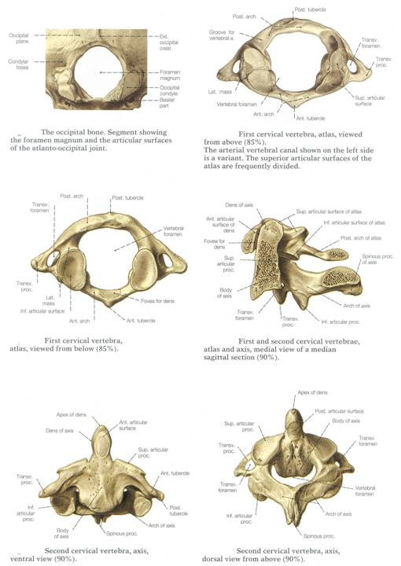
Atlas and Axis Vertebrae

Slide 59
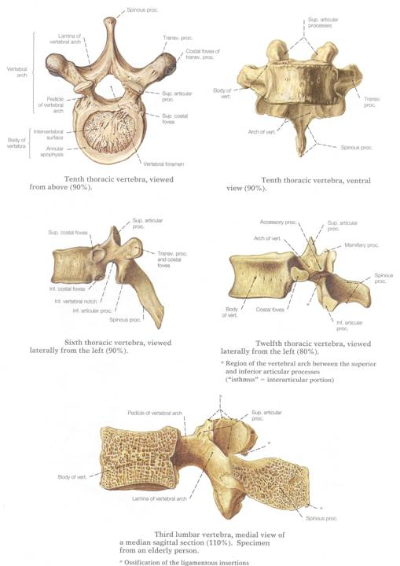
Thoracic vertebrae

Slide 60
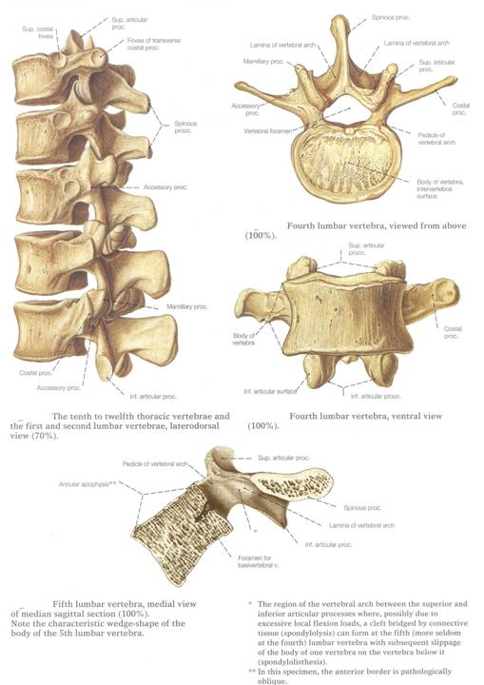

Slide 61
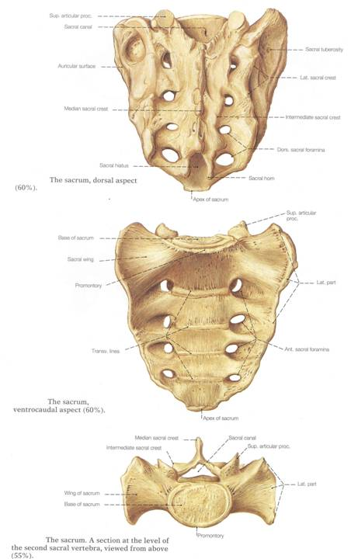
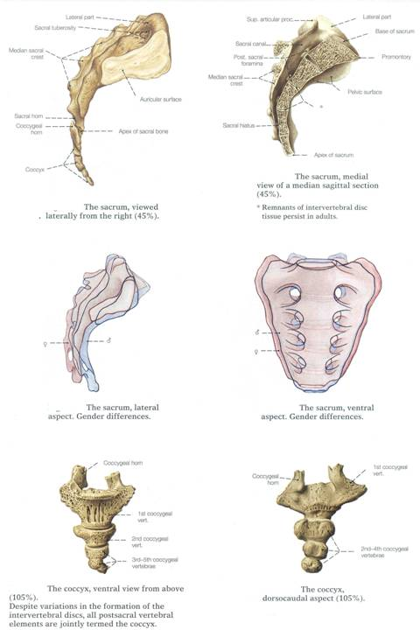

Slide 62
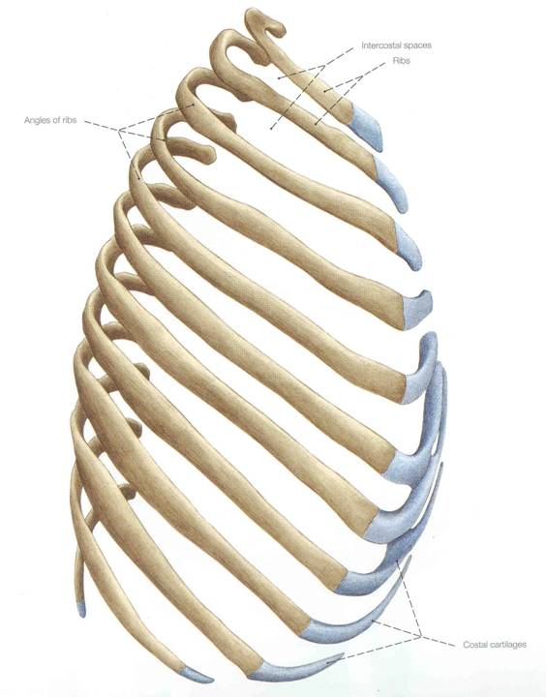

Slide 63
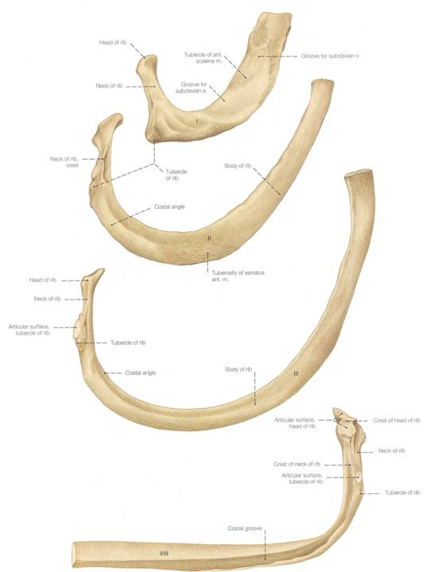

Slide 64
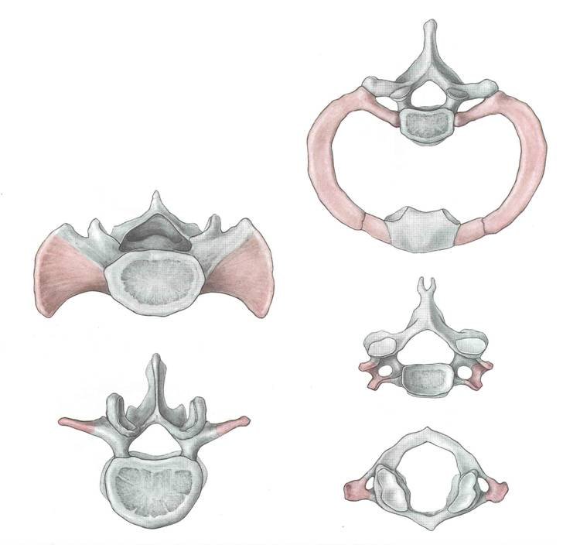

Slide 65
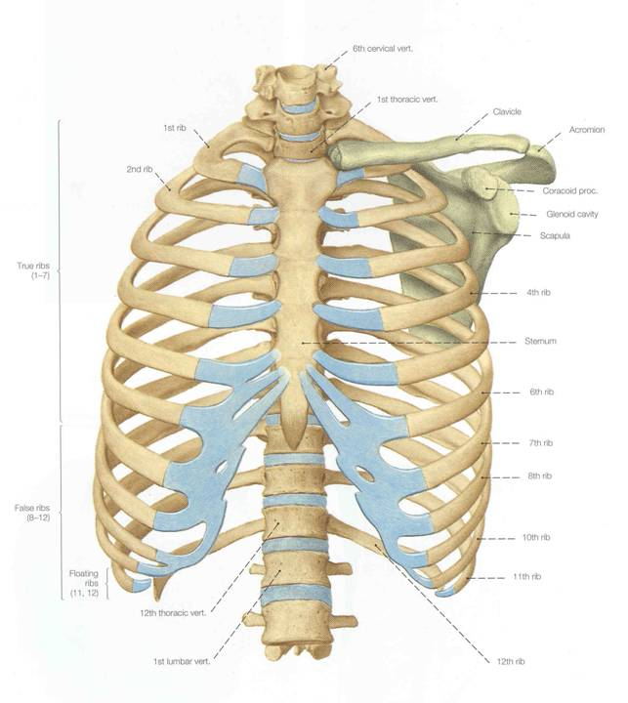

Slide 66
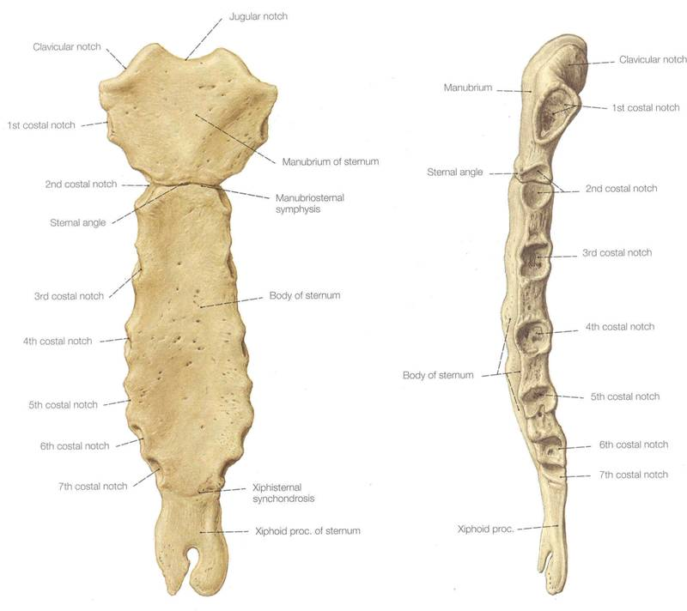

Slide 67
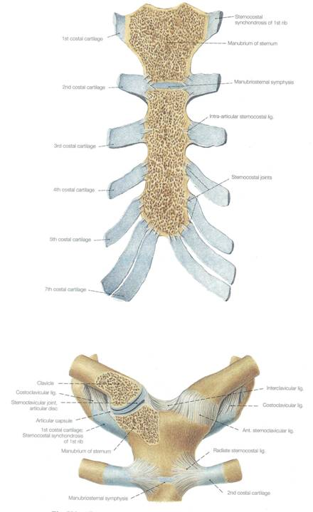

Slide 68
Functions of the Axial Skeleton
Support
Protection
Respiration

Slide 69
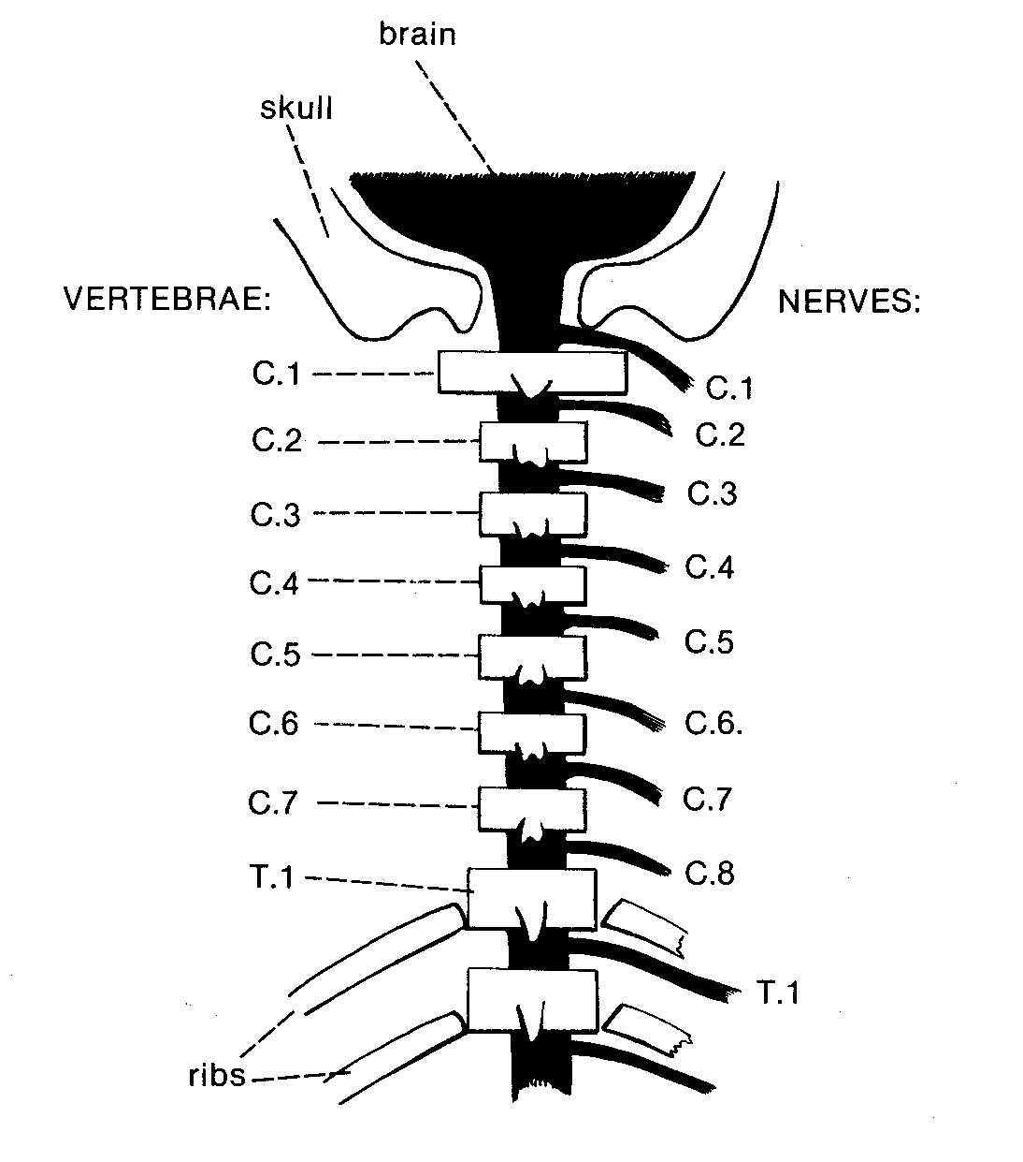
Characteristic number of vertebrae in each region
Segmental spinal nerves
Number system for the spinal nerves
(See pages 68-69 of your lab manual.)

