Slide 1
INTRODUCTION TO BASIC BIOLOGY OF BONE
Stuart S. Sumida
Biology 622
Winter 2011

Slide 2
Bone is classified as a type of connective tissue.
Bone
Cartilage
Fibrous connective tissue
Adipose tissue
Blood
With the exception of adipose tissue, each type of connective tissue is characterized by a distinctive cell type surrounded by relatively abundant extracellular matrix.
BONE is a specialized connective tissue in which calcium phosphate and other organic salts are deposited in the extracellular matrix by bone cells (OSTEOCYTES).

Slide 3
SKELETAL TISSUES
Bone is part of a spectrum of supporting tissues ranging from softer (more water and organic material; less inorganic material) to harder (less water and organic material; more inorganic material)
SOFTER
Cartilage
Calcified Cartilage
Bone
Dentin
Enamel
HARDER

Slide 4
BONE AT THE MOLECULAR LEVEL – I
At the simplest level, bone may be considered a composite material consisting of fibrous protein, collagen stiffened by a dense component of crystalline phosphate salts, polysaccharides, and in many but not all cases living cells and blood vessels.

Slide 5
BONE AT THE MOLECULAR LEVEL – II
Most texts refer to the collagen protein as “matrix”. Collagen is a structural protein is most if not all metazoan animals, but only in vertebrates does it undergo a complete transformation into mineralized skeletal material.
The crystalline material of bone is the apatite salt HYDROXYAPATITE:
Ca₁₀(PO₄)₆(OH)₂

Slide 6
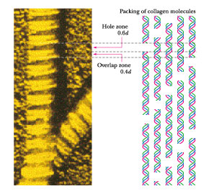
BONE AT THE MOLECULAR LEVEL – III
Collagen organization: The collagen of skin, tendon, dentin, and bone are “Type I” Collagen or Tropocollagen.
These long chain molecules line up in (single) files, and bond to parallel files adjacent to them.
Between each collagen molecule in series is a gap.

Slide 7
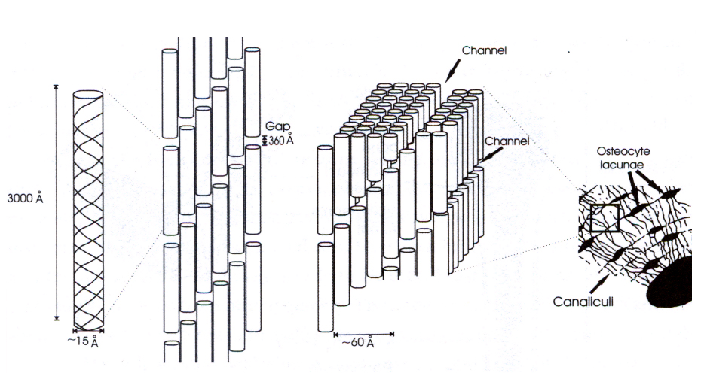
It is within these gaps that it is suggested that hydroxyapatite crystals reside. However, notably, Currey (2002) suggests this may not be correct – that there is not enough space in those gaps for the large hydroxyapatite crystals. Chinsamy-Turan accepts that the crystals line up parallel to the tropocollagen fibers.

Slide 8
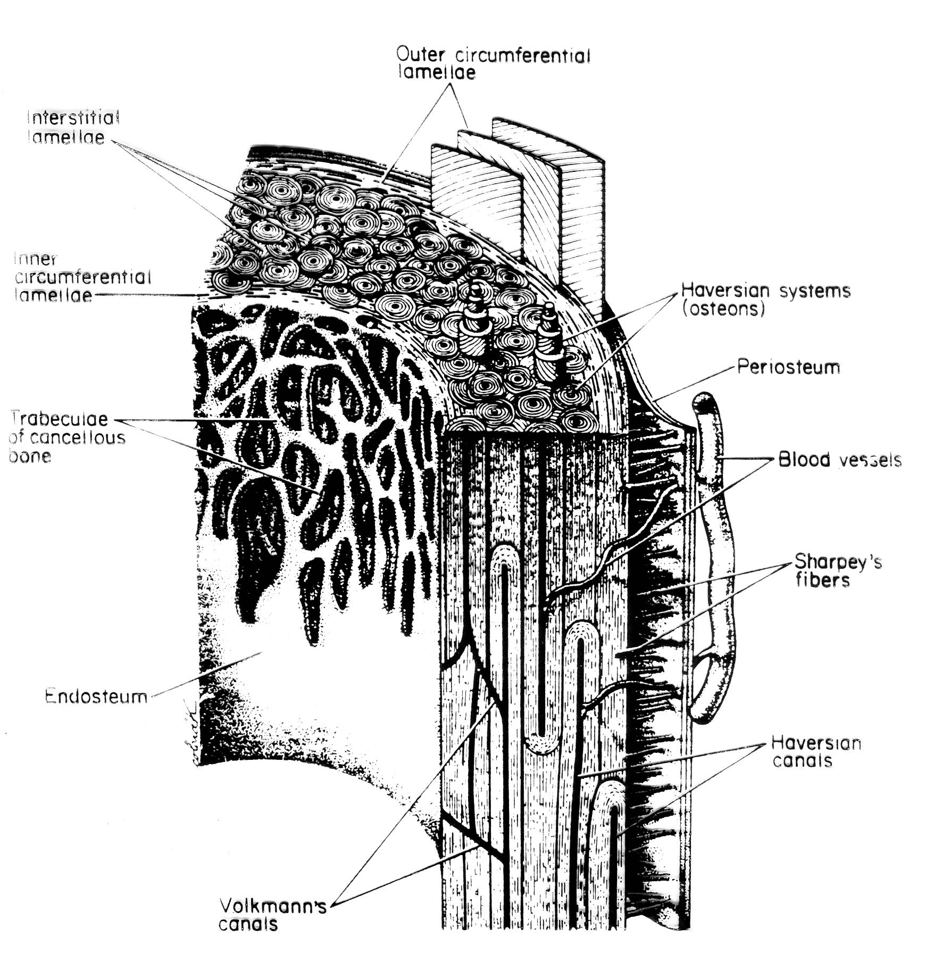
TYPES OF BONE CELLS – I
BONE-LINING CELLS – cover all surfaces of bones, inside and out, forming a thin continuous sheet that controls the movement of ions between body and bone
PERIOSTIUM – the layer of cells on the outside of a bone.
ENDOSTIUM – the layer of cells on the inside of a bone.

Slide 9
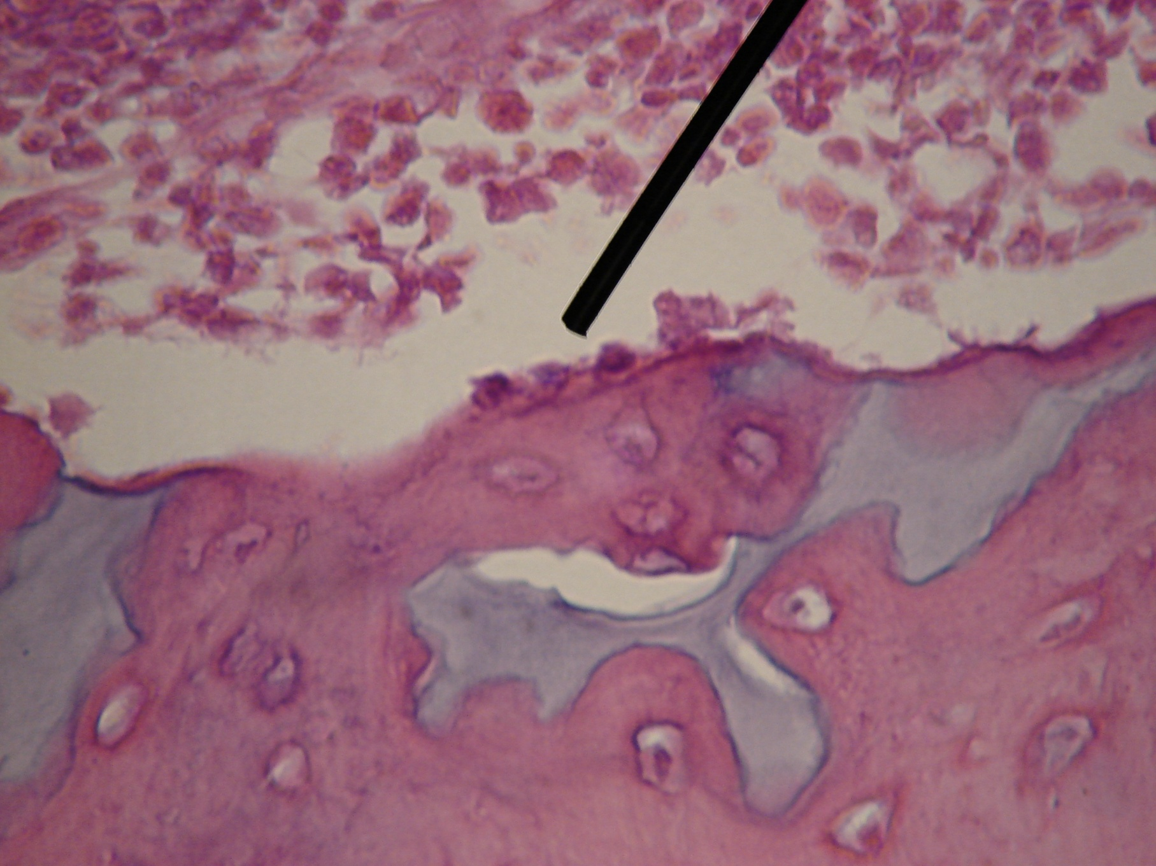
TYPES OF BONE CELLS – II
OSTEOBLASTS – derived from the bone-lining cells. Responsible for the actual formation of bone.
Lay down the collagen matrix.
Probably also have a role in its mineralization.

Slide 10
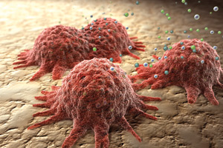
Computer generated image of osteoblast

Slide 11
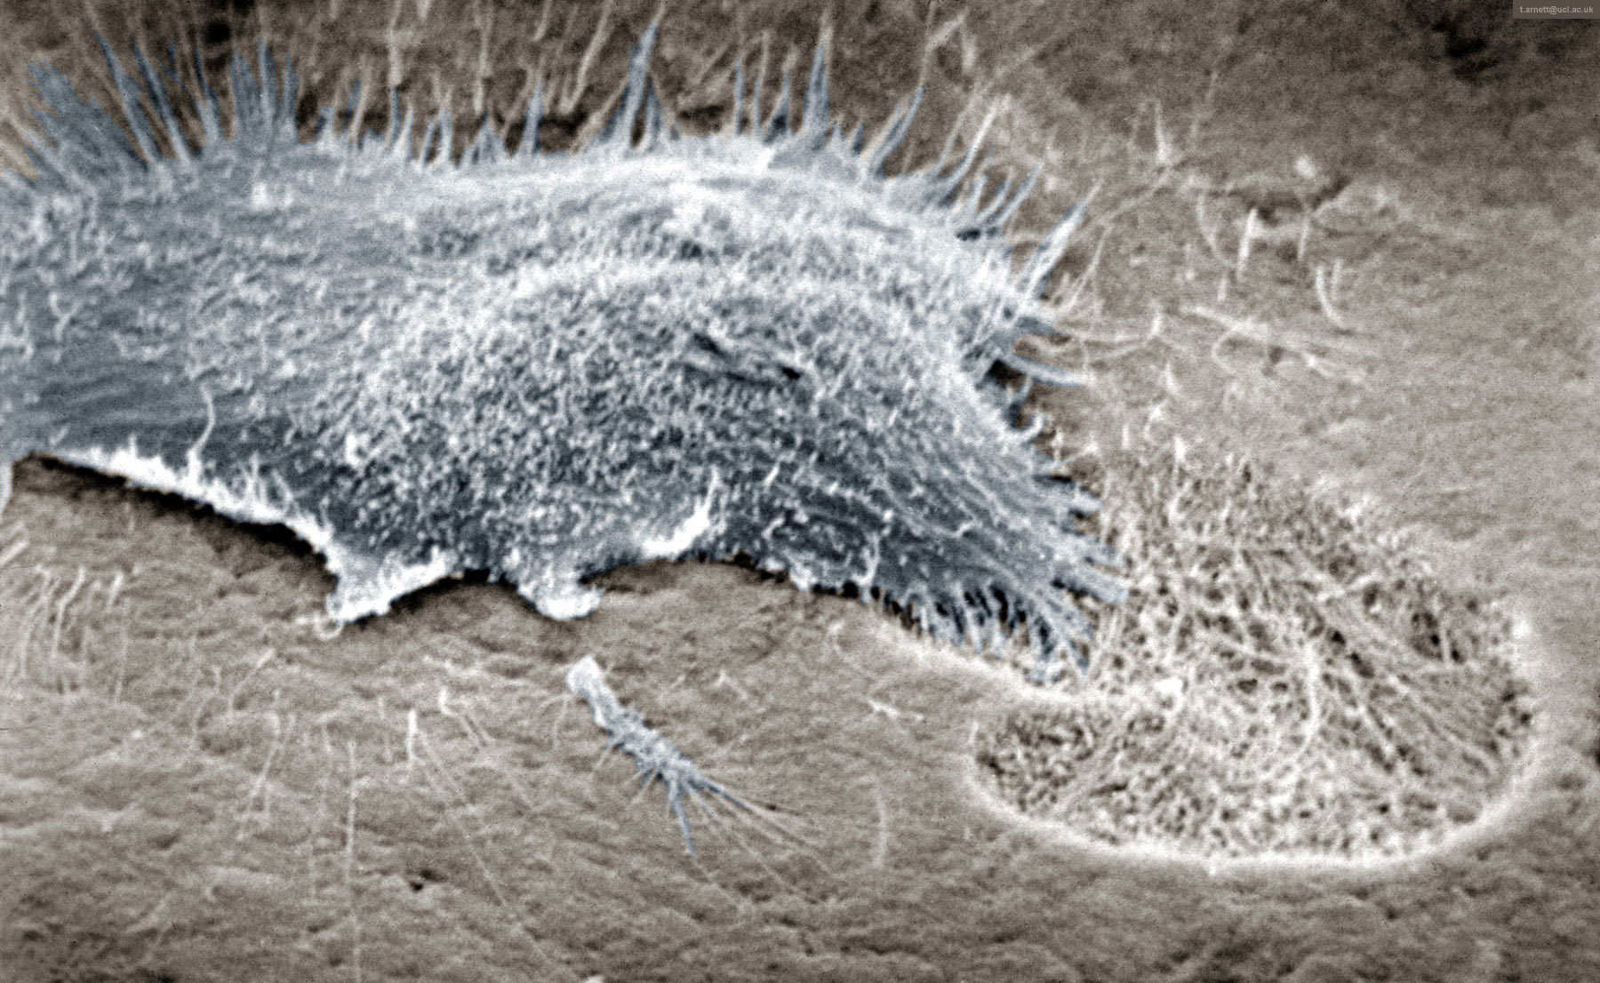
TYPES OF BONE CELLS – II
OSTEOCLASTS – bone destroying cells. Large, multinucleate.
Scanning electron micrograph showing osteoclast resorbing bone:

Slide 12
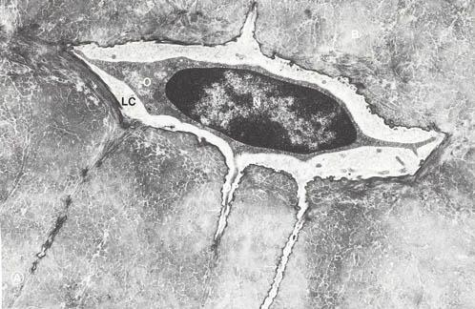
TYPES OF BONE CELLS – IV
OSTEOCYTES – cells in the body of the bone. They maintain the fully formed bone.

Slide 13
TYPES OF BONE – IA
WOVEN BONE
Woven bone is usually laid down very quickly; more than 4 µm/day.
Often found in fetal skeleton, in areas of bone repair, or very fast bone growth.
Collagen is variable in diameter and is oriented almost randomly.
As a result, though highly mineralized, there remain many mineral-free spaces, so the bone appears quite porous.

Slide 14
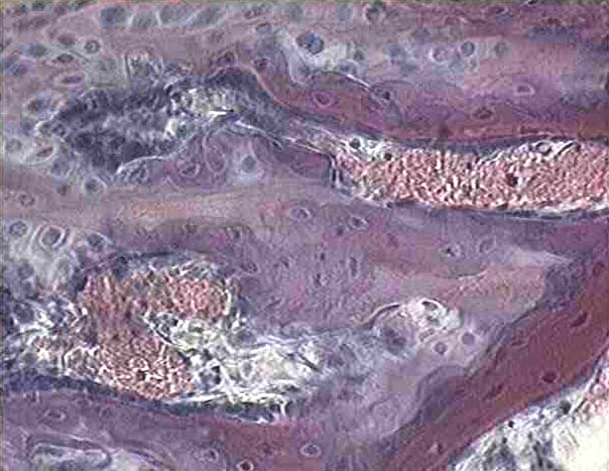
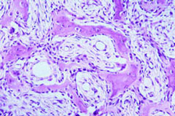
TYPES OF BONE – IB
WOVEN BONE
This image of a section from developing bone shows trabeculae of woven bone, which is characterized by lacunae occupied by osteocytes, and a basophilic ground substance that lacks a lamellar substructure. The woven bone is often associated with fragments of cartilage matrix, which are palely stained and cell-free. In a couple of places, pink-staining lamellar bone has been laid down on the surface of the woven bone. Note that the lacunae of lamellar bone are in parallel rows, whereas the lacunae of woven bone show no particular arrangement.

Slide 15
TYPES OF BONE – IIA
LAMELLAR BONE
Lamellar bone is laid down much more precisely than woven bone, and more slowly; less than 1 µm/day, and is typical of slow growing bone.
Collagen fibrils laid down in sheets.
Division between one lamella and the next appears to be abrupt under the light microscope.
The spaces in which osteocytes reside (LACUNAE) tend to be oblate spheroids, with the equatorial axis about five times greater than the polar axis.

Slide 16
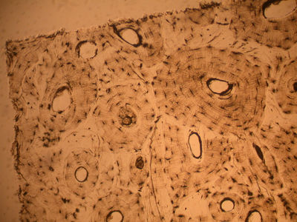
TYPES OF BONE – IIB
LAMELLAR BONE
Lameallar bone is typical around haversian systems.
The spaces in which osteocytes reside (LACUNAE) tend to be oblate spheroids, with the equatorial axis about five times greater than the polar axis.

Slide 18
TYPES OF BONE – IIIA
FIBROLAMELLAR BONE
Note: woven bone has a relatively loose structure and random orientation makes it almost certain that it is mechanically inferior to lamellar bone.
Thus, it is surprising, therefore, to ﬁnd woven bone as a characteristic feature of the mature bone of large dinosaurs, birds and mammals. This bone is known as ﬁbrolamellar bone (Francillon-Vieillot et al., 1990).
It is found particularly in large animals, whose bones have to grow quickly. If a bone has to grow faster than the rate at which lamellar bone can be laid down, other bone must be laid down instead. Essentially, an initial scaffolding of woven bone is laid down quickly to be ﬁlled in more leisurely with lamellar bone.

Slide 19
TYPES OF BONE – IIIB
FIBROLAMELLAR BONE
This method of construction results in alternating layers of woven bone and lamellar bone tissue wrapped around the whole bone.
Fibrolamellar (often known as ‘plexiform’) bone, which is primary, seems to be stronger, particularly when loaded along the grain, than Haversian bone which in many animals replaces it.

Slide 20
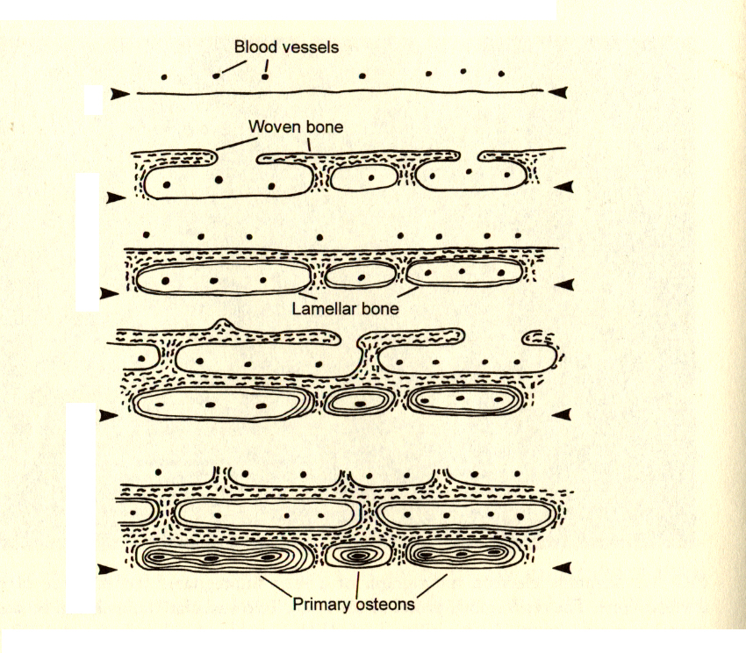
TYPES OF BONE – IIIC
THE FORMATION OF FIBROLAMELLAR BONE
Below is a series of cross-sections of the outer surface of a rapidly growing bone. The arrowheads show the position of the original surface of the bone. Blood vessels are indicated by black spots.
Original situation
Woven bone shown by squiggly lines. It grows very quickly to form a scaffolding clear of the original surface.
Lamellar bone shown by fine continuous lines starts to fill in the spaces.
As more lamellar bone is laid down, another scaffolding of woven bone is laid down.
The process continues, and by the time the first row of cavities if filled in, forming primary osteons, the outer surface of the bone is far away from the original surface.

Slide 21
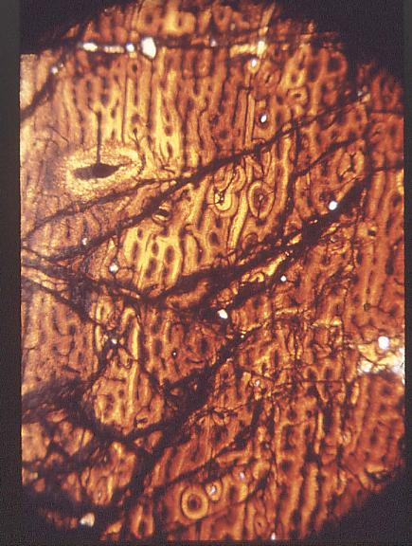
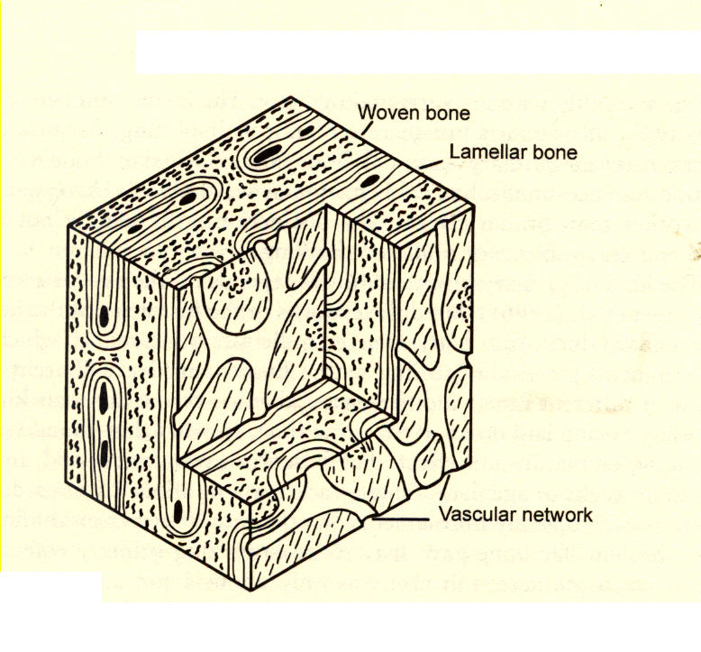

Slide 22
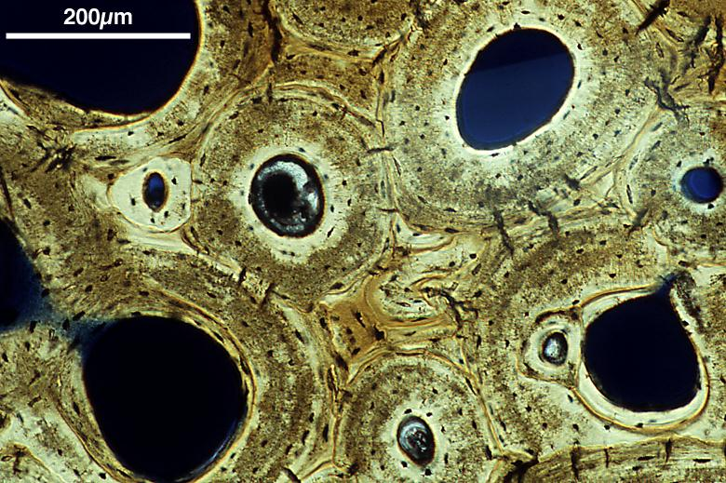
TYPES OF BONE – IVA
HAVERSIAN BONE
Haversian bone is system whereby a central canal is surrounded by a series of lamellae. It is the classic result of remodeling. The central canal contains blood vessels and nerves, and communicates with lacunae of concentric lamellae via tiny canals called canaliculi.

Slide 23
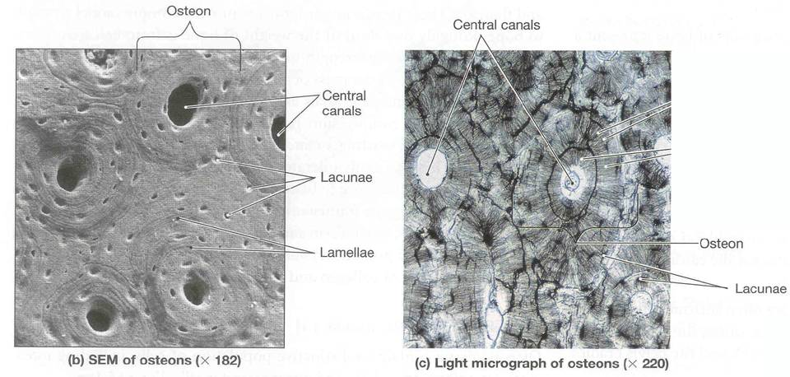

Slide 24
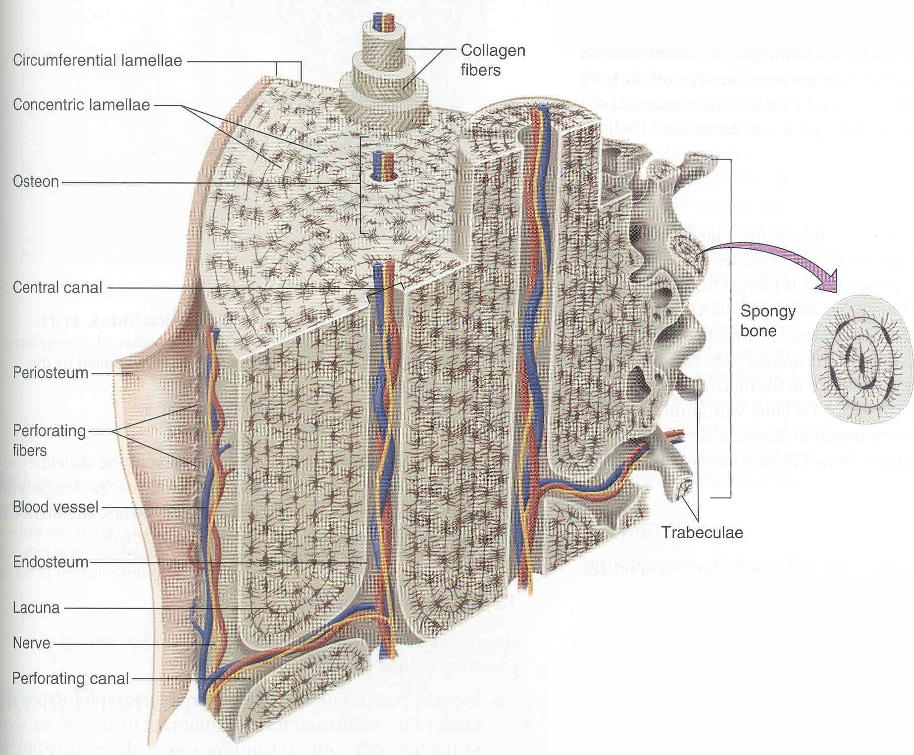

Slide 25
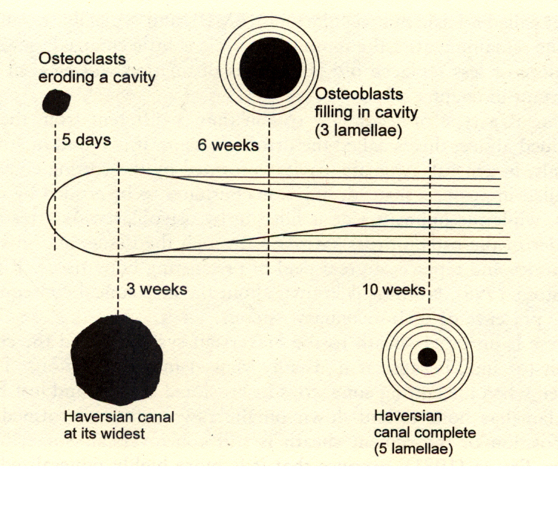
TYPES OF BONE – IVA
HAVERSIAN BONE
The formation of secondary osteons, or secondary Haversian systems:
Osteoclasts digest a cavity within bone tissue.
Following behind that, osteoblasts begin to lay concentric layers of lamellar bone within the excavated space.
Eventually the entire space except for the Haversian canal has replaced the excavated canal with a new Haversian system.

Slide 26
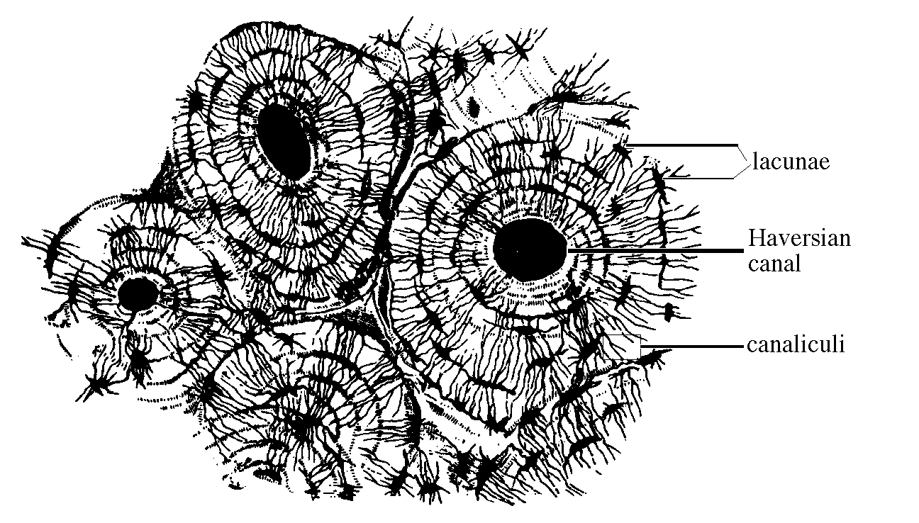

Slide 27
BONE DEVELOPMENT – I
TWO BASIC TYPE OF BONE DEVELOPMENT
INTRAMEMBRANOUS– bone develops directly from mesenchyme (loosely arranged embryonic connective tissue) without a cartilage precursor.
ENDOCHONDRAL – bone that originates initially as a small cartilage model before being replaced with bone.

Slide 28
BONE DEVELOPMENT – IIA
ENDOCONDRAL BONE DEVEOPMENT
Endochondral bone development involves formation of a cartilage model of the future bone from mesenchymal tissue and subsequent replacement of this cartilage model by bone tissue.

Slide 29
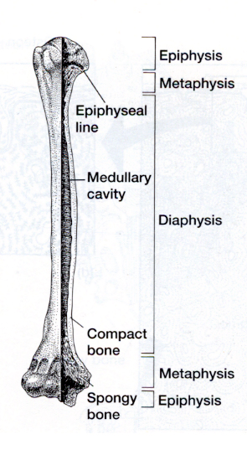
BONE DEVELOPMENT – IIB
ENDOCONDRAL BONE DEVEOPMENT
REGIONS OF DEVELOPING ENDOCHONDRAL BONES.
DIAPHYSIS – middle of shaft
EPIPHYSIS – ends of bone.
EPIPHYSEAL PLATE (“METAPHYSIS”) – region between diaphysis and epiphysis; area of most active cartilage growth and elongation.

Slide 30
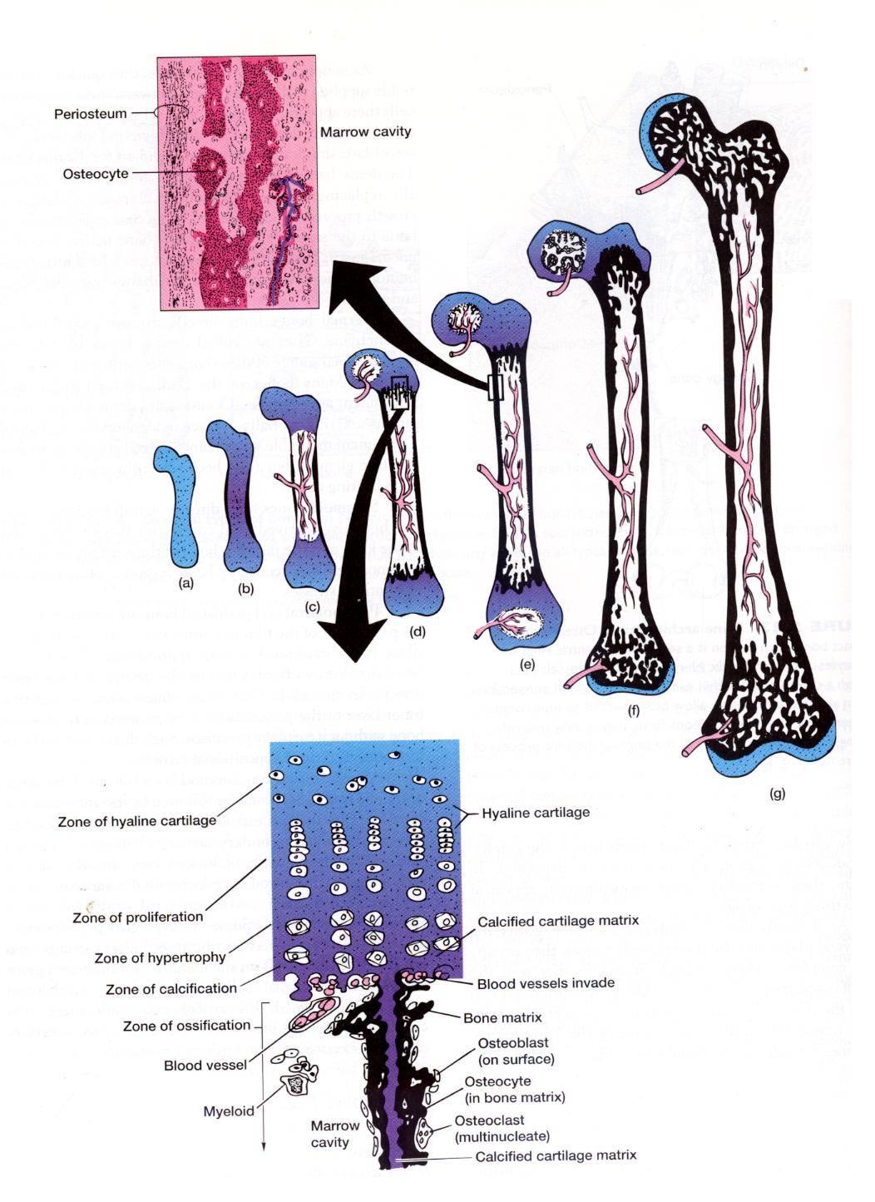
BONE DEVELOPMENT – IIC
STEPS IN ENDOCONDRAL BONE DEVEOPMENT
(A) Loose collections of mesenchymal cells for hyaline cartilage model of future bone surrounded by perichondrium.
(B) Periosteal bone collar forms in region of diaphysis. Cells on the inner surface of the diaphyseal perichondrium become osteoblasts and deposit the bone collar.
(C) As the bone collar is being formed, inorganic calcium salts accumulate in the matrix to calcify the matrix on the core of the diaphysis. These calcium salts also seal off chondrocytes from nutrition and gas-exchange. Entombed chondrocytes eventually die as calcification continues.

Slide 31
BONE DEVELOPMENT – IID
STEPS IN ENDOCONDRAL BONE DEVEOPMENT
(D) Vascular system invades calcified cartilage. These proliferating blood vessels erode away cartilage debris to form the initial spaces of the marrow cavity.
(E) Osteoblasts appear within the core of the bone, and the primary center of ossification is formed. Cartilage replacement – initiated in the diaphysis – continues in the metapysis, also known as the epiphyseal plate. The epiphyseal plate is the active area of cartilage growth, and will continue to grow until the individual stops growing in length/height. Proliferation of cartilage in the epiphyseal plate lengthens bone.

Slide 32
BONE DEVELOPMENT – IIE
STEPS IN ENDOCONDRAL BONE DEVEOPMENT
(F) In amniotes (mammals, some reptiles, and birds), secondary centers of ossification arise in the epiphyses (following a similar sequence of events as in the diaphysis).
(G) At or shortly after sexual maturity of mammals and some others, the epiphyseal plates ossify completely. Thus, there can be no more bone elongation. (However, active remodeling and reorganization [including healing of breaks] may take place throughout the remainder of life.)

Slide 33
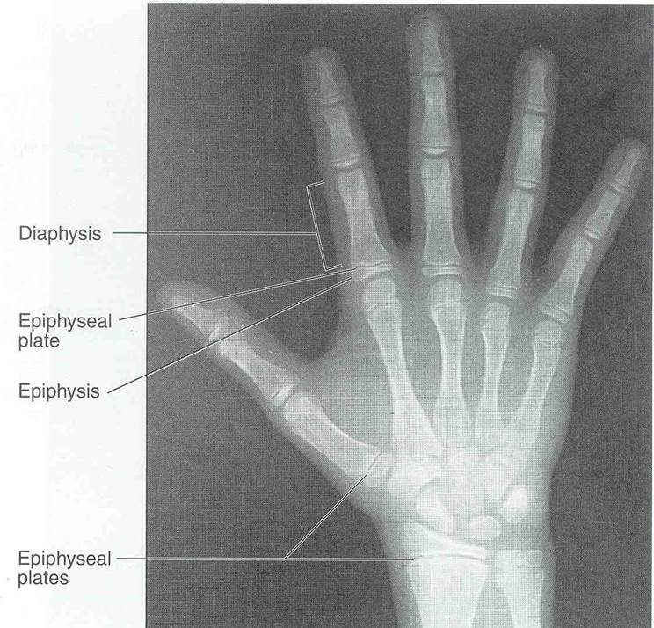

Slide 34
BONE DEVELOPMENT – IIIA
STEPS IN INTRAMEMBRANOUS BONE DEVEOPMENT
Intramembranous bone develops directly from mesenchyme without a cartilage precursor.

Slide 35
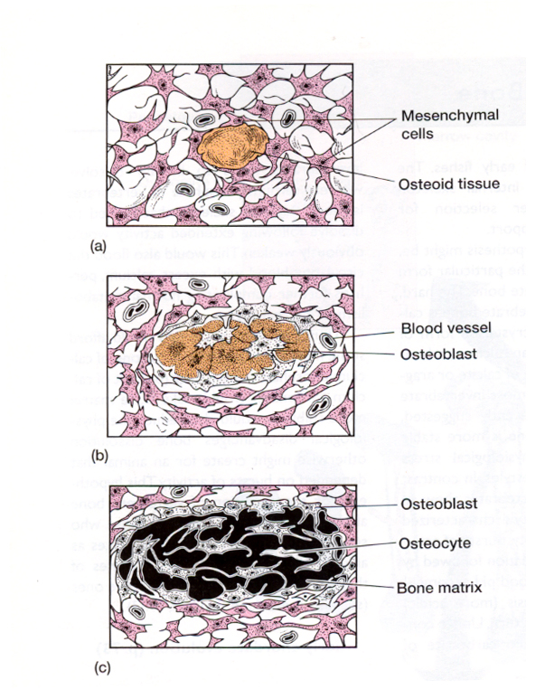
BONE DEVELOPMENT – IIIB
STEPS IN INTRAMEMBRANOUS BONE DEVEOPMENT
Intramembranous bone develops directly from mesenchyme without a cartilage precursor.
Mesenchyme cells condense, then become quickly supplied with blood vessels.
Between these compacted cells a gel-like ground matrix appears.
Dense bars of bone matrix are deposited in the ground substance and osteoblasts appear.
The dense bars of bone become more numerous; eventually replace the gel-like ground substance.
Subsequent growth proceeds by the formation of successive layers of new bone to the existing bone matrix bars.

Slide 36
BONE DEVELOPMENT – IIIC
TYPES OF INTRAMEMBRANOUS BONE
DERMAL – form directly through ossification of mesenchyme. Called dermal because source of mesenchyme is dermis of skin.
SESAMOID – form within tendons, which are themselves derived from connective tissue.
PERICHONDRAL and PERIOSTEAL BONE – formed from the deep cell layer of the fibrous layer covering cartilage or bone respectively.

Slide 37
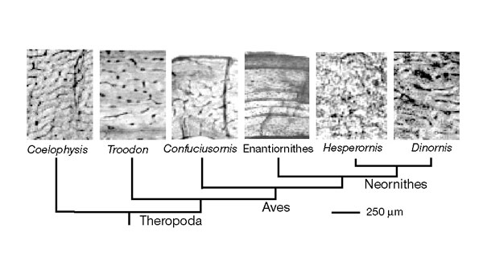
Padian et al. (2001) Primitive condition in small carnivorous dinosaurs: fibrolamellar bone
They see evidence of fibrolamellar bone, indicative of fast bone depostion, and presumably therefor of fast overall growth rate, all the way through lineage to primitive birds.

Slide 38
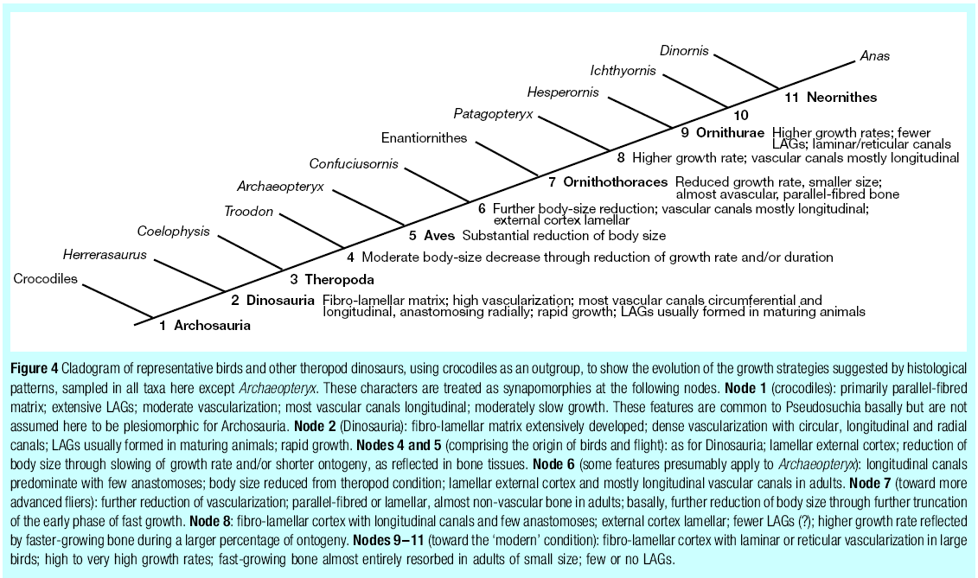
From: Padian et al. 2001.

Slide 39
Bone Function
Structural
Red blood cell manufacture
Homeopoietic tissue
Red bone marrow vs. yellow bone marrow
Mineral regulation
Calcium levels
Importance of phosphorus

Slide 40
REFERENCES
Curry, J. D. 2002. Bones – Structure and Mechanics. Princeton University Press. 436 pages.
Padian, K., A. de Ricqlés, and J. R. Horner. 2001. Dinosaurian growth rates and bird origins. Nature, 412:405-408
Useful images:
http://www.brsoc.org.uk/gallery/index.htm

