Slide 1
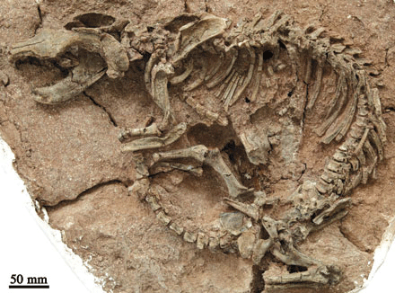
Unraveling Dinosaur Bones

Slide 2
Overview of Topics
Upon Death of Dinosaur
Changes in Bone Composition during Fossilization: Garland’s Categories
Organic Matter in Dinosaur Bones
Soft Tissue Preservation in Dinosaurs

Slide 3
What is Taphonomy?
Taphonomy: “is the science of the laws of embedding or burial… the study of the transition, in all details, of organics from the biosphere into the lithosphere or geological record.” Vertebrate Taphonomy pg 1
“Considers all the natural processes of preservation and destruction of the remains of organisms, from death to burial and to its ultimate collection.” pg 6

Slide 4
Upon Death of a Dinosaur
The taphonomic history of a bone begins at the moment of death to discovery and collection of that bone.

Slide 6
Taphonomy
Type of taphonomic processes that affect the animal include:
Morphology
Behavior Pattern
Life History
Ecology
How and where it died

Slide 7
Taphonomy
Why is knowing the taphonomic history important to a paleontologist?

Slide 8
Death and Fossilization
For an animal to become fossilized a suite of conditions must be met.
Knowing the circumstances of death and the environment are very important.

Slide 9
Conditions for Fossilization
The most important condition that must be met is a fast burial.
Why is this the most important condition?
Mechanisms of fast burial: mudslides, volcanic ash fall, and flood.

Slide 10
Conditions for Fossilization

Slide 11
Death and Fossilization
How a dinosaur dies is very important.
Predation is seen in the fossil record by dismemberment, and dissociation of the skeleton and also by tooth marks and puncture wounds left on the bone.

Slide 12
After Burial
The environment the bone is buried in is an important factor in the process of fossilization.

Slide 13
Diagenesis
Process of mineralization of bone.
Both intrinsic and extrinsic factors affect diagenesis.
Intrinsic: size, porosity, chemical and molecular structure of specimen.
Extrinsic: sediment pH, water and temperature regimes, and bacterial action of environment.

Slide 14
Changes in Bone Composition during Fossilization
During the process of fossilization bones can suffer compression, distortion, and fragmentation.
Other bones are not as altered and retain overall anatomy, bone structure, muscle scars, and pathologies.

Slide 15
Changes in Bone
Mechanical and physical properties of bone affect taphonomic processes.
Bone fractures are influenced by the amount and distribution of osteons and collagen fibers.

Slide 16
Internal changes of Bone
Most of the organic materials of bone decompose soon after burial.
The inorganic fraction, hydroxyapatite, is preserved with only slight modification.
The hydroxyl group is usually replaced with a fluorine.

Slide 17
Modern analogues help us to understand ancient bones
The use of modern animals helps shed light into taphonomic history.
Behrensmeyer study of microscopic and macroscopic changes during the early stages of taphonomic history.

Slide 18
Important Findings
Space that was filled with organic materials is usually secondarily filled after decomposition of the organic materials.
Hypothesized that areas are filled by apatite biogenic seed crystals.

Slide 19
Diagenic Changes

Slide 20
Changes to Bones
Significant changes occur during fossilization.
Martill: looks at within bone tissue, within pore space, and within the sediment around the bone.
Garland: looks at normal bone, destructive bone, inclusions and infiltrations.

Slide 21
Normal Bone vs. Destructive Changes in Bone
Normal Bone: mineral infilling pore spaces but nature of tissue is unaltered.
Destructive Changes: disintegration, disaggregation, and disassociation of osteons.

Slide 22
Why is there destruction in some and not in others?
Some scientists have suggested that for a bone to survive, bioerosion must be prevented or halted.
Bioerosion, carried out by microbes, occurs soon after death and can lead to the total destruction of the bone.

Slide 23
Inclusions in Fossil Bone
Inclusions: external material found within the open space in the bone.
Can be biologically derived like plant material or a mineral.

Slide 24
Destructive Inclusions
Microorganisms can cause extensive damage to bones.
Tissue alterations include destruction and tunneling of the cortex and mineral redisposition.
How does this affect the examination of bones?

Slide 25
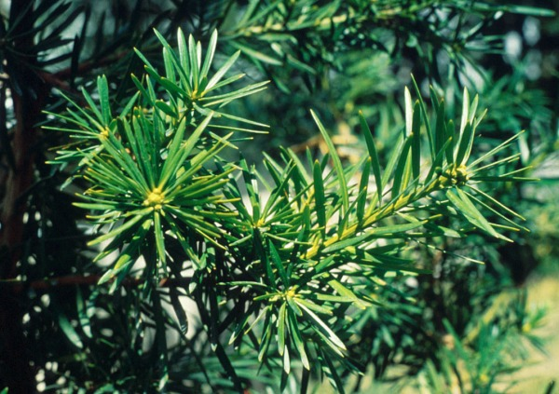
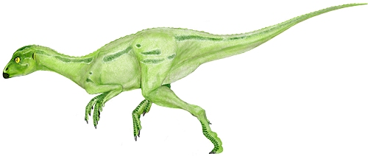

Slide 26
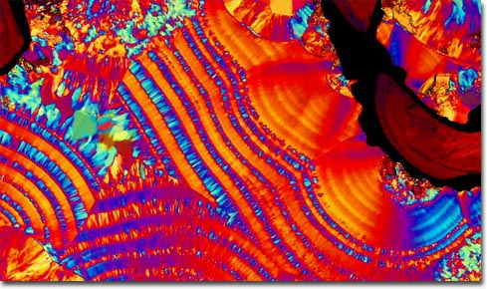
Inorganic Inclusions

Slide 27
Infiltrations in Fossil Bones
Infiltrations: “extraneous material within the bone substance itself.”
Elements usually incorporated into apatite: barium, sodium, lead, strontium, and zinc.

Slide 28
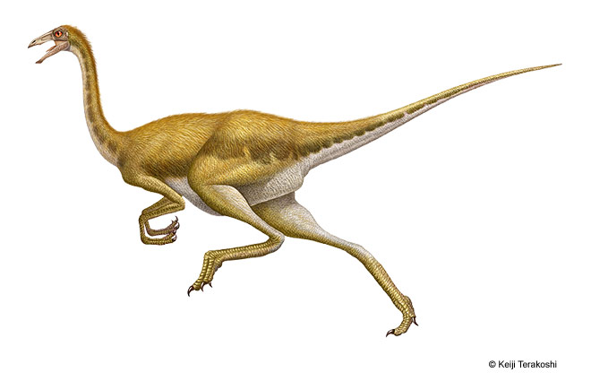
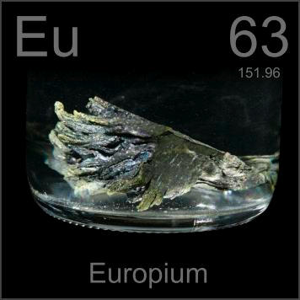
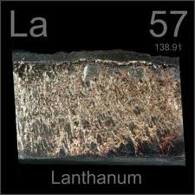
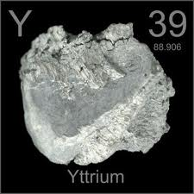
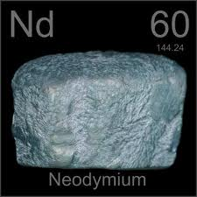

Slide 29
Infiltrations
Infiltrations can be important in establishing provenance.
Infiltrations may signal the early depositional environment.
Bones fossilized together should all contain the same trace elements.

Slide 30
Iron in Bone
There has been debate about the origin of iron found in bone.
Two possible sources: iron from the environment or possibly from the blood that was in the bone at time of death.
Author believes that iron is from environment.

Slide 31
Possible RBC? No, Pyrite framboid.

Slide 32
Organic Matter in Dinosaur Bone
While most organic matter decomposes there have been cases on bones that contain proteins and fatty acids.

Slide 33
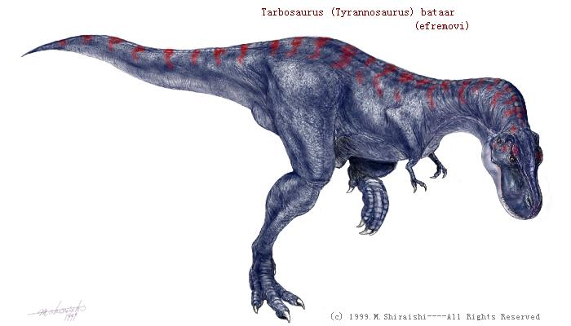
Glycoprotein

Slide 34
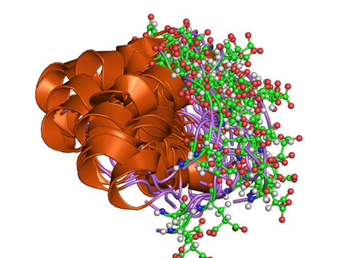
Osteocalcin

Slide 35
DNA extraction?
Phylogenies based on molecular data are much more accurate than phylogenies based on morphology.
It is thought that DNA would not last more than 10,000 to 100,000 years and therefore would not be found in any dinosaur bones.
Others believe that under exceptional conditions it is possible that DNA could remain.

Slide 36
Problems with Ancient DNA
Only small pieces of DNA recovered.
Contamination is a problem.
Inclusions could alter the DNA sequences.

Slide 37
Soft Tissue Preservation in Dinosaurs
In some exceptional circumstances soft tissue can remain to be fossilized.
Both desiccation and freezing can lead to the preservation of soft tissue.
Putrefaction, the bacterial breakdown of protein under anaerobic conditions, must be inhibited.

Slide 38
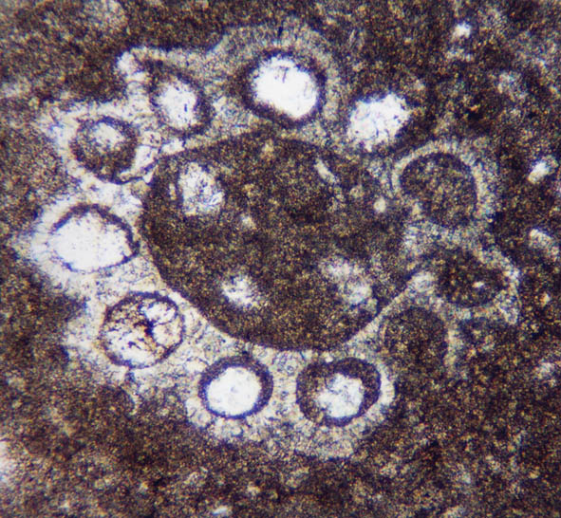
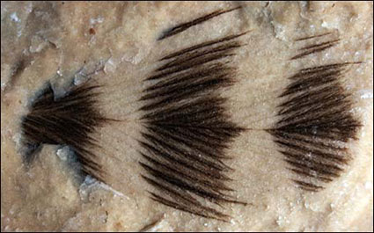
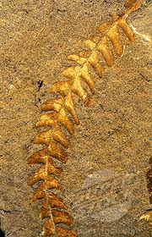
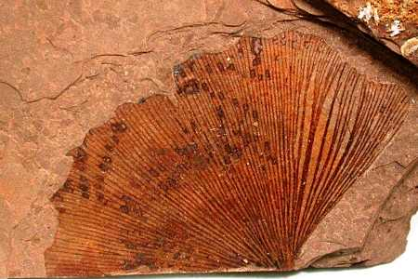
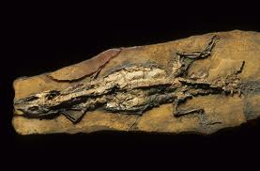
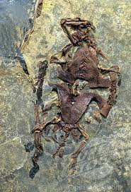

Slide 39
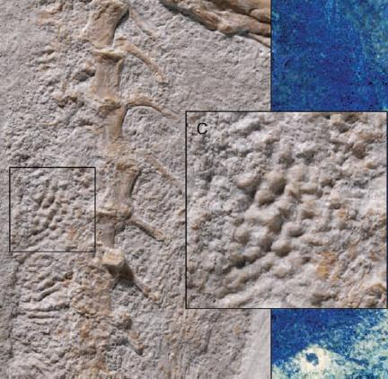
Pelecanimimus polydon

Slide 40
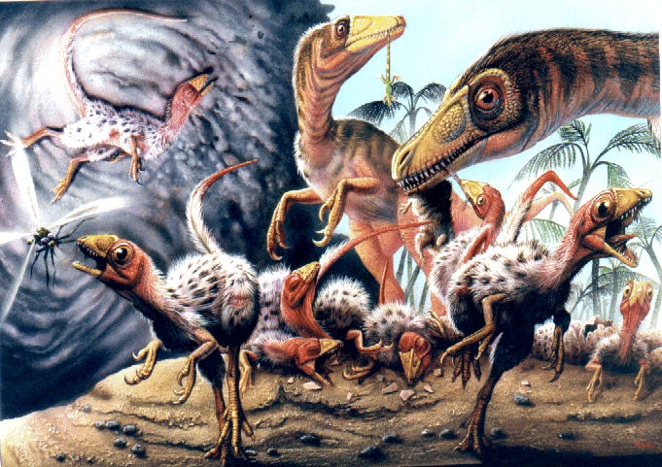
Scipionyx samniticus

Slide 41
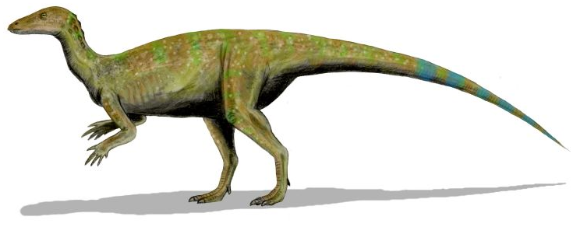
Thescelosaurus Heart?

Slide 42
Conclusions
Knowing the taphonomic history is critical for the study of dinosaur bones.
Many factors affect the fossilization process including biotic and abiotic factors.

Slide 43
Final Exam Question
Taphonomy is the science of fossilization and considers the natural processes of preservation and destruction of the remains of organisms, from death to burial and to its ultimate collection. What biotic and abiotic forces affect fossilization? How is knowing the taphonomic history pertinent to the field of paleontology?

