Slide 1
From Bone Microstructure to Biology
Chapter 3

Slide 2
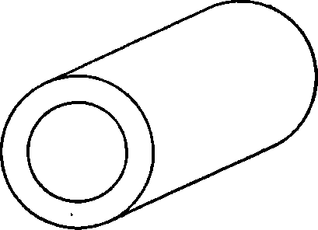
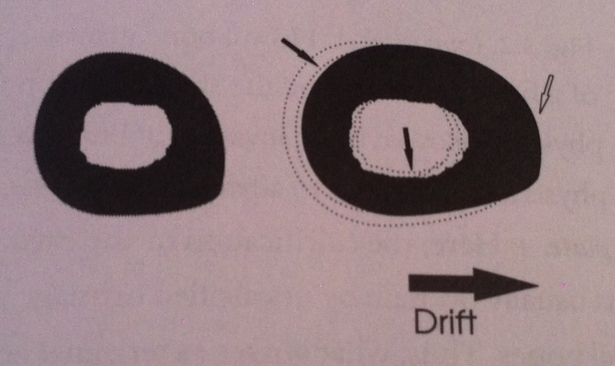
Bone Terminology
Periosteal surface
Endosteal surface
Drift- growth of one surface involves removal of bone from the contralateral surface

Slide 3
Types of Bone
Woven Bone
Lamellar Bone
Fibrolamellar Bone
Haversian Bone

Slide 4
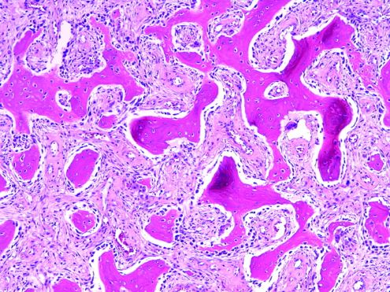
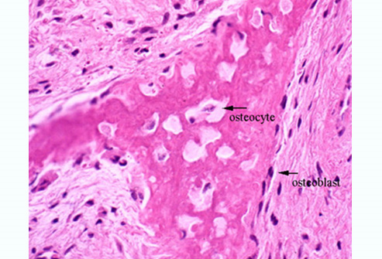
Woven Bone- fast deposition
Found in fetal skeleton, areas of bone repair, or fast bone growth
Porous
Lamellar Bone- lower deposition rate, but more organized
Osteocytes reside in lamellar bone within the lacunae

Slide 5
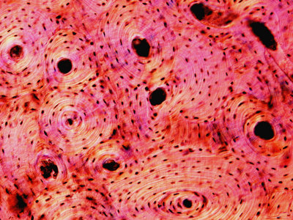
Fibrolamellar Bone- speed and characteristics intermediate to woven and lamellar bone
Builds scaffolds quickly, then layer lamellar bone: alternating layer patterns
Haversian Bone- also known as Primary and Secondary Osteon
Central canal surrounded by series of lamellae
Canal carries arteries, nerves, and communicates with lacunae of concentric rings

Slide 6
Woven Bone
Lamellar Bone
Fibrolamellar Bone
Haversian Bone

Slide 7
Osteons
Bone tissue containing blood vessels surrounded by concentric rings of bone is called an osteon
Primary Osteon- formed by mineralization of cartilage, thus forming where bone is not present
Secondary Osteon- results from bone remodeling (osteoclast resorption, osteoblast deposition)

Slide 8
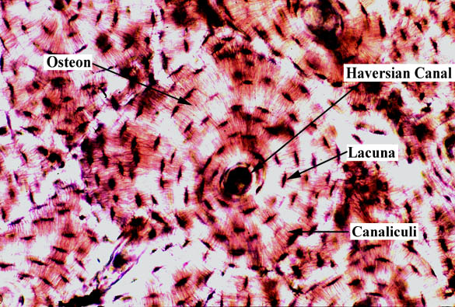
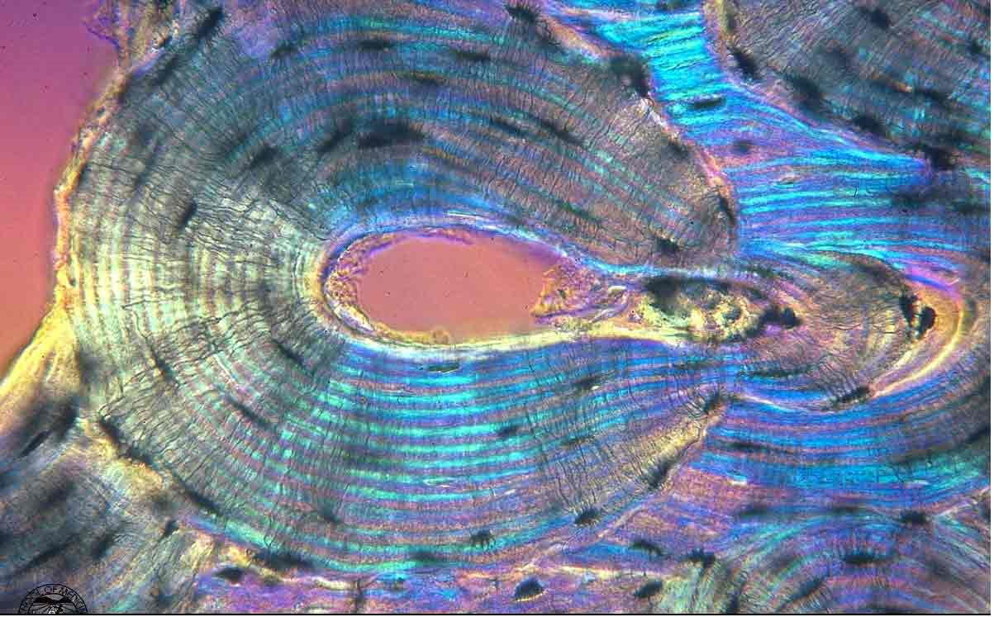
Primary Osteon
Haversian Canal- carries vessels and nerves
Lamellae- concentric rings made by collagen patterns
Lacuna- osteocytes reside, turn over of bony matrix
Canaliculi- link lacunae
Cement- outer perimeter of an osteon
Secondary Osteon
Results from bone remodeling (osteoclast resorption, osteoblast deposition)

Slide 9
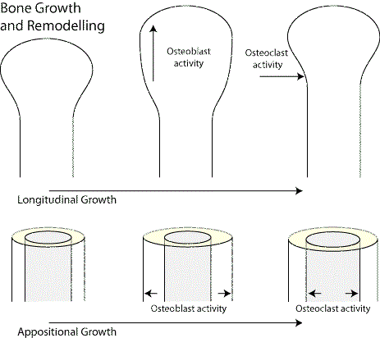
Bone Growth
Cancellous Bone
Synonymous for spongy bone
Metaphyseal Remodeling Metaphyseal region decreases in diameter and incorporates into the long bone during growth
- Produces distinct cortex stratification (layering)

Slide 10
Stages in Endochondral Ossification

Slide 11
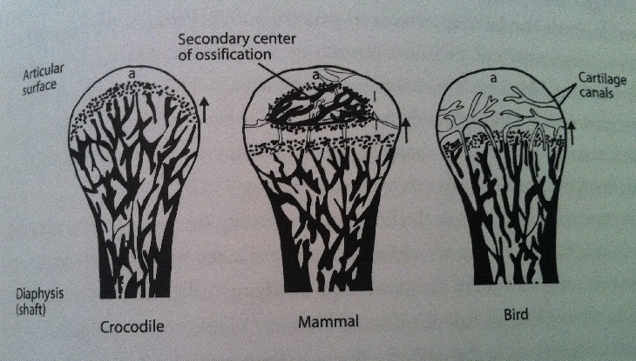
Long Bone Growth Strategies
Bone length limited by secondary center of ossification
Can grow in length indefinitely

Slide 12
Stratified Cortex Produced by…
Metaphyseal reduction and reversal
Cortical drift
Tubercle formation
Secondary reconstruction (resorption and redeposition of bone)
* Different parts of the same bone can have very different patterns

Slide 13
Cortical Stratification Example
Indications:
Compacted coarse spongy bone: Tissue was produced during endosteal growth and was once located near the ends of the bone
Inner circumferential lamellae in bone cross section: Formed in the absence of spongy bone resulting from metaphyseal and diaphyseal remodeling

Slide 14
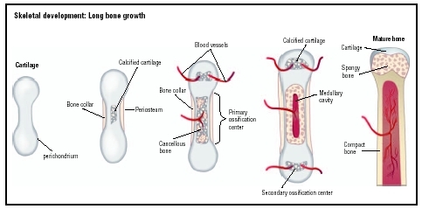
Femoral Growth in Length
Cartilage formation
Osteoblasts deposit bone over the cartilage surface
Calcification of inner shaft, chondroclast resorb cartilage and vessels invade the cavity
Osteoblast line cavity with bone
Process continues along shaft
Mammalian Femur
Bones thicken via periosteal bone production
Bones lengthen via terminal cartilage growth

Slide 15
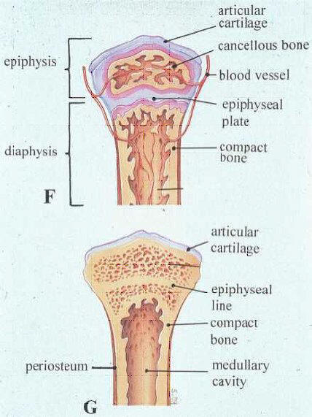
Mammalian Femur Growth
2 ossification centers:
Diaphysis
Spongy Bone
Contact of the two inhibits further growth

Slide 16
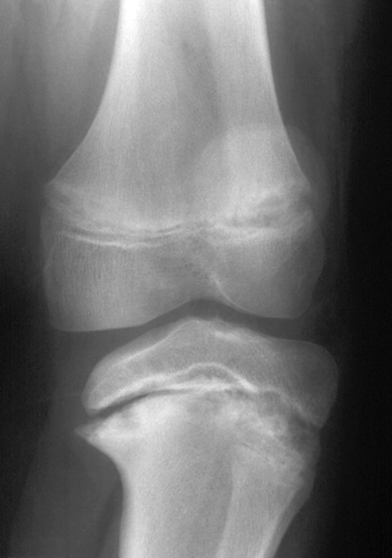
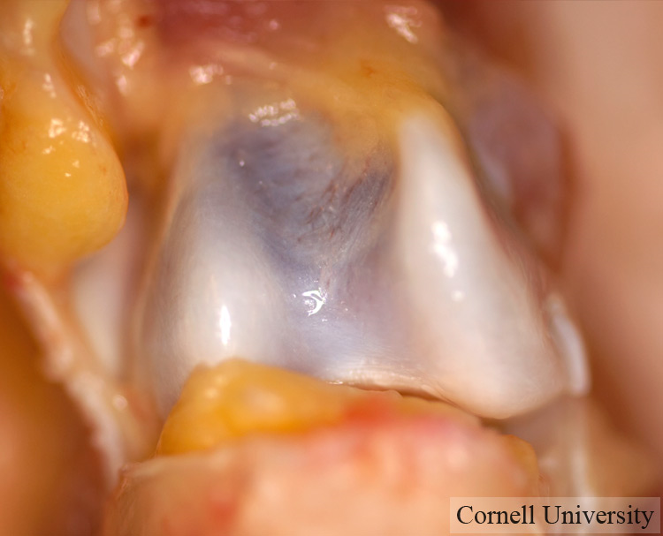
Cartilaginous regions usually degrade and don’t get preserved

Slide 17
Amprino’s Hypothesis
Italian scientist Amprino proposed that differences in bone tissue types reflect variations in bone depositional rates
Slow rate of bone formation results lamellar bone matrix- ordered arrangement of collagen fibers and osteocytes
Fast rate results in fibrolamellar bone tissue in which collagen fibers are haphazardly arranged and forms woven bone matrix.
Randomly distributed globular osteocytes and numerous entrapped blood vessels
Lamellar bone is eventually formed around each blood vessel to produce primary osteons

Slide 18
Rate of Bone Formation
Although organic components (collagen, osteocytes, and vessels) are not preserved, arrangement of crystals of the bone mineral is preserved
Bone mineral arrangement follows the organization of collagen matrix
Permits deduction about the type of bone tissue that was present
Inference about qualitative rate of bone formation
Fossil bones preserve canaliculi, lacunae, and cavities

Slide 19
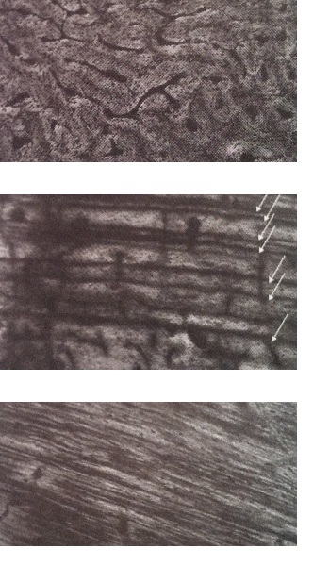
Fibrolamellar bone
Lamellar bone with lines of arrested growth
Endosteally lamellated bone tissue

Slide 20
Quantitative information about the rate of bone formation: Fluorescent labeling using fluorochrome stains
Binds to newly formed bone
Used to determine where and how much bone was deposited
Different color stains to demarcate duration of differing periods of growth- quantification of bone deposition rate

Slide 21
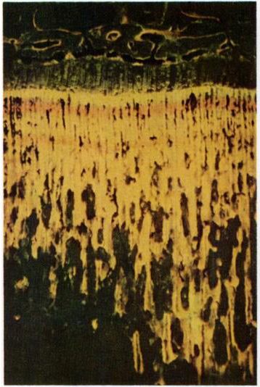
Fluorochrome Staining
Labeled in order:
Tetracyclin
Hematoporphyrine
DCAF
Tibial Metaphyseal Bone

Slide 22
Cyclical vs Noncyclical Growth
Structure of primary compact bone provides direct assessment of whether bone deposition was continuous or interrupted
Cyclic- interrupted growth
Non-cyclic- continuous growth

Slide 23
Cyclical Rates
Distinct growth rings or alternating bands of tissue types
This tissue type is termed zonal bone and the resulting bands of tissue are the zones and annuli
Zones more vascularized, represents fast growth
Poorly vascularized annuli (usually lamellar bone) represents periods of slower growth
Pauses in bone growth are called Lines of Arrested Growth (LAG)

Slide 24
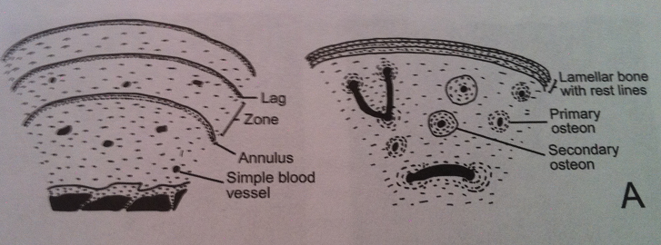
Cyclical vs Noncyclical Growth
Cyclic (interrupted)
Noncyclic (continuous)
Counting zones and annuli to estimate the organism’s age is called Skeletochronology

Slide 25
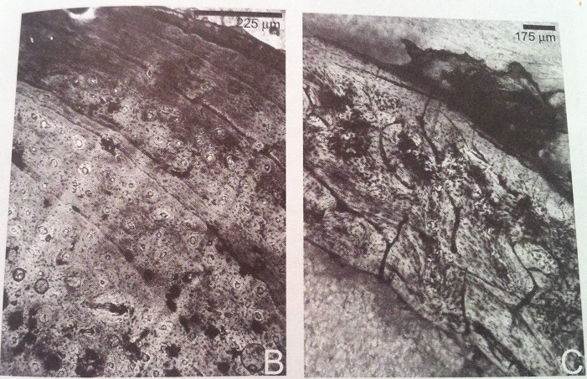

Slide 26
Bone Growth Rings
Reptiles generally have one single zone and annulus per year
Zones form during warmer months
Annulus form during unfavorable periods
Skeletochronology- age estimate
Dye patterns reveal seasonally related bone deposition
Spacing between rings become closer after sexual maturity
Estimates age of maturity

Slide 27
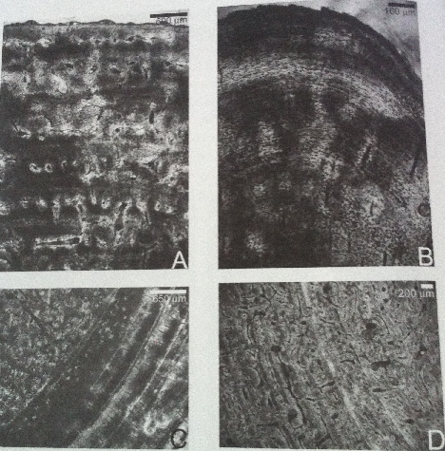
Zonal Bones
Alligator
Monitor Lizard
Kangaroo
Polar Bear

Slide 28
Growth Rings in Mammals
Unlike zonal bone formed in compact bone of reptiles, the “recording” part of the bone is the periosteal zone (outermost region of the coritcal bone)
Formed when overall body growth rate slowed down
Juvenile mammals have highly vascularized bone without any interruptions in the rate of growth
Later in ontogeny, mammals begin depositing dense bone periosteally and can form rest lines in this region
Only periosteal zone of compact bone is a recording structure of growth
Estimation of age requires correction factor

Slide 29
Zonal Bones
Alligator
Monitor Lizard
Kangaroo
Polar Bear

Slide 30
Complications
Mammal skeletochronology
Some mammals have periosteal bone without rest lines
Fast growing mammals
Periosteal bone is not considered good for age determination since it persists for a limited time only
Structure for recording growth is mainly cementum and dentine of teeth

Slide 31
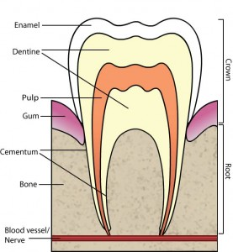
Cementum is regarded as best for skeletochronology since it forms during entire of the animal and unaffected by remodeling and reconstruction
Dentine forms only until pulp caivty is filled
Affected by seasonal, intraseasonal, and daily changes in growth rate and calcification
Cementum > Dentine

Slide 32
Noncyclical Bone Formation
Sustained, uninterrupted bone formation results in lack of zonation in the compacta
Indicates bone deposition was rapid and noncyclical
Tissue comprising the compacta can be entirely of fibrolamellar bone or can grade into a parallel-fibered or lamellar type of tissue
Fibrolamellar correlates with rapid growth

Slide 33
Bone Vascularization
Vascular bones have a network of blood vessels
Armand de Ricqles equated channels to be occupied fully by vascularization, which is wrong
Nerves and connective tissues also
Shape of cavity bore no resemblance to shape of blood vessels within
Avascularized bones have osteocytes developing a more extensive system of intercommunicating canaliculi (probably compensating for lack of blood vessels)

Slide 34
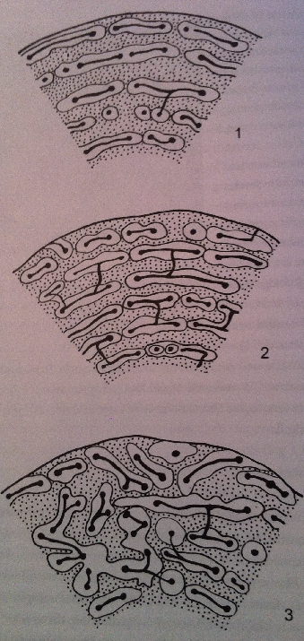
Types of Fibrolamellar Tissue
Laminar bone- bone formed in the periosteal region
Concentric channels around the cortex
Plexiform bone- rapid depositional bone with increased mechanical support
Concentric channel with radial connections
Reticular bone
Irregular channels

Slide 35
Blood Vessels
Simple Blood Vessels- vessels that have no change in bone microstructure around the vascular channel
Primary Osteon
Secondary Osteon
Primary osteons result when bone is formed rapidly and spaces are left around the blood vessels
These spaces are later filled by lamellar tissue around the blood vessel, thus can be distinguishable by a bony ring around each blood vessel

Slide 36
Secondary osteons do not reflect rate of bone formation, but are the result of secondary reconstruction
Removal of bone around a primary vascular canal, followed by subsequent redeposition of concentrically arranged lamellar bone in the erosion cavity
Secondary osteons are distinguished from primary by presence of a cement line or reversal line, marking the furthest extent of bone removal

Slide 37
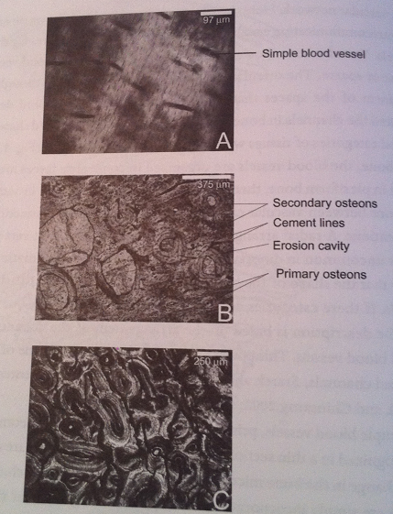
Dense Haversian Bone

Slide 38
Ontogenetic Status
Ontogeny describes the origin and development of an organism
Surface texture, articular surfaces, open/closed sutures
Sometimes, morphological features cannot distinguish ontogenetic status
Use of bone microstructure for more info
Juveniles typically have largely spongy bone from rapid rate of bone deposition
Result is woven bone with haphazardly arranged osteocytes

Slide 39
Woven bone provides more surface area for deposition of bone matrix than lamellar bone formation and permits more bone deposition at a given time
With increasing age, porous spaces are infilled with lamellar type of bone t issue and primary osteon results
Increases strength of developing bone

Slide 40
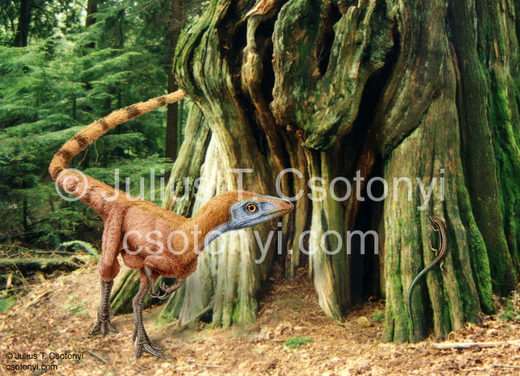
Sexing Bones
Hominids
Pelvic girdle and jaws exhibit sexual dimorphism
clueless about majority of extinct animals
Sinosauropteryx – preserved oviducts

Slide 41
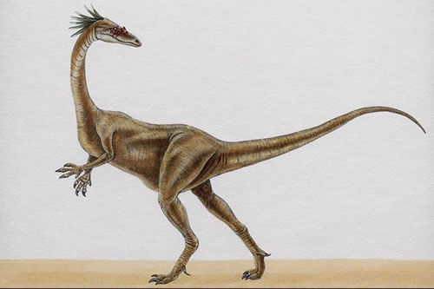
Single taxa samples show dimorphism
Robust vs thin forms
Syntarsus
Perimedullary erosion cavities in robust forms linked to egg laying

Slide 42
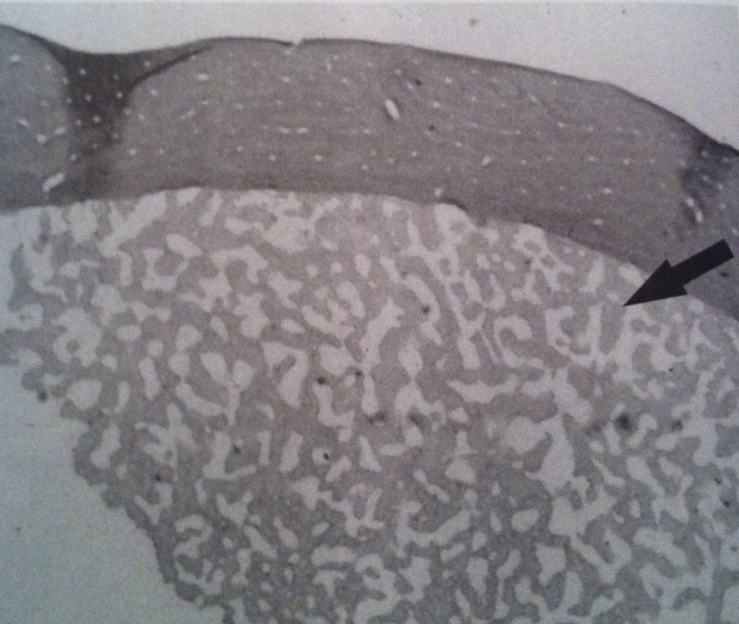
Medullary bone
Found in the medullary cavity of ovulating birds
Mineral store for eggshell formation during egg laying
Fig. 3.10 – femur of an ovulating hawk

Slide 43
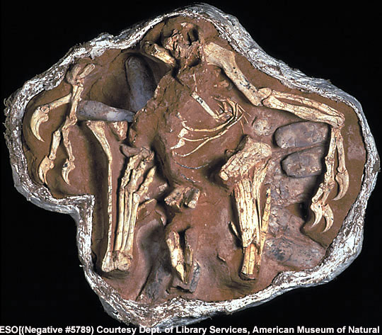
Medullary bone might indicate female
Has not been recognized in any dinosaur bone
No evidence of medullary bone forming preovulation in modern reptiles
Oviraptor found with a nest of eggs

Slide 44
Biomechanical Adaptations
Internal architecture of bone
Forces that may have acted on it during life
Muscle contraction during embryogenesis
Most important epigenetic factor of skeletal development
Bone is stressed and strained by complex factors
Muscular activity, joints, ligaments, and tendons

Slide 45
Mechanical response to forces
Dependent on
Magnitude force
Direction of force
Bone geometry
Bone material properties

Slide 46
Different bones respond differently
Variability in bone stiffness and strength
Type of bone tissue
Porosity
Mineralization
Location of bone in skeleton

Slide 47
Bone is a composite material
Mechanical properties of the whole bone is different from each of its components
Secondary osteons
Interstitial bone
Collagen-bone material

Slide 48
Mechanical properties are dependent on mineralization
High mineralization
Highly elastic but fractures easily
Low mineralization
Resistant to fractures but low elasticity

Slide 49
Mineralization is controlled by various factors
Mineralization lag time
Time delay between deposition of organic matrix and mineral
Newer bone is mechanically different than older bone
Bone remodeling
Removal of primary bone increases porosity

Slide 50
More factors
Metabolic bone diseases
Rickets
Lack of Vit D, Ca, Phosphates
Leads to soft weak bones
Osteomalacia
Lack of Vit D, cannot breakdown Vit D
leads to soft weak bones

Slide 51
Different tissue types afford different mechanical properties
Compact vs. cancellous bone
Porosity (spaces between trabeculae)
Cancellous is 30% to 90% porous
Compact is 5% to 30% porous
Cancellous is substantially less mineralized than compact

Slide 52
Different tissue types exhibit different strengths
Cortical bone
Mechanical properties influenced by porosity and composition
Woven fibered bone
Without primary osteons
Weakest bone type
Circumferential lamellar bone
Strongest bone type

Slide 53
Remodeled bone strength
Cow bone experiments
Remolded bone 35% weaker than primary bone
Haversian remodeling
Decreased bone density
Reduced tensile strength
Fatigue resistance

Slide 54
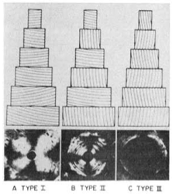
Secondary osteon mechanical properties
Vary in collagen-fiber orientations
Each type designed to overcome a particular type of stress
Ascenzi and Bonucci 1968

Slide 55
Bone is an adaptive tissue
Able to remodel itself in response to changes in its mechanical environment
Alters its structure is response to repeated stress and strain

Slide 56
Bone is an adaptive tissue
Sheep
Exercised sheep had higher periosteal modeling and Haversian remodeling than sedentary control animals
Japanese Quail
Effects of asymmetrical loads on hips
Femur remodeled from normal cylindrical patterns to asymmetrical cross-sections
bone deposition increased 2X-3X

Slide 57
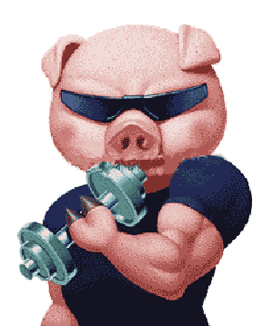
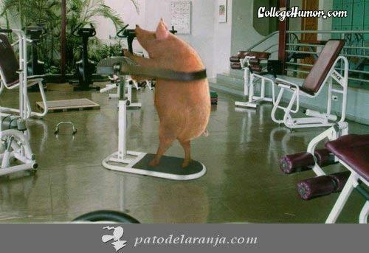
Bone is an adaptive tissue
Pigs
Cortical thickness of limb bones of exercised pigs higher than nonexercised ones
New bone mainly formed endosteally
Mechanically more optimal to for periosteally

Slide 58
Bone is an adaptive tissue
Adaptation isn’t due to stress alone
Many unknown factors
Complicates the use of fossil architecture to interpret functional adaptation of the bone
Need more research on extant animal cortical bone

Slide 59
Cross-sectional shape of long bones
Used to calculate
Forces that acted on the bone
Absolute and relative bone strength
Dryosaurus lettowvorbecki

Slide 60
Cross-sectional shape of long bones
Dryosaurus lettowvorbecki
Change in cortical bone distribution throughout ontogeny
Quadrupedal juvenile shift to bipedal adult
Changes in femora due to increasing mechanical load
Caudal shift in center of gravity

Slide 61
Biomechanical adaptations
Assessments can tell us about the live animal
Mechanical properties
Function of particular skeletal element
Required data
Weight estimates
Muscle reconstruction
Bone strength
Force estimates

Slide 62
Bone Wall Thickness
Relationship between
Bone wall thickness
Habitat of animal
Forces that act on the bone
All about efficiency
Vertebrate long bones have minimal mass
Perform locomotor function at minimum energy costs

Slide 63
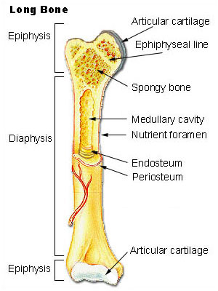
Variability in cross-sectional architecture
Bone wall thickness is related to lifestyle
Some have thick bone walls with small medullary cavities
Some have thin bone walls with large medullary cavities

Slide 64
Bird bones are good examples of variability
Large flying species have thinner walls than medium and small sized species
Aquatic vs. terrestrial limb bones
Higher densities in aquatic
Increased compact bone mass to overcome buoyancy

Slide 65
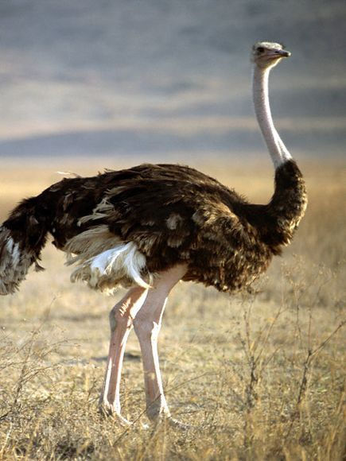
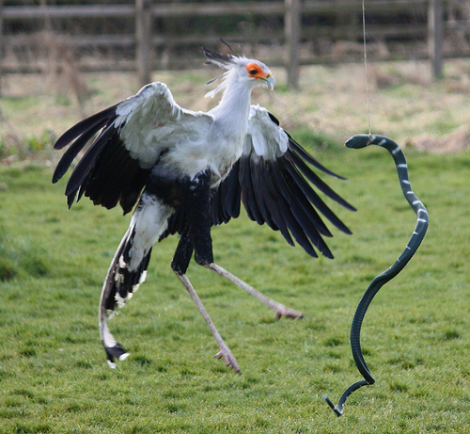
Relative bone wall thickness (RBT)
Massospondylus

Slide 66
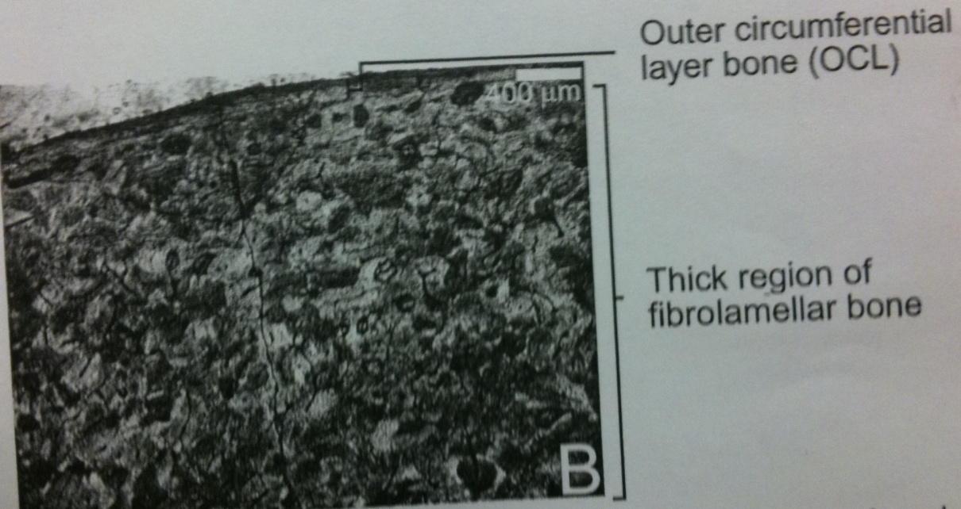
Penguins have extremely thick bone walls
Flying bird (Albatross)
Flightless diving bird (Penguin)

Slide 67
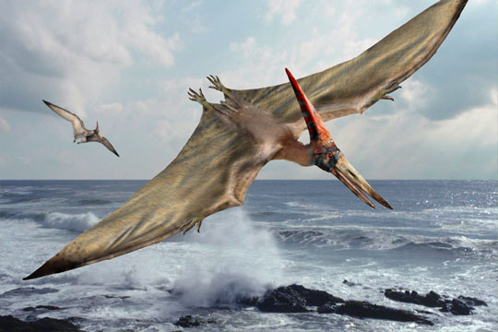
Pteranodon have unsually thin bone
Remarkably thinner than flying birds
Bones not as sturdy as bird bones
Unable to withstand localized impact
Thinnest bone walls among tetrapods

Slide 68
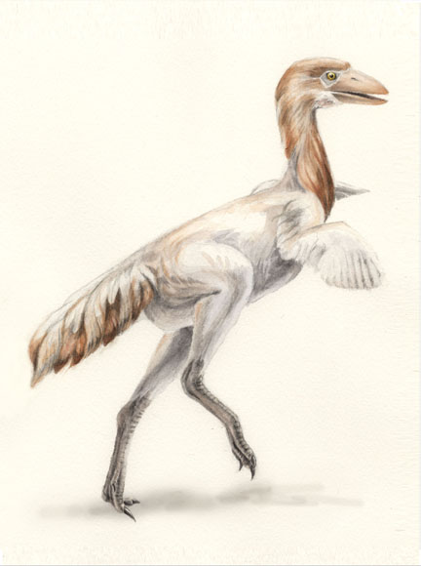
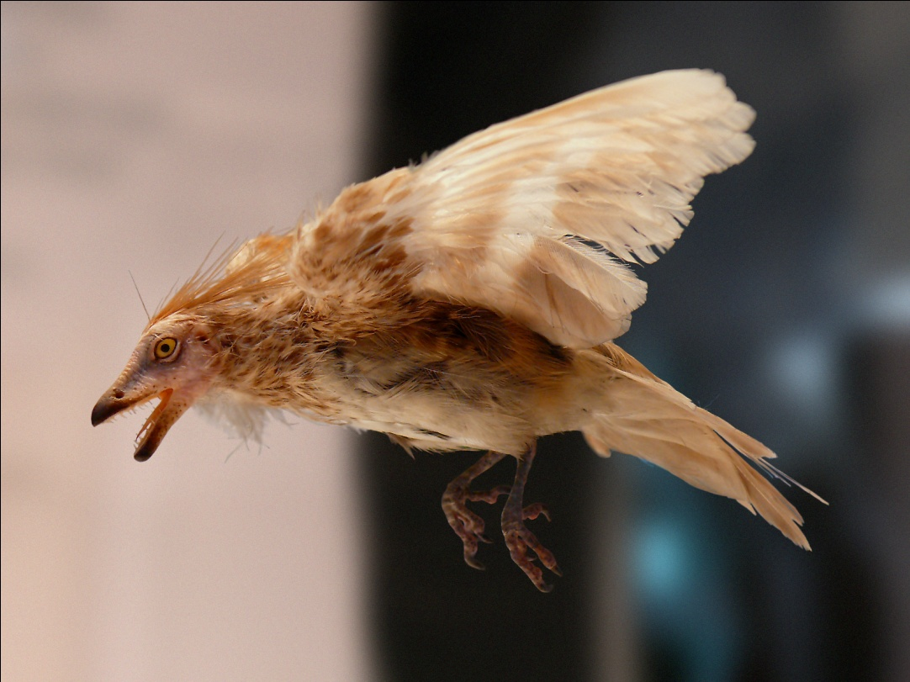
More examples of RBT
Enantiornithine
flight
13.7% RBT
Patagopteryx
flightless
18% RBT

Slide 69
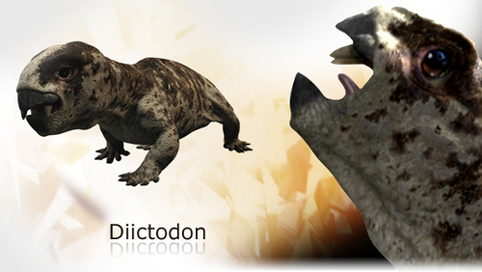
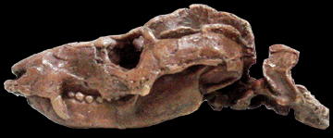
Digging induced morphological changes in long bones
Digging rodents have relatively thicker long bones
Nonmammalian therapsids show adaptations for digging
Trirachodon

Slide 70
Bone Microstructure of Aquatic Vertebrates
Internal organization is similarly modified irrespective of phylogeny
Bone adapts to 2 forms
Pachyostotic bone
Through pachyostosis - bone thickening
Unusually solid with little or no marrow
Osteoporotic bone
through osteoporosis – loss of bone density
Extreme cancellous, spongy, highly porous

Slide 71
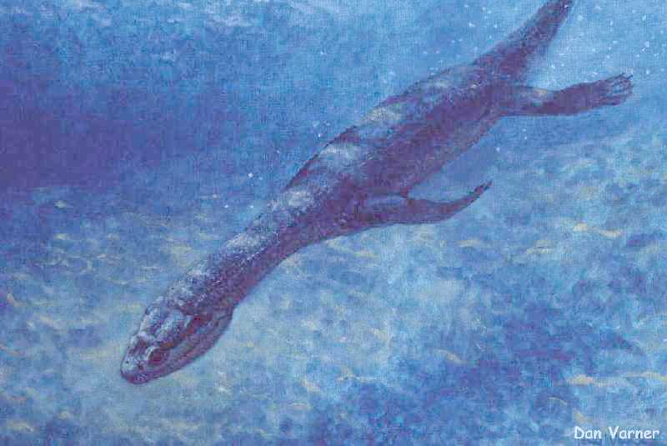
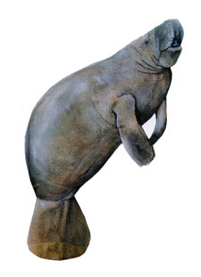
Pachyostotic adaptation
Nothosaurs
Sirenians (modern sea cow)

Slide 72
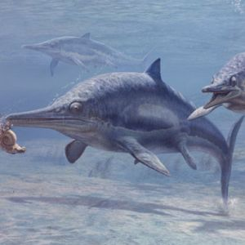
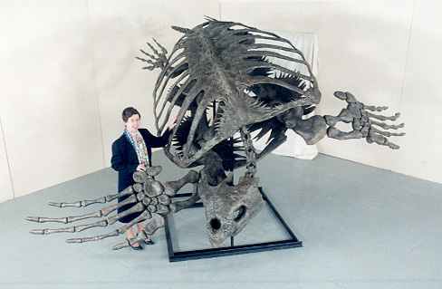
Osteoporotic adaptation
Ancient turtles
icthyosaur

Slide 73
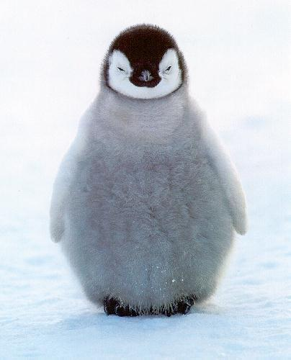
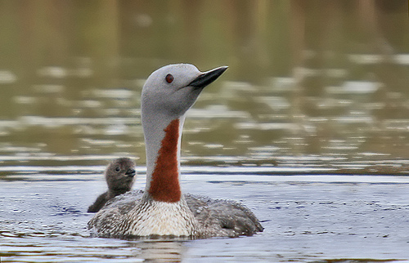
RBT probably accounted for dive depth ability
Higher RBT = deeper dive depth
Polarornis (not pictured) – 37%
Gavia stellata – 15%
Emperor penguin – 33%

Slide 74
Conclusions
Microscopic structure can tell us
How they grew
What factors affected growth
Factors that affect bone growth
Ontogenetic age
Skeletal location
Location within an individual bone
Environmental factors

Slide 75
Conclusions
Mammals typically form azonal (uninterrupted) bone
Reptiles usually form zonal bone
NOT always true
Substantial plasticity due to a variety of environmental factors

Slide 76
Conclusions
New developments
Bone channel shape has no bearing on blood vessel shape
Microstructure of modern bones can help tremendously to reconstruct the biology of extinct animals

Slide 77
Question
How are bones formed and what can bone microstructure tell us about the ontogeny of the living animal?

