Slide 1
Inside Dinosaur Bones
Discussion By:
Laughing Bear Torrez
Aaron Gilmore

Slide 2
Dinosaur Bone Timeline
Comparison of Iguanodon bones to bones of modern lizard. Osteocyte lacunae observed.
Haversian canals identified in sauropod, illustrated osteons in dorsal spine of Hylaeosaurus.
Named Dinosauria, vertebrae of Cetiosuarus used to illustrate dense laminar or plexiform tissue.
1849 – John Thomas Quekett
1850 – Gideon Mantell
1859 – Sir Richard Owen
http://upload.wikimedia.org/wikipedia/commons/thumb/f/f2/John_Thomas_Quekett.jpg/220px-John_Thomas_Quekett.jpg
http://www.nndb.com/people/048/000095760/gideon-mantell-2-sized.jpg
http://blog.everythingdinosaur.co.uk/sir_richard_owen.jpg

Slide 3
Microstructure Timeline
Illustrated “Knochen koperchen” in many dinosaurs, established primary and secondary vascular canals in compact bone.
Dinosaur bone unlike lamellar zonal bone in extant reptiles, more like mammals and birds
Identified zonal bone in sauropod dinosaur. (Cambell, 1966)
Clarification of Terminology
1980s – Robin Reid
1960s – Armand de Ricqles
1907 – Adolf Seitz
http://www.ssplprints.com/lowres/43/main/45/124586.jpg
http://micro.magnet.fsu.edu/primer/techniques/phasegallery/images/dinobones/camarasaurus.jpg
http://lettre-cdf.revues.org/docannexe/file/587/25_08_armand_ricqles-small200.jpg

Slide 4
Work by Chinsamy (1980s – )
Comparative changes in the ontogeny of different dinosaurs
Extant Phylogenetic Bracketing ?– extant sharks, crocodiles, birds, non-mammalian synapsids, and pterosaur bones and teeth.
http://archosaurmusings.files.wordpress.com/2009/11/epb1.jpg

Slide 5
Interesting Contemporary Studies
Horner & Padian w/ Ricqules – bone microstructure of:
Hypacrosaurus
Maiasaura peeblesorum
Confuciusornis
Erickson & Tumanova
Growth series of femora of Psittacosaurus
Rigby-Schweitzer
Search of Biomolecules
Rimbolt-Baly
Calculated daily bone depositional rates

Slide 6
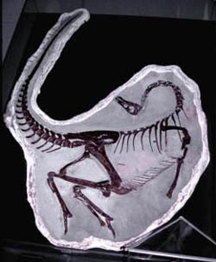
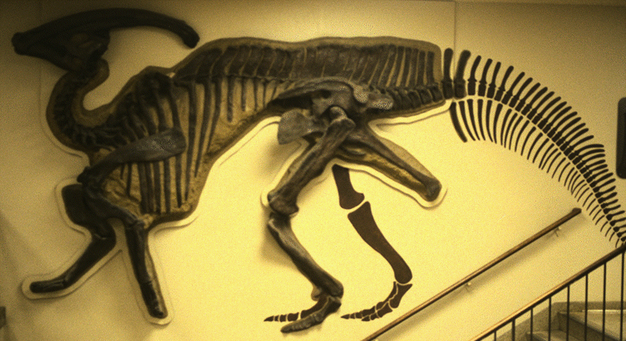
Controversy
Rensberger & Watabe (2000) – collagen fibers and canaliculi are differently organized in different dinosaur lineages:
Ornithomimid – arrangement similar to birds
Ornithiscian – similar to mammals
Chinsamy – highly variable orientation due to age, rate, and sectioning of bone
Need more extant research
http://scienceblogs.com/tetrapodzoology/upload/2007/04/ornithomimid.jpg
http://www.ucmp.berkeley.edu/diapsids/ornithischia/parasaurolophus.gif

Slide 7
Types of Bone in Dinosauria
Compact (cortical)
Primary periosteal bone
Accretionary
Haversian bone
Metaplastic bone
Cancellous (spongy)
Endochondral primary
Secondary reconstructed
Dental
Cavernous
Flat bone - diploё

Slide 8
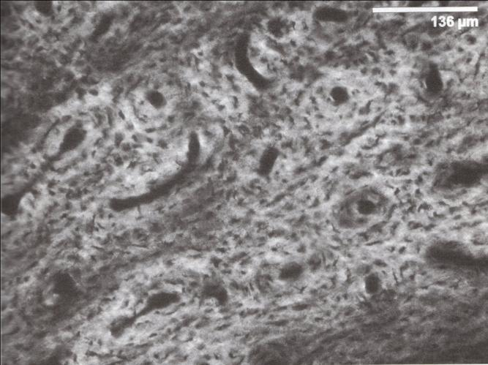
Compact Bone Tissues
Channels house blood vessels and connective tissue
Starck and Chinsamy (2002) – only 20% of channels occupied by blood vessels.
Figure 4.1

Slide 9
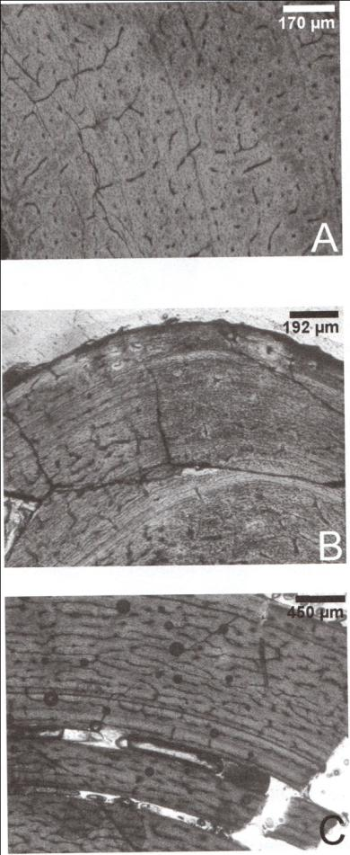
Dinosaur Zonal Bone
de Ricqles (1974, 76) – fibrolamellar with secondary haversian reconstruction
Campbell (1966) – described annulate structures in cortical dinosaur bone
Robin Reid (1981)- lamellar-zonal bone in pelvis of sauropod - widespread
Figure 4.3

Slide 10
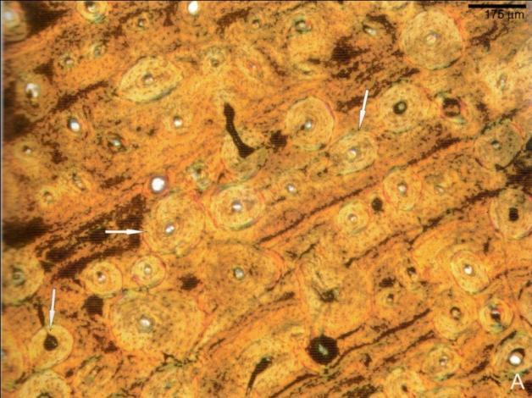
Zonal Bone Structure
Alternating fibrolamellar bone and Lines of Arrested Development (LAGs)
LAG – pause in osteogenesis
Annuli – more slowly formed bone
Could be seasonal
Plate 5A

Slide 11
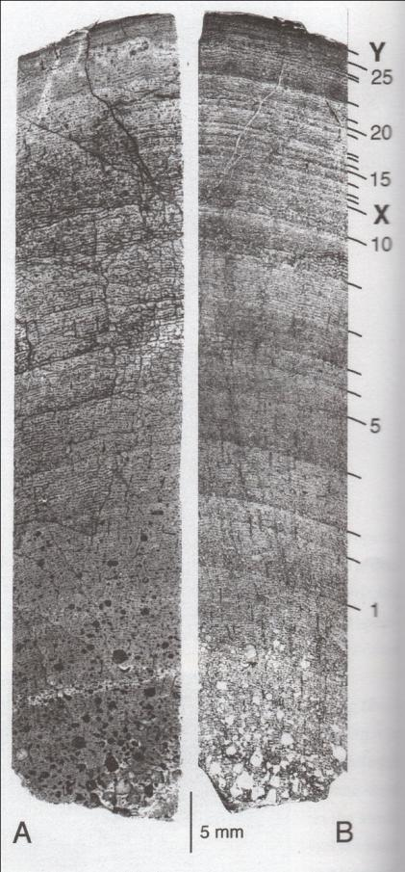
Sexual Maturity
Decrease in the width of zones (after X)
Chinsamy is not convinced – irregular width of growth rings
Figure 4.4

Slide 12
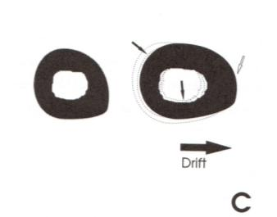
Caution
Growth rings could be caused by other factors (such as drift).
Figure 3.1
Different bones in skeleton have different morphology – Best in long bones
Negligible remodeling in nonweight-bearing bones
Shape of bone, lifestyle adaptations, and age are important considerations
Tyrannosaurus fibula with 17 rings and dense haversian bone remodeling.

Slide 13
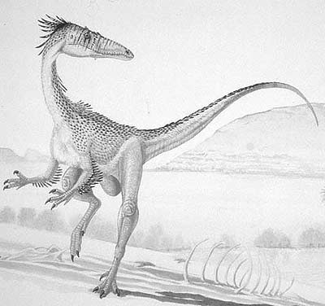
Skeletochronology
If you have increasing number of growth rings with increasing size:
Syntarsus
Troodon
Massospondylus
Psittacosaurus
Most likely periodic
interruptions
http://www.nhm.ac.uk/resources/nature-online/life/dinosaurs/dino-directory/drawing/Syntarsus.jpg

Slide 14
Sexual Dimorphisms
Both azonal and zonal bone (Dryosaurus letterwvorkbecki) found
Barosaurus (Sander, 2000) – found bones with both azonal and zonal microstructure from the same dinosaur.
Could be a sexual dimorphism
Small sample size – taxonomic differences?
Cynagnathus & Diademodon (skull)
Other sauropods are type A
Apatosaurus (Rogers)
Richly vascularized reticular and laminar bone

Slide 15
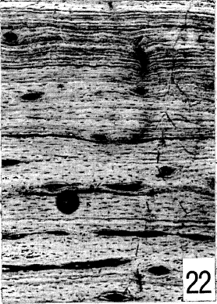
Outer Circumferential Layer
Formed in mammals and birds with determinate growth strategies
Avascularized
With/without growth lines
Ceratosaurus (Reid, 1996)
Many do not have OCL
Dinosaurs grew throughout their lives (de Ricqules)
Largest Dinosaurs not sampled

Slide 16
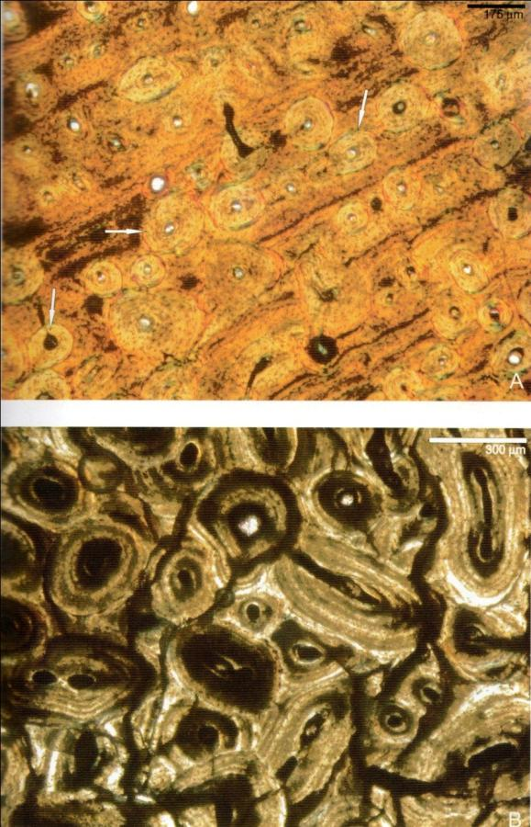
Haversian Bone
Secondary, dense haversian bone
Well developed sauropod bones

Slide 17
Secondary Reconstruction
Increases with age among modern vertebrates
Dryosaurus small femur already had completely formed secondary osteons
Similar to a mammal
(dogs – seven weeks/humans – eight months)
Occurs in the inner parts of cortical bone near the medullary cavity
Unremodeled bone is stronger – better on the outside (periosteal region)

Slide 18
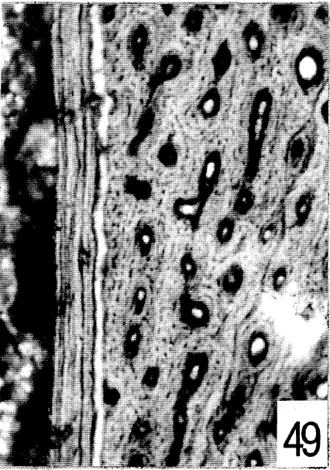
Inner Circumferential Layer
Medullary lining bone (Reid, 1996)
Following medullary enlargement – deposits of lamellar bone
ICL is found in many dinosaurs – Iguanodon, Rhabdodon…
Distinctive external boundary – tide line
Marks resorption – also in ICL

Slide 19
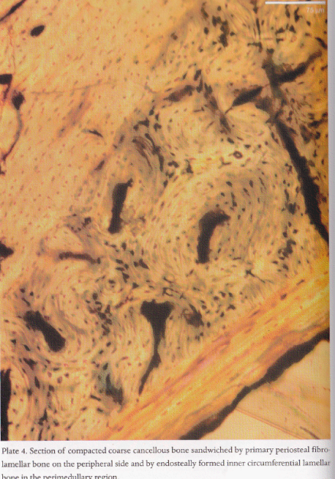
Compacted Coarse Cancellous Bone
Results from the endosteal infilling of cancellous spaces, and indicates that the bone was located at the metaphysis in early ontogeny and was relocated to the diaphysis as the growth and remodeling occurred.
Chinsamy has documented compacted coarse cancellous bone in Dryosaurus femora distal and proximal ends.
Notes:
Chinsamy Some sections showed the entire compacta was CCCB from periphery to medullary cavity. Plate 4!!!

Slide 20
Compacted Fine Cancellous Bone
Fine cancellous bone is compacted into compact bone. Although not observed in dinosaurs spicules of calcified cartilage are present in the resulting compact bone of Mesozoic mammals and white rat cortical bone.

Slide 21
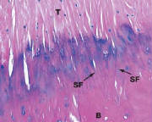
Summary of Compacta
Several types of endosteally and periosteally compact bone occur throughout the skeleton, in different bones and even at the level of a single bone cross section. Even similar tissue types will have variation.
Sharpey’s fibers are collagen fibers responsible for securing a tendon or ligament to the outer fibrous layer of periosteum and to the outer circumferential and interstitial lamellae of bone. The number of Sharpey’s fibers vary between similar tissue types.
Notes:
Should I add more… there wasn’t a lot on the web ☹
Pic from Wheater's Functional Histology

Slide 22
Cancellous Bone in Dinosaurs
In long bone is located internally around the medullary cavity and at the proximal and distal end.
Called diploë in flat bones.
Types of Cancellous bone in dinosaurs:
Endochondral primary bone, secondary reconstructed cancellous bone, dental bone and cavernous bone.

Slide 23
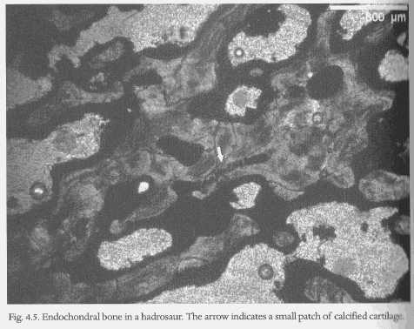
Cancellous Bone: Endochondral Bone
Forms by endochondral ossification that replaces cartilage.
Described in Iguanodon centra; epiphyses of Iguanodon, Hypsilophodon, Dryosaurs; limb bones of Valdosaurus; Nqwebasaurs femora; and in Maiasaura.
Rapid endochondral bone formation is inferred if “islands of calcified cartilage” are present in trabeculae, observed in many adult dinosaurs.
Notes:
Figure 4.5 Hadrosaur arrow=cartiledge

Slide 24
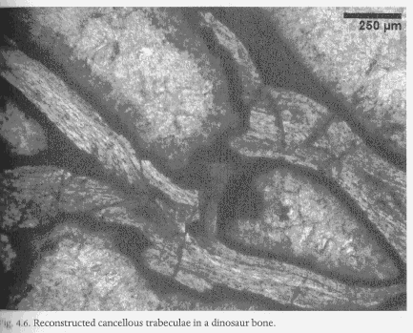
Cancellous Bone: Secondary
Resorption of primary cancellous bone of trabeculae walls with lamellar replacement of a cancellous texture; this reconstructed cancellous bone is the major type of dinosaur cancellous bone except at the metaphysis.
Distinguished by tide lines of bone resorption in the trabeculae.
Resorption of primary compact bone from vascular channels without redeposition also results in secondary cancellous bone transformation.
Also well described in dinosaurs .
Notes:
Secondary implies that tissue is formed by resorption. There are two way this is formed.
Ex: All of the vertebral cancellous bone is secondary.
Figure 4.6 put arrow to tide lines… ask lauren???

Slide 25
Other Bone Types: Metaplastic
When tendon or ligament tissue undergoes ossification to become mineralized and preserved the resulting bone is considered metaplastic.
Osteoderms were once considered metaplastic but new theories treat it separately.

Slide 26
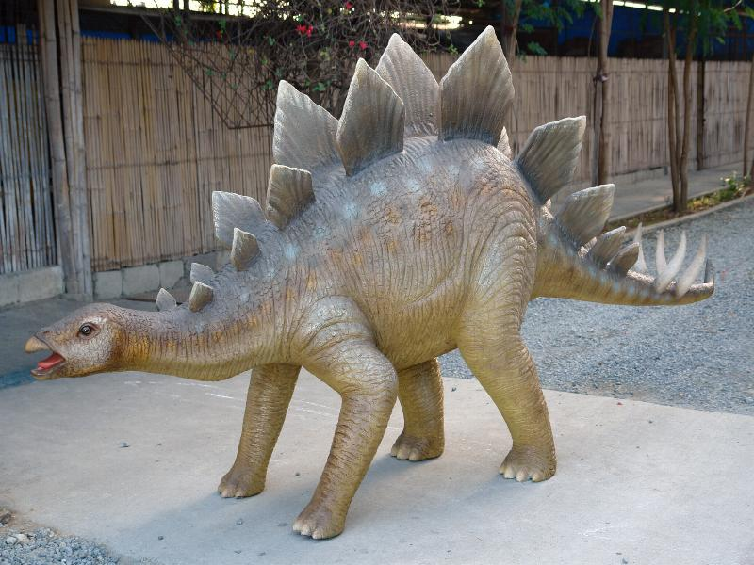
Other Bones: Osteoderms
Osteoderms consisit of a variety of bone tissues, and can vary in the same dinosaur.
Example: stegosaur dorsal plates and a lateral ossicle of the body.
A single Stegosaur dorsal plate osteoderm was observed to vary in microstructure from the apex to the base.
Periphery of compact bone tissue in thin sheets→ cancellous bone in the center → sparely vascularized lamellar zonal bone → Haversian systems→ Haversian coreing to cancellous spaces, also reconstructed →Sharpey’s fibers within primary cortical bone.
The orientation pattern from Sharpey’s fibers of the dorsal plates was used as evidence of a vertical orientation along the dorsal midline.
So is it more likely that the dorsal plates functioned as armor or some form of thermoregulation?
Notes:
Periphery was compact bone tissue in thin sheet→ cancellous bone (THIN BONY TRABECULEA FORMING IRREGULAR MEDULLARY SPACES) in the center → Sharpey’s fibers and primary cortical bone
Sharpeys fibers were symmetrically arranged on either side of the sagittal plane of the plate.
Anwser: thermoregulation, armor eliminated by structure→function. Click for stegosaurs picture during discussion.

Slide 27
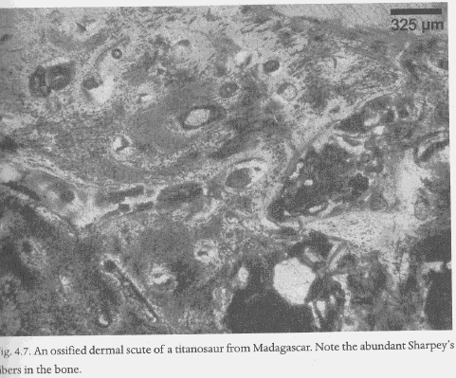
Other Bones: Osteoderms
Recent Studies of Osteoderms have suggested non metaplastic origins:
Riqcles found ankylosaur dermal ossifications that were button-like having dense parallel fiber bundles, abundant Sharpey’s fibers, poor vascularization. The fibrillar mesh size and diameter increase radially which is contrary to metaplastic formation and suggests de novo formation of the ossicles.
Salgado found titanosuar bony dermal plates characterized as non-osteoderms. He suggested the plates were true bone originating from epiphysis of neural spines, similar to cartilaginous structures in reptiles that can undergo ossification.
Notes:
4.7

Slide 28
Pathological Bone
Diffuse idiopathic skeletal hyperostosis (DISH)- calcification of ligament and tendon attachments. Frequent in dinosaurs along spinal longitudinal ligaments parallel to the vertebral column long axis; keeps vertebral column aligned, possibly permitting the tail to be high off the ground and stabilizing lateral movement.
Notes:
Stegosaurus probably used tail for defense, don’t exhibit DISH.
Commonly 2-4 vertebrae in caudal position 17-23 fused→ stiffer tail. This would also maintain the cloaca??? in a more accessible mating position; suggested method of sexing sauropods based on DISH in males.
Does class think pathology is a solid way to sex?

Slide 29
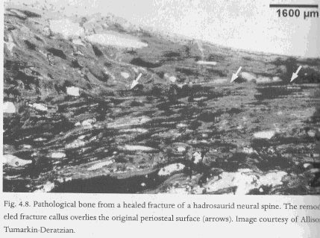
Pathological Bone
Although most pathologies observed via X-rays and morphology some other histological identifications are:
Campbell’s hyperstotic periosteal outgrowths (recactive bone), which are honeycomb-like in structure and exhibit some communication.
Osteoporotic bone observed in Apatosaurs scapula and Camarasaurus limb bone.
Common are healed fracture calluses. It was observed that 1% of ceratopsians and hadrosaur have midposterior dorsal rib fractures and dorsal neural spine fractures in iguanodontians have been associated with bearing the weight of the male during copulation. (Rothschild)
Notes:
Are both used to support theory???? What does reactive bone indicate???
If so, Does class think 1% is enough support for what Rothschild proposes, would this be a good way of determining sex?
4.8

Slide 30
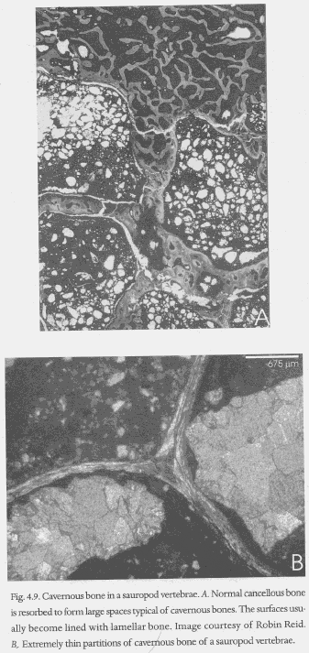
Cavernous Bone
Made up of various compact bone with centimeters wide internal spaces. Known in extant species of bird bones associated with air sac systems and elephant skull bone.
Cavernous bone is present in the ribs and vertebrae in theropods and sauropods, formed during large scale reconstruction.
Cavernous bone implies lighten mass and its been suggested to be pneumatic.
Using extant phylogenetic bracket approach (EPB) Wendel proposed that sauropod vertebrae are correlates to air sacs in birds.
Notes:
Various compact bones like: primary periosteal, haversian bone, endochondral, lamellar/lamellated bone of ICL and medullary bone lining.
How does class feel about this bone being pneumatic, what benefit would it give since these dinos are so large?
Fig 4.9

Slide 31
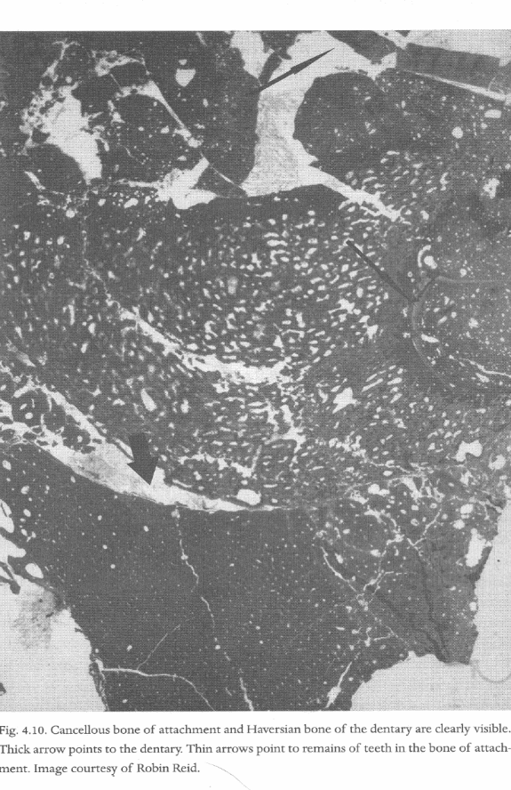
Dental Bone
Dinosaurs are similar to basal archosauromorphs and crocodilians in their bones of attachment.
Dinosaur teeth are formed in deep grooves of tooth bearing bones, with teeth sockets being alveolar bone
Allosaurus, Camarasaurus, amptsaurous and Marshosaurus.
Notes:
Fig 4.10

Slide 32
Conclusion
Dinosaur bone microstructure is well preserved, and has been used to understand the various bone tissue types that existed in dinosaurs.
Different parts of the skeleton, bones and crosssections can have multiple bone tissue types present. Several types of compact and cancelluos bone have been identified.
The bone tissue types have been used to gain insight on the qualitative rate of formation and how the bones formed.
Using EPB approach biological implications of dinosaur bones can be inferred. Ex pneumatic structures in sauropods.

Slide 33
Question:
There are two types of bone primarily found in the dinosaurs. Pick one type (and its subtypes), and explain the biological implications associated with the microstructure present.

